Slide 1
Statistical downscaling of sub-seasonal forecasts and the ERA-5 reanalysis
Estibaliz Gascon, Augustin Vintzileos and Tim Hewson

Slide 2
INDEX
Introduction to ERA-5
Introduction to ECMWF Sub-seasonal forecasts
What is ecPoint?
Benefits of ecPoint for HIGHLANDER, and overlap with MISTRAL (what can we re-use?)

Slide 3
Introduction to ERA-5 reanalysis
Complete: combining vast amounts of observations into (global) fields
Consistent: use the same physical model and DA system throughout
Convenient: “maps without gaps”, always available in the same way
Reanalyses offer a detailed overview of the past Earth’s climate even if direct observations are sparse
However The observing system has evolved considerably, and so has the quality of the reanalysis products that rely on this!
ERA5 incorporates a 10-member Ensemble 4D-Var data assimilation system
0.75 (1979) – 24 Million (2019) obs per day
Over 200 types of reports

Slide 4
WHAT IS NEW IN ERA-5 ?
 | ERA-Interim | ERA5
Period | 1979 – present | 1950 – present, produced in 2 phases
Availability behind real time | 2-3 months | 2-3 months (final product) 2-5 days (ERA5T)
Assimilation system | 2006 (31r2), 4D-Var | 2016 (41r2), 4D-Var, hybrid EDA
Model input (radiation and surface) | As in operations, (inconsistent SST and sea ice) | Appropriate for climate Includes e.g. evolution greenhouse gases, volcanic eruptions, sea surface temperature and sea ice
Spatial resolution | 79 km globally 60 levels to 10 Pa | 31 km globally 137 levels to 1 Pa
Uncertainty estimate |  | from 10-member EDA at 62 km
Output frequency | 6-hourly Analysis fields | Hourly (three-hourly for the ensemble), Extended list of parameters ~ 9 Peta Byte (1950 - timely updates)
Extra Observations | Mostly ERA-40, GTS | Various reprocessed CDRs, latest instruments
Variational Bias control radiosondes | Satellite radiances, RAOBCORE | Also ozone, aircraft, surface pressure, RISE
Land downscaling product | ERA-Interim land, 79km | ERA5L, 9km (forced by ERA5)

Slide 5
Sub-seasonal forecasts at ECMWF
ENS configuration beyond 10 days and up to 46 days describe weather parameters, usually averaged over a period of 7 days and expressed as a departure from re-forecast values for that period.
A particularly difficult time range: In fact this time range is generally too long for the atmosphere to keep a memory of its initial conditions, and too short for the ocean variability to have an impact on the atmospheric circulation.

Slide 6
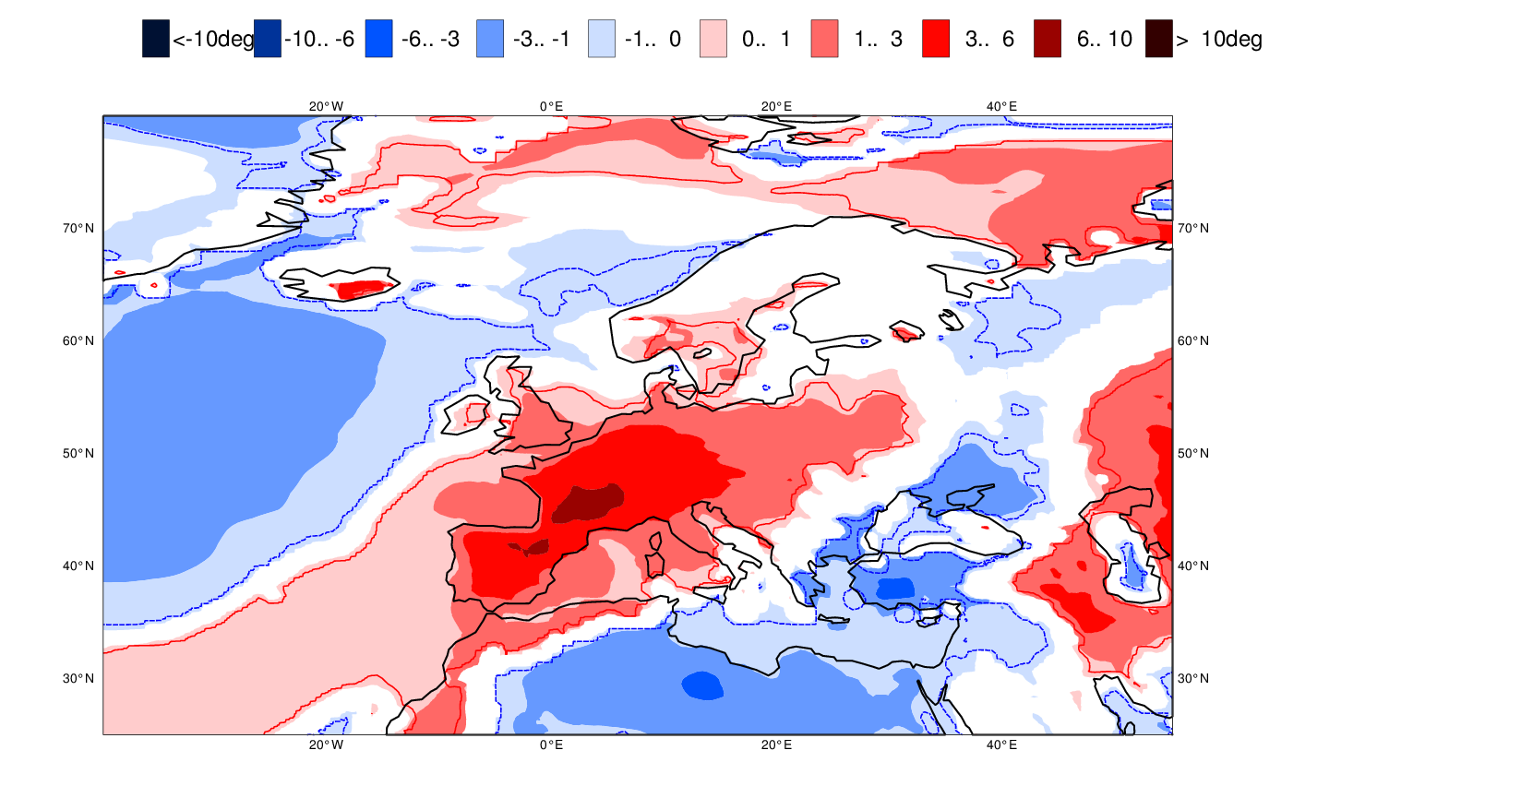
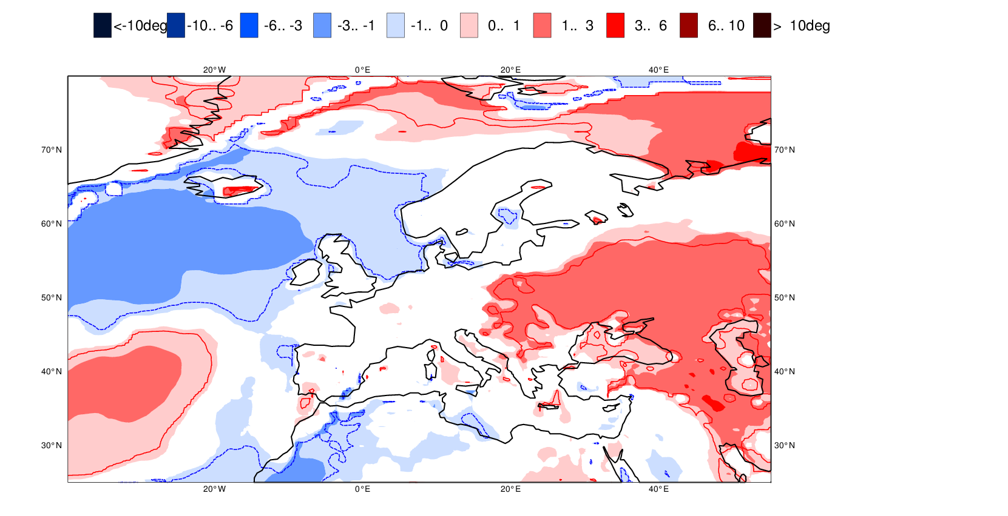
Sub-seasonal forecast: large scale patterns
Forecast week 1.5
Heatwave in Europe
29 June – 5 July 2015
Forecast week 2.5

Slide 7
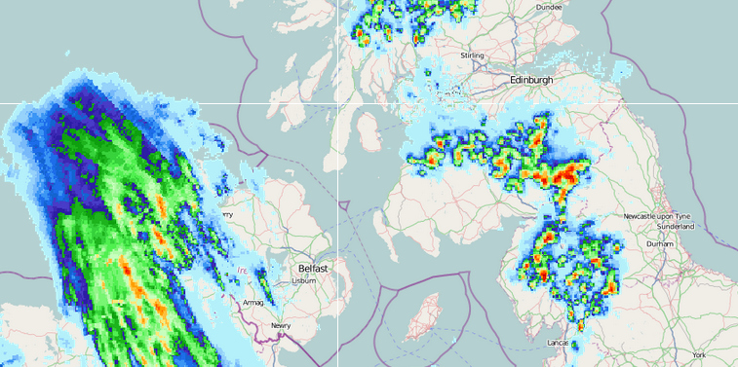
Introduction of ecPoint
“ecPoint” is an ECMWF post-processing system, that aims to deliver improved probabilistic forecasts of surface weather (such as rainfall and temperature)
Let’s concentrate on rainfall. What does one mean by “accurate rainfall forecasts”?
One wants to forecast extreme point-rainfall in the right location with a good lead time
Case 1)
Large-Scale System
Case 2)
Convective System
Anticipate different degrees of sub-grid variability
(and account for model biases)
5-12mm (point values)
Mean ~ 8mm (model grid-box forecast)
0-80mm (point values)
Mean ~ 6mm (model grid-box forecast)

Slide 8
ecPoint-Rainfall
A new statistical post-processing system that accounts for relevant physical processes in rainfall generation mechanisms that are not captured in the NWP model output. These are the primary error sources affecting verification scores (versus point observations).
In accounting for the error sources, statistically, we are (i) anticipating weather-dependant sub-grid variability, and (ii) addressing weather-dependant biases in the model. Verification scores improve markedly when ecPoint is used. In other words we make the forecasts much better!

Slide 9
The “Remote Calibration” concept
Let’s forecast rainfall for Louisiana. The conditions are mainly convection, light winds, in summer, flat area. How did the model perform, at a short range, in other sites with similar conditions?
Errors at those “remote sites” provide a good guide to assess the model reliability for those particular conditions somewhere else.

Slide 10
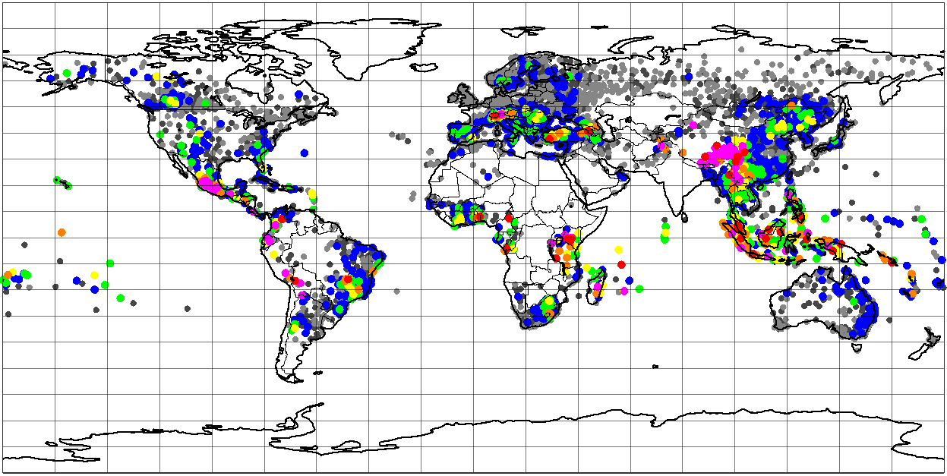
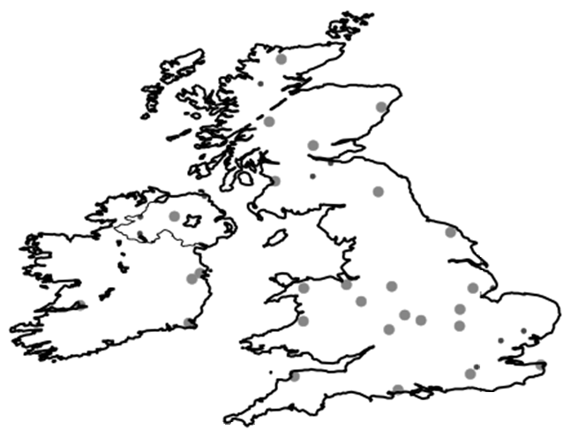
Real example of “Remote-Calibration”
Extreme weather in UK (mainly convective precipitation, light winds, medium values of tp)
27907 instances in total globally
Unevenly spatially distributed in situ (rain gauge) rainfall obs
1 2 5 10 15 20 25 >30
30 instances in total in the UK
Frequency of observed instances for a particular weather condition in each location
For the period June 2015 – February 2016
30 instances in total in the UK

Slide 11
The “Remote Calibration” concept
It provides immediately a massive training dataset (if a global dataset is used) from a much shorter training period (~ 1 year should be enough).
Non-stationarity issues for observational data solved.
It can facilitate point-based rainfall forecast for any lead time, for any grid box

Slide 12
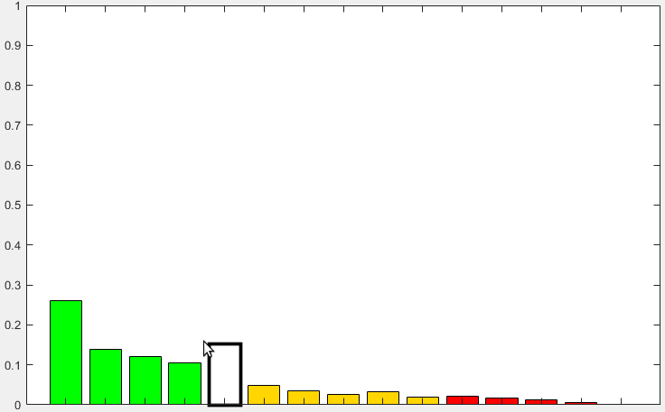
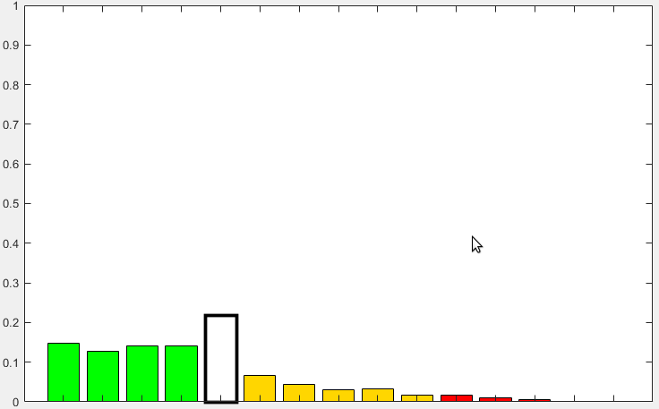
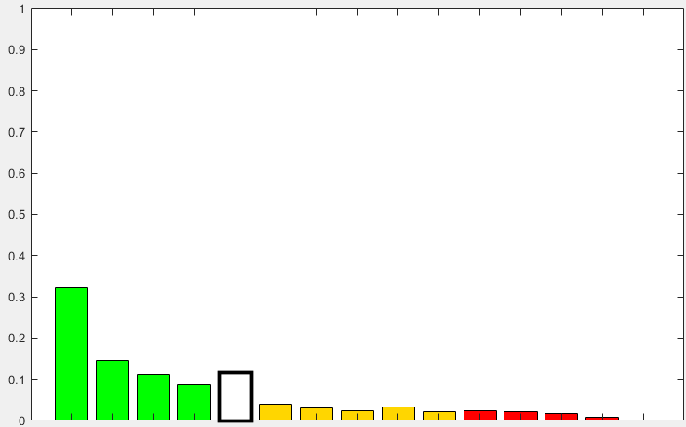
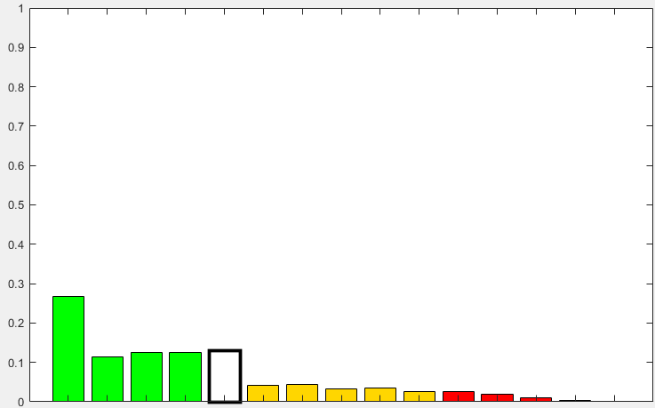
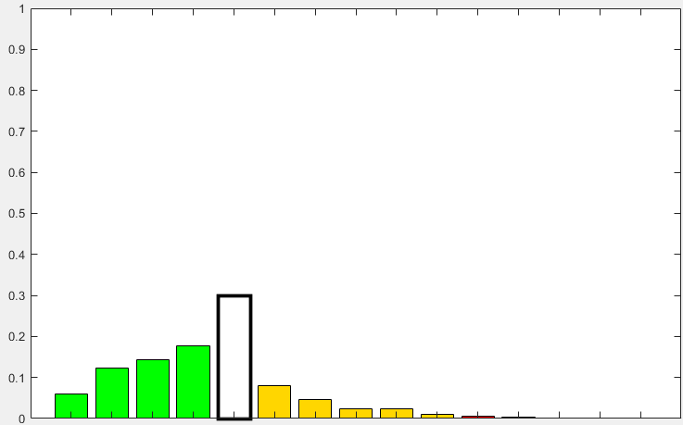
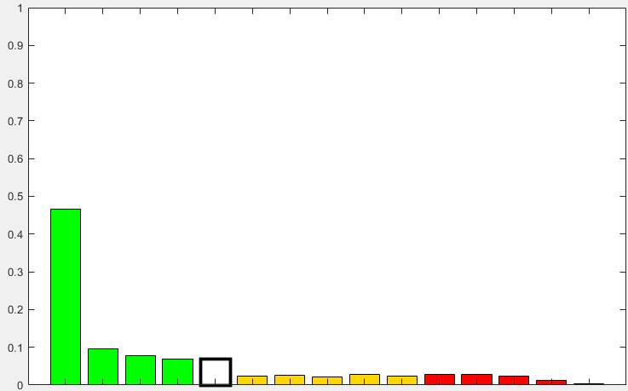
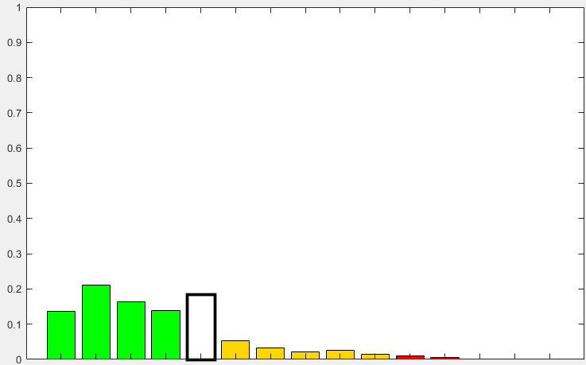
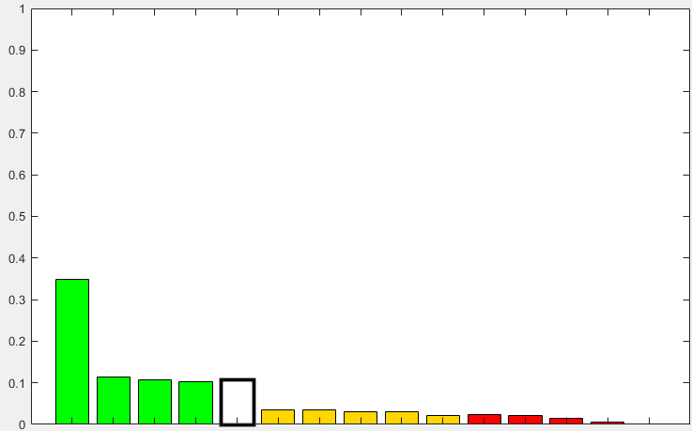
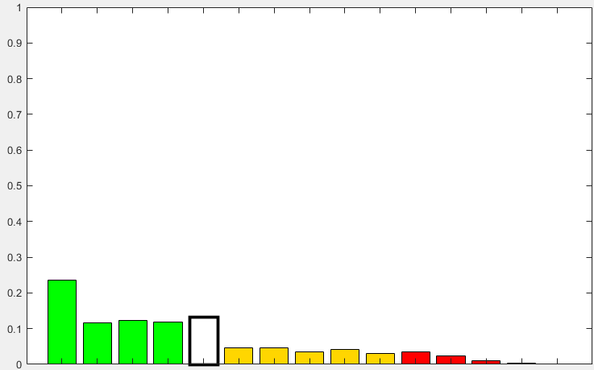
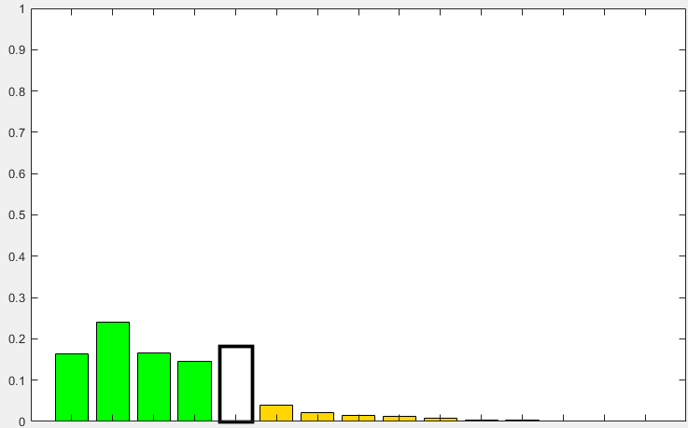
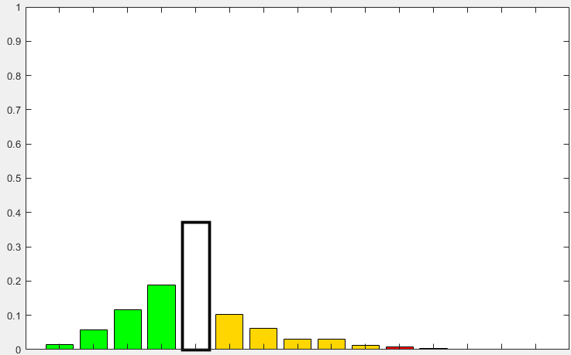
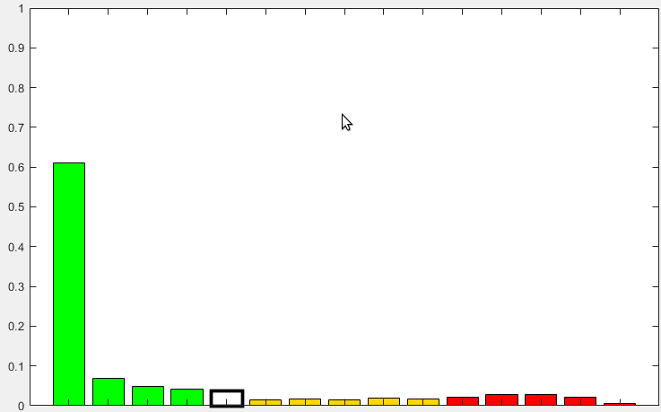
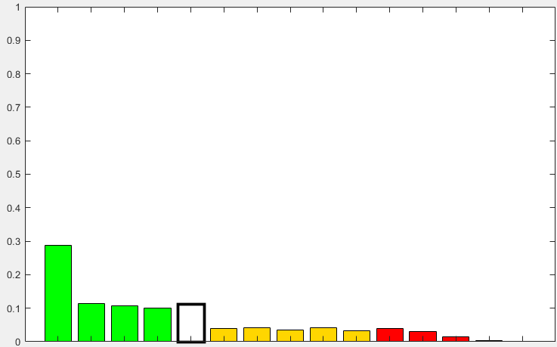
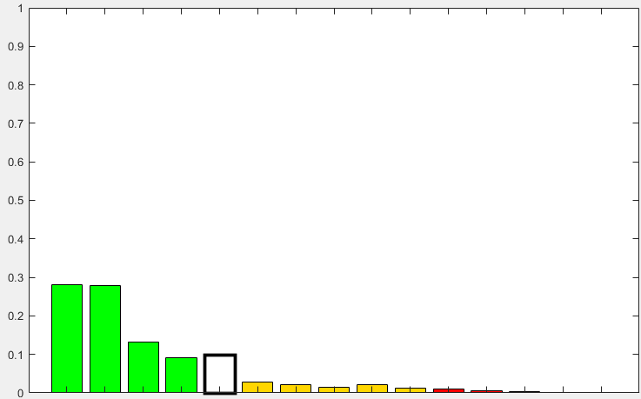
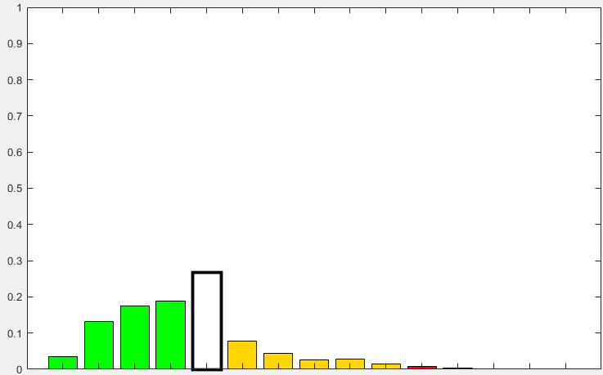
The Decision Tree concept
All cases
Mainly L-S PPT
Mainly Conv. PPT
Small TP
Big TP
Small TP
Big TP
Low Steering Winds
High Steering Winds
Low Steering Winds
High Steering Winds
Low Steering Winds
High Steering Winds
Low Steering Winds
High Steering Winds
Future Work

Slide 13
PREDICTORS
MISTRAL PROJECT
ecPoint Rainfall 6-h
ecPoint Rainfall 12-h
DECISION TREE
Convective precipitation ratio
1
Convective precipitation ratio
< 0.25
> 0.25
6-h total precipitation
6-h total precipitation
2
12-h total precipitation
Solar radiation
Solar radiation
3
700 hPa wind speed
Local solar time
Local solar time
4
CAPE
Standard deviation of filtered orography
Standard deviation of filtered orography
5
Solar radiation
700 hPa wind speed
700 hPa wind speed
6
CAPE
CAPE
7

Slide 14
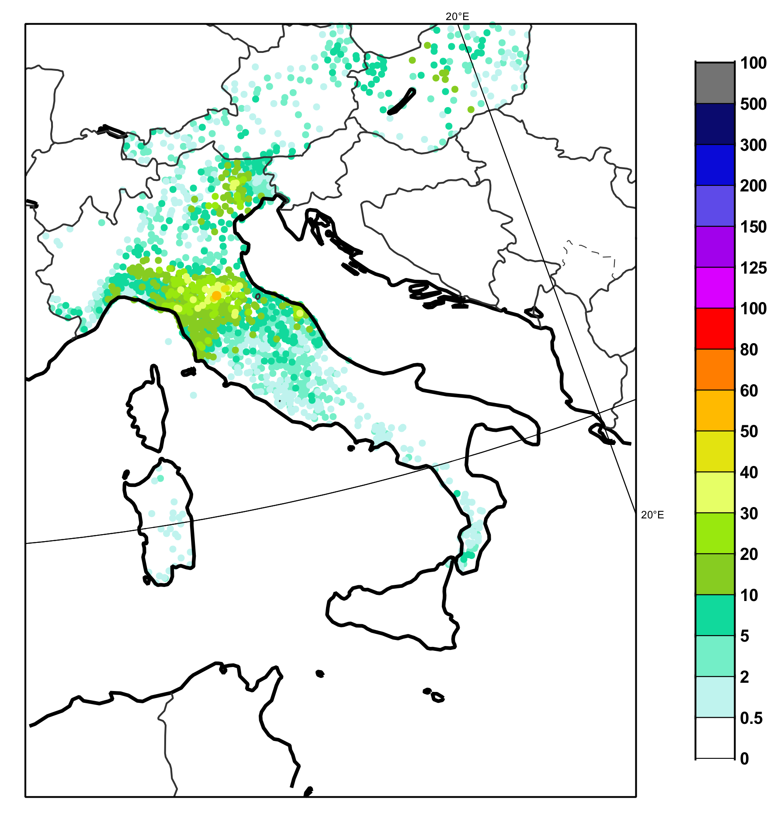
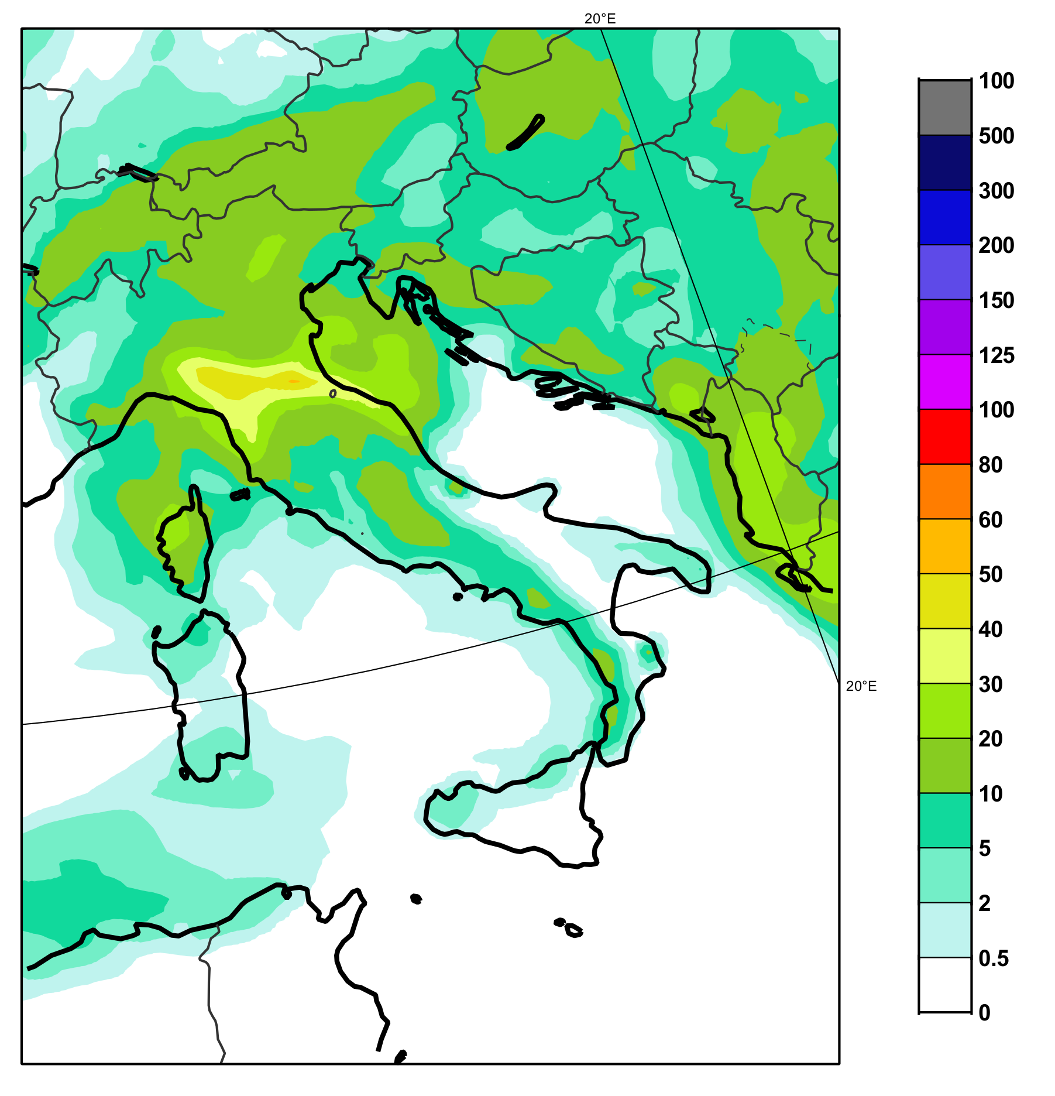
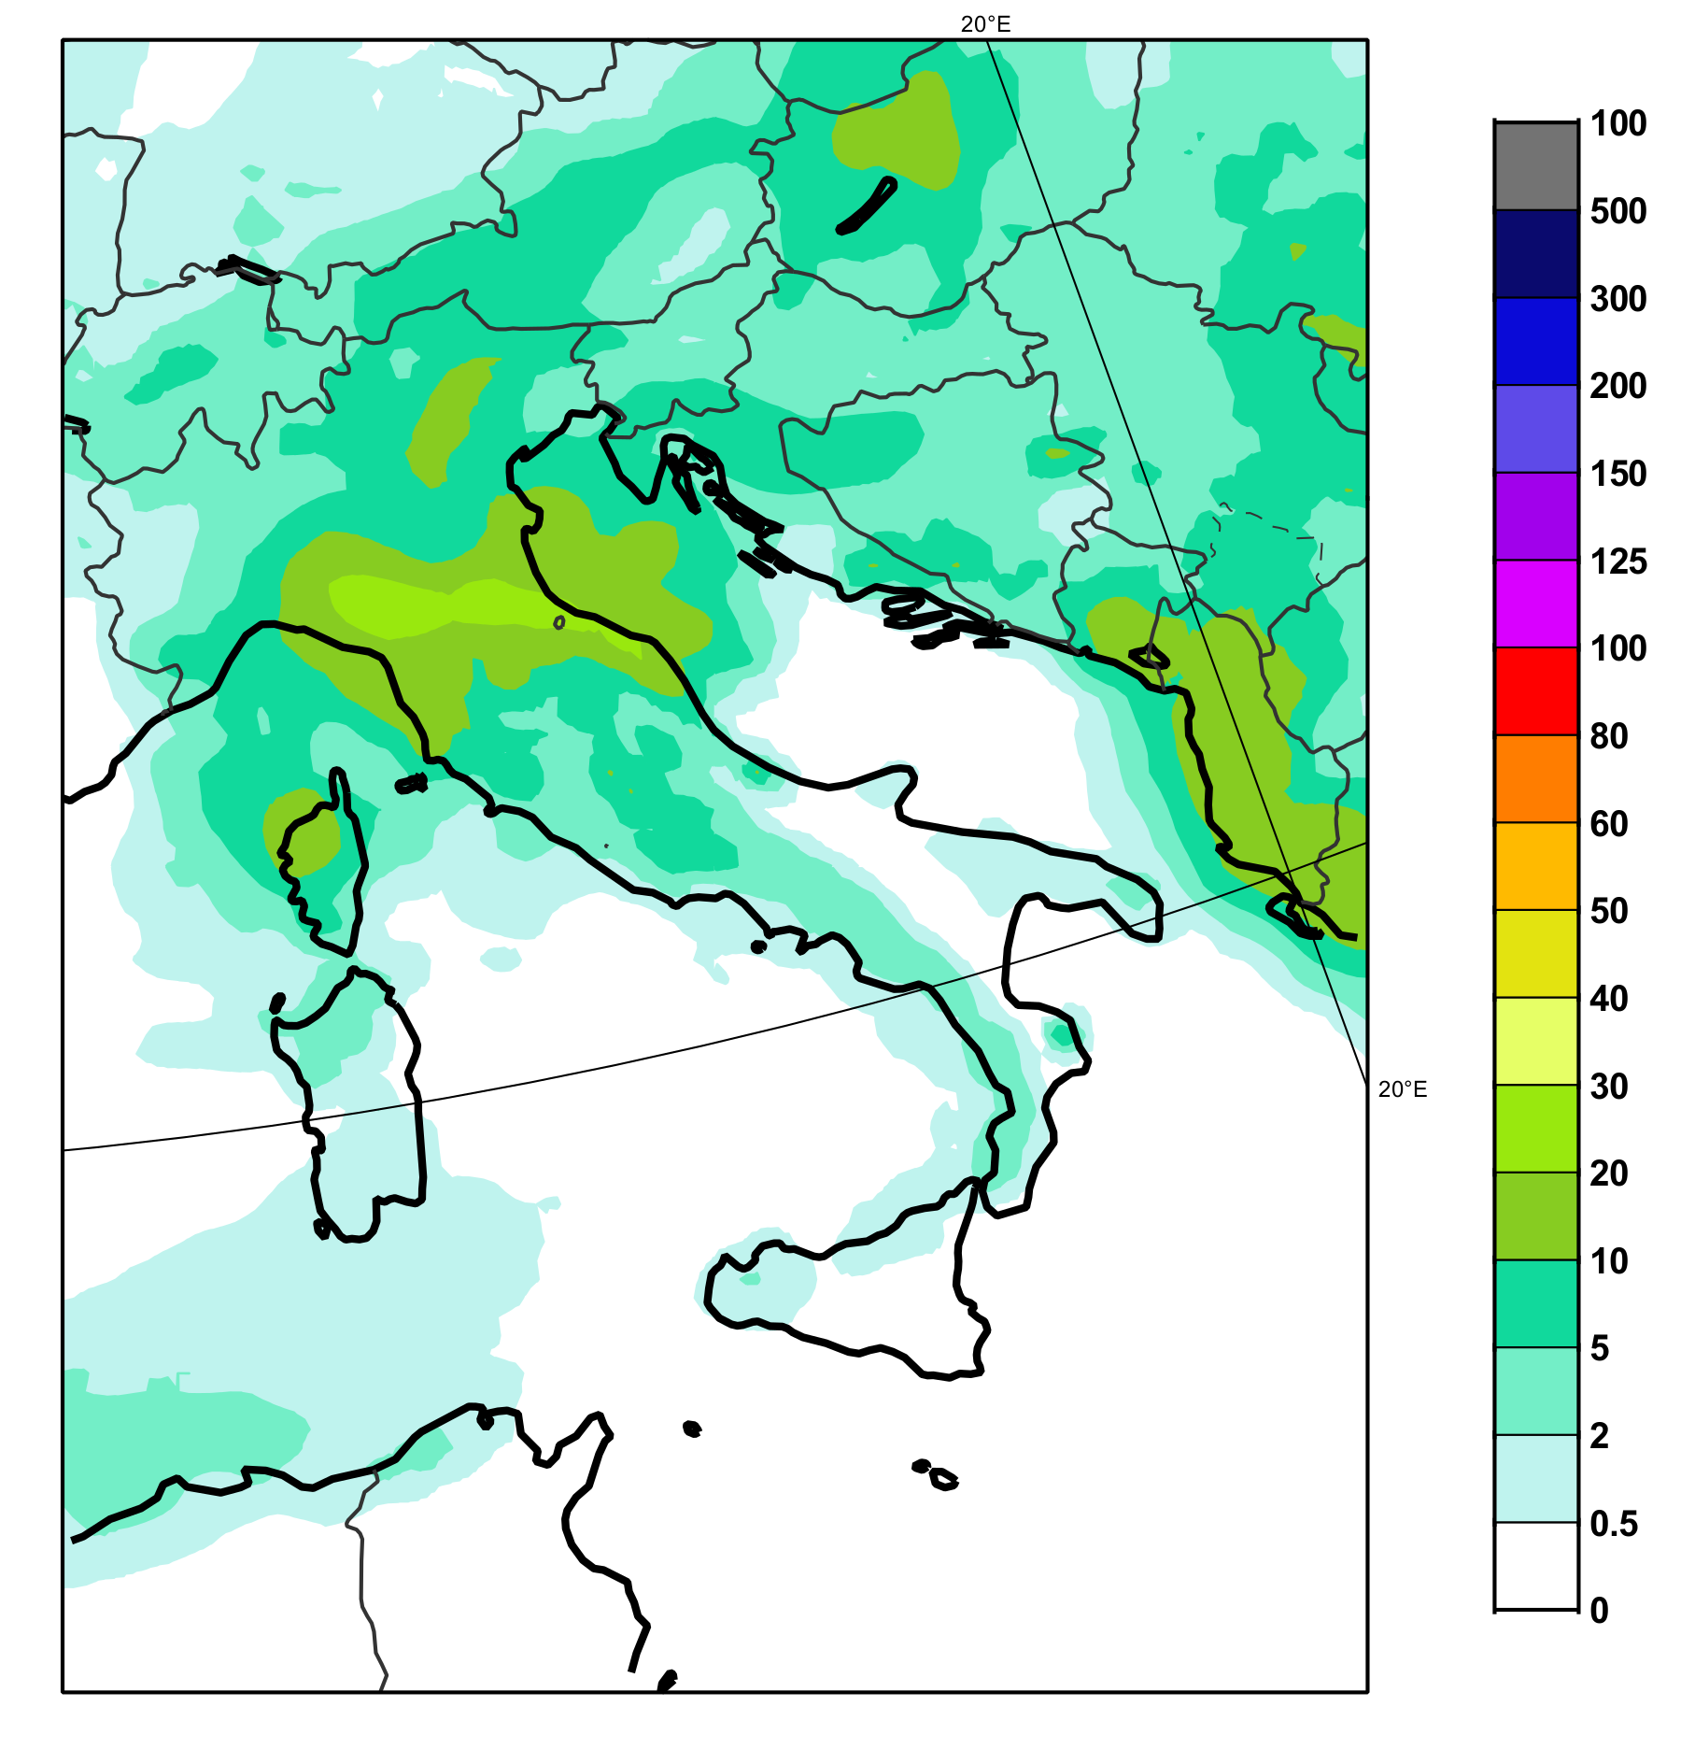
Case study: 28th May 2019 18 UTC
95th percentile ecPoint Rainfall total precipitation in 6h (in mm)
95th percentile ECMWF ENS total precipitation in 6h (in mm)
OBSERVATIONS

Slide 15
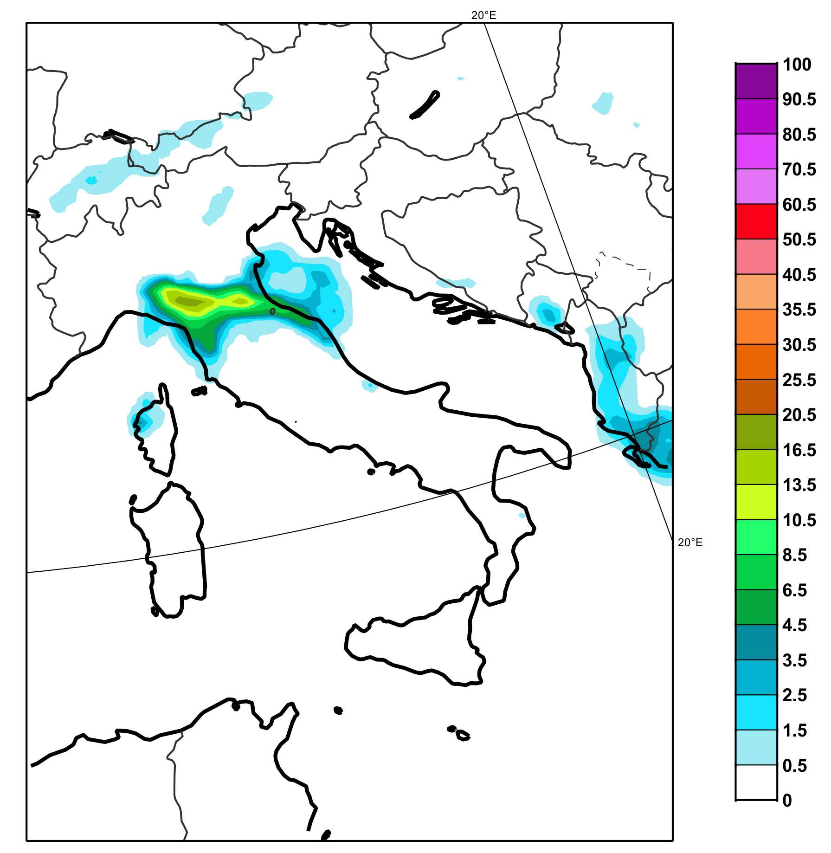
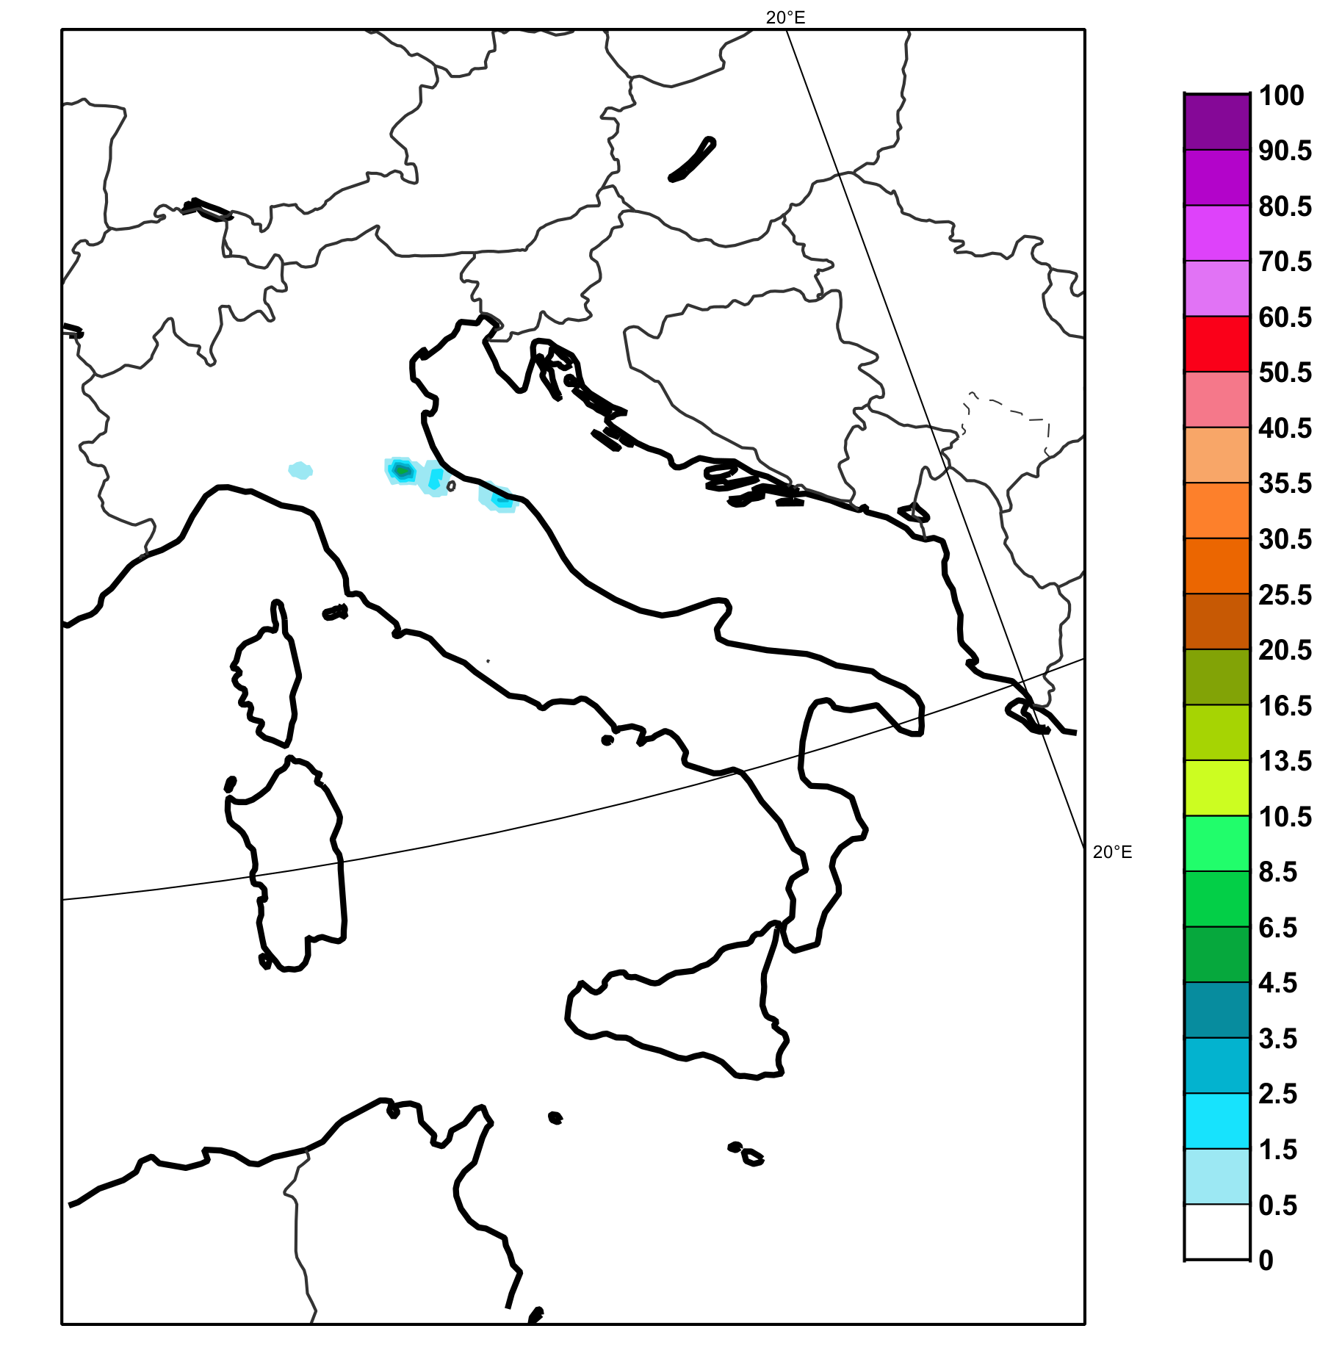
Case study: 28th May 2019 18 UTC
Probabilities ECMWF ENS total precipitation > 30 mm/6h (in %)
Probabilities ecPoint Rainfall total precipitation > 30 mm/6h (in %)
OBSERVATIONS

Slide 16
HIGLANDER and ECMWF (activities 4.1 and 4.3)
Rainfall:
24h (optionally 6h, 12h)
ecPoint
2m Temperature:
Daily - options: fixed times, max, min, mean
ERA-5 reanalysis (4.1)
For 68+ years of data (1950 onwards)
Apply to “Deterministic” reanalyses
Optionally:
Use 10 EDA runs for enhanced uncertainty estimates (up to 18h) ?
Blend with COSMO-CLM output ?
ECMWF Sub-seasonal forecasts (4.3)
Days 15-30, optionally also 10-15 and 30-45
(note that days 30-45 generally have very low skill)

Slide 17
Benefits of ecPoint for HIGHLANDER
Much more (statistically) reliable representation of 2m temperature and rainfall accumulations
This means the frequency of occurrence of certain events in the extended range forecasts and the re-analyses will generally match the frequency of occurrence in observations
When ecPoint is not used this matching is much worse
ecPoint “added value” is envisaged to be greatest for the following classes:
Heavy rainfall events (amounts normally badly underestimated)
Dry days (frequency normally significantly underestimated)
Extreme temperatures (normally represented as cooler than observed)
Impacts of built-up areas on temperature (not captured at all in raw model output)
Differences in temperatures between forested and crop-covered regions (can be improved)
Differences in rainfall between topographically complex and flat regions should improve
We cannot however deliver “miracles” in extended range forecasting!
If the weather patterns delivered by the extended range forecasts are fundamentally wrong, it is very difficult to improve those
Expectations have to be realistic!

Slide 18
MISTRAL overlap: what can be re-used in HIGHLANDER?
1. ecPoint Rainfall 12-h already operational and 6-h already developed in MISTRAL for Medium-Range Forecast (0-10 days).
Calibration software developed and open source, can be used in HIGHLANDER
The development of the new suites with the ERA-5 and sub-seasonal post-processing will be based on the one already implemented in CINECA
2. Ecflow suite for Medium-Range Forecast already migrated from ECMWF to CINECA

