Slide 1
Planetary Rock Compositions for Four Stellar Disks
Gül Sevin Pekmezci
Universita' di Roma Tor Vergata
Olivier Mousis
Institut UTINAM, Université de Franche-Comté
UPS-OMP, CNRS-INSU, IRAP, Université de Toulouse
M. Ali Dib
Institut UTINAM, Université de Franche-Comté
Jonathan I. Lunine
Center for Radiophysics and Space Research, Cornell University

Slide 2
The Study
Presuming that rocky composition is a product of the distance to the stars, the formation conditions of refractory species are examined under certain thermodynamic conditions with the assumption of chemical equilibrium.
Four host stars are chosen as case studies due to availability of chemical composition, even if the data are partial: the Sun (Asplund et al., 2009), WASP-12 (Fossati et al., 2010) , WASP-19 (Hebb et al., 2010) , and XO-1 (McCullough et al., 2006) .
The silicate and metal compounds are calculated with HSC Chemistry 7.1. Temperature range is taken from 100 to 2000 Kelvin, and pressure is kept fixed at 10⁻⁴ bar (Bond et al., 2010; Fegley, 2000; Lodders, 2003).
The largest possible list of species is constituted with Al, C, Ca, Co, Cr, Cu, Fe, K, Mg, Mn, N, Na, Ni, O, P, S, Sc, Si, Sr, Ti, V, and Zn, along with H and He.

Slide 3
The Sun

Slide 4
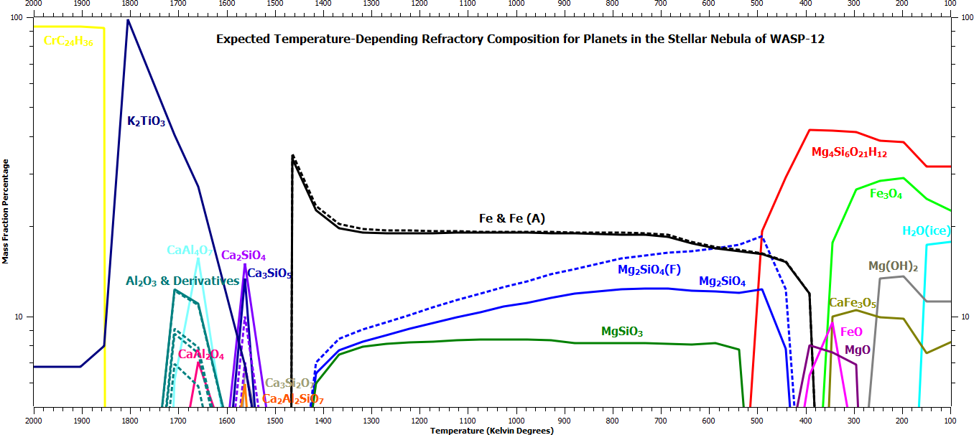
WASP-12

Slide 5
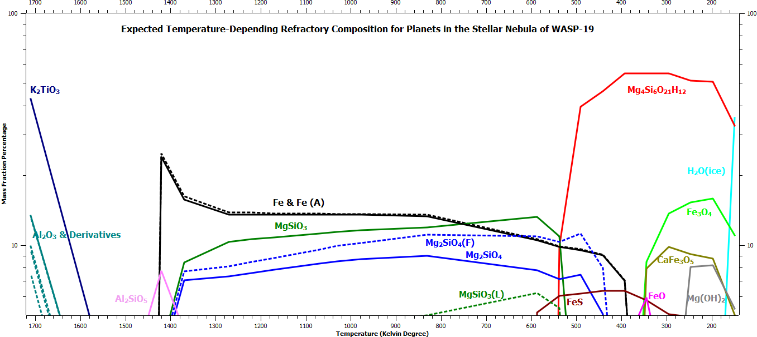
WASP-19

Slide 6
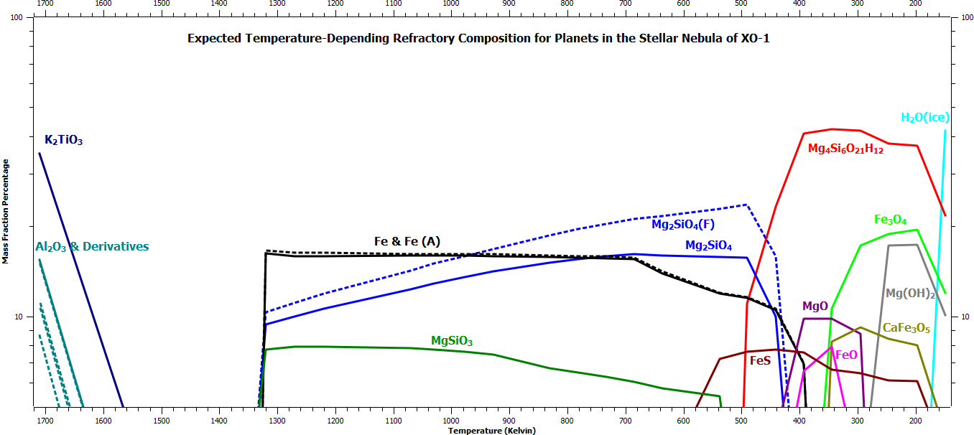
XO-1

Slide 7
Distribution of Refractory Compounds
A zonal division between diverse refractory compounds formed out of certain elements is clearly observable throughout the disks, as noted also by Bond et al. (2010a).
The disks can be imagined as being divided into belts where some certain compounds dominate within, or frontlines where some other compounds are found from there on.
Toward cooler regions, the formation of compounds shifts from refractory to volatile products.

Slide 8
Magnesium-Bearing Species
The most dominant magnesium refractory compound in the disks of four case stars is Mg₄Si₆O₂₁H₁₂ (SEPIOLITE).
Mg₂SiO₄ (MAGNESIUM ORTHOSILICATE):~500 - 1400K for ~ 20%.
MgSiO₃ (MAGNESIUM METASILICATE): ~550 - 1300 K.
Apart from MgO, magnesium tends to combine with silicon, and apart from disthene (Al₂O₃.SiO₂), silicon always combines with magnesium. So when both are found together, they form various magnesium-silicate compounds, which are the fundamental contributors in rocky planets.

Slide 9
Iron-Bearing Species
Fe₃O₄ (MAGNETITE): T < ~350 K for ~15 - ~25%.
Fe (METALLIC IRON): ~700 - 1300 K for~30 - ~40%.
At~1350 K, a peak almost doubling the percentage.
FeS (PYRRHOTITE): ~600 K for ~5%.
FeO (WUESTITE): ~350 - 400 K for ~5-10%.

Slide 10
Calcium-Bearing Species
CaFe₃O₅ (CALCIUM TRIIRON PENTAOXIDE): T< ~350 K for ~10%.
CaAl₄O₇, Ca₂SiO₄, Ca₂Al₂SiO₇, Ca₃SiO₇ and Ca₃SiO₅ (CALCIUM OXIDES with ALUMINIUM and/or SILICATES): ~1750-1500 K.
Ca₂TiO₃ (CALCIUM TITANIUM OXIDE): T > ~1600 Kelvin for ~85 - 100%.

Slide 11
Aluminum-Bearing Species
Combinations of Al₂O₃ (ALUMINIUM OXIDE) with calcium to (CaAl₂O₇, CaAl₂O₄)or disthene (Ca₂Al₂SiO₇): ~1750-1500 Kelvin.
Calcium and aluminum are observed only in hot regions for a short range of nearly 200 Kelvin, excluding CaFe₃O₅.
At 2000-1750 Kelvin, rocky parts of disks are dominated only by CrC₂₄H₃₆ and K₂TiO₃/CaTiO₃.

Slide 12
WASP-12 Composition for 1854 K
The rocky part of a planet should consist of
92% CrC₂₄H₃₆ and 8% K₂TiO₃.

Slide 13
WASP-12 Composition for 1659 K
The entire rocky composition is shared by various oxides of calcium and/or aluminum, as with 28% K₂TiO₃.

Slide 14
WASP-12 Composition for 1562 K
Another example for the mixture of oxides with aluminum and/or calcium, also including silicates. This combination is a candidate for terrestrial planets, probably with a large mantle and rich crust structure, but lacking of a metallic core.

Slide 15
WASP-12 Composition for 1026 K
A proper terrestrial planet, with an elemental iron contribution of 42% mass fraction to make up the core. The rest is divided among silicates of magnesium, aluminum and calcium.

Slide 16
WASP-12 Composition for 441 K
Still has an iron core to cover 32% of the total mass, but the major part consists of magnesium silicates. With a rich combination of FeS, FeO, Ca₃Si₂O₇ and Cr₂FeO₄, this planet also falls within the category of terrestrial.

Slide 17
WASP-12 Composition for 344 K
The iron core disappears, iron is incorporated to the oxide compounds like Fe₃O₄, FeO, CaFe₃O₅, FeAl₂O₄, Cr₂FeO₄ or FeS. Dominance belongs to Mg₄Si₆O₂₁H₁₂ with 44%. This combination is reminiscent of the planet Mars.

Slide 18
Conclusions
Although the order of abundances might change in each case, and a few species might appear or disappear in some of the disks as well, the general behaviors of species are quite similar for all the stars.
Direct measurement data of elements have been available only for the Sun and WASP-12, but they do not radically differ from each other either.
Close abundances of elements result in alike disk refractory distributions in all cases. This finding was previously mentioned by Lodders (2009) as well, stating that disk gases, similar to the solar one, enriched with hydrogen and helium are expected to exhibit similar refractory compounds and stability sequences based on temperature.
That way the fundamental planetary constructing material in different disks can be expected to contain similar oxygen-, silicon-, metal-, sulphur-bearing species.

Slide 19
References
Alibert, Y. et al. 2005. Astronomy and Astrophysics 434, 343.
Asplund M. et al., 2009. Annual Review of Astronomy & Astrophysics 47, 481.
Bond J. C. et al., 2010. Icarus 205, 321.
Bond J. C. et al., 2010. The Astrophysical Journal 715, 1050.
Carter-Bond J. C. et al., 2012. The Astrophysical Journal 760, 44.
Dodson-Robinson et al. 2009. Icarus 200, 672.
Fegley B., 2000. Space Science Reviews 92, 177.
Johnson T. V. et al., 2012. 39th COSPAR Scientific Assembly 2012, E1.18.
Johnson T. V. et al., 2012. The Astrophysical Journal 757, 192.
Kuchner M. J., Seager S., 2005. Eprint arXiv:astro-ph/0504214.
Léger, A. Et al., 2004. Icarus 169, 499.
Lodders K., Fegley B., 1999. Asymptotic Giant Branch Stars, IAU Symposium #191, LOC: 99-62044, 279.
Lodders K., 2009. arXiv:0910.0811
Lodders K., 2003. The Astrophysical Journal 591, 1220.

Slide 20
Thanks
Prof. Roberto Buonanno and Prof. Torrence Johnson for their valuable comments.
The staff of University of Franche-Comté in Besançon for the facilities they provided, and for their hospitality.
Michael Banks for proof-reading.

Slide 21
Treasure your
ONLY planet.
Thank you.

