Slide 1
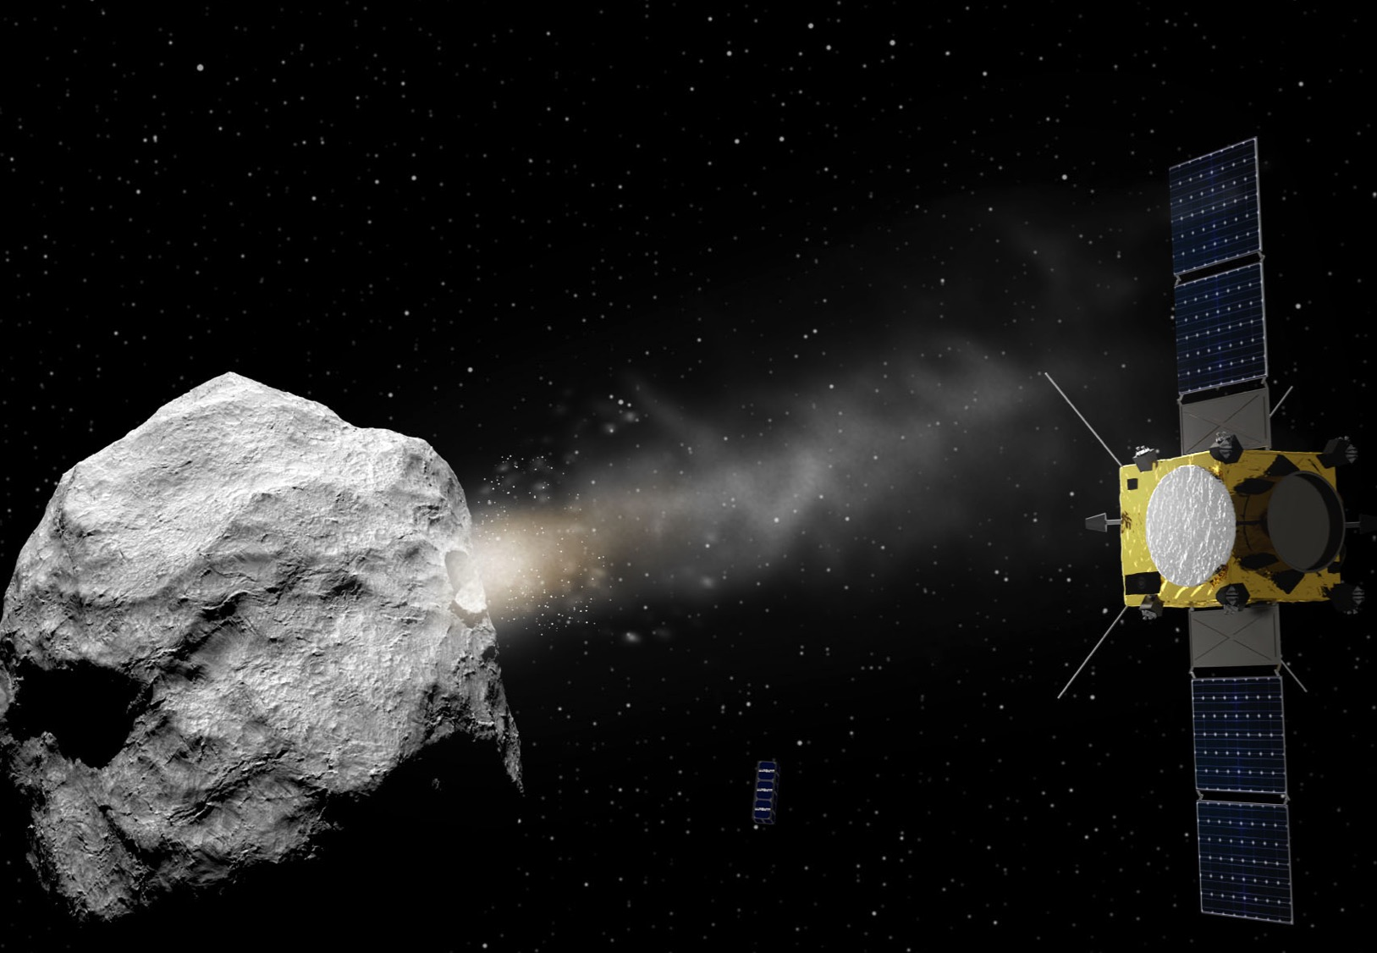
→ ASTEROID IMPACT MISSION
Ian Carnelli project manager
Michael Küppers project scientist
Karim Mellab platform manager
Andres Galvez payload manager
Patrick Michel Science advisory team lead
and the AIM team

Slide 2
AIDA COOPERATION Asteroid Impact & Deflection Assessment
AIDA: Two simple, independent and self-standing mission developments operated in coordination:
DART: demonstrate the ability to modify the orbital path of the moon of an asteroid and measure the deflection by monitoring the binary´s orbital period change
AIM: measure all scientific and technical parameters to interpret the deflection and extrapolate results to future missions or other asteroid targets
TARGET: Binary NEA Didymos

Slide 3
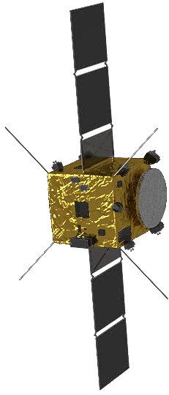
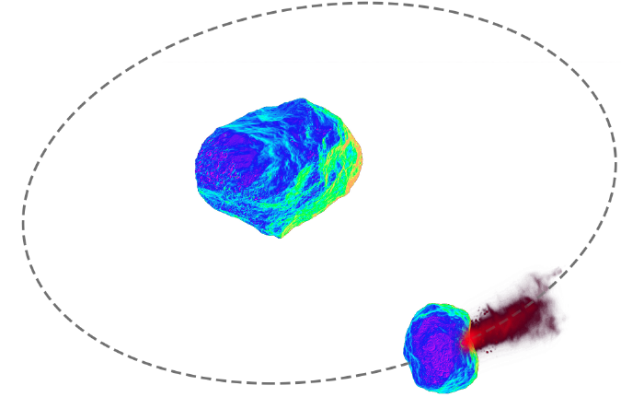
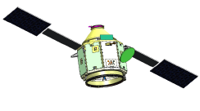
AIDA COOPERATION
→opportunity: Binary NEA Didymos close approach in October 2022
asteroid target and impact date are fixed
AIM
physical &
radar
dynamical characterization
ground telescopes
0.1 AU
DART
kinetic impactor

Slide 4
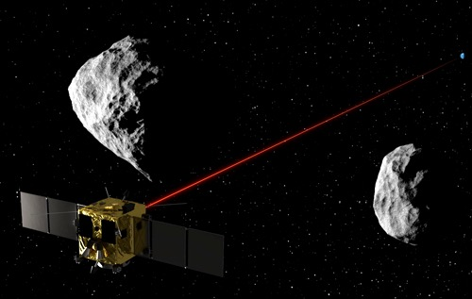
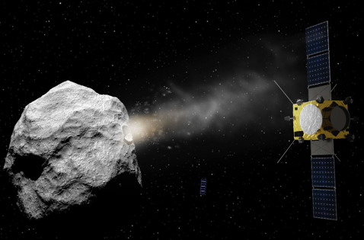
ASTEROID IMPACT MISSION (AIM)
Small mission of opportunity to explore and demonstrate technologies for future deep-space missions while addressing planetary defense objectives and performing asteroid scientific investigations.
TECHNOLOGY
ASTEROID IMPACT
SCIENCE
DEMONSTRATION
MITIGATION
Notes:
AIM is a small mission of opportunity with a triple set of objectives: scientific, technology demonstration, e.g. optical communications, inter-satellite links, platform technologies, navigation by payload, e.g. the GPR, etc. and planetary defence relevant to the SSA programme, NEO segment.

Slide 5
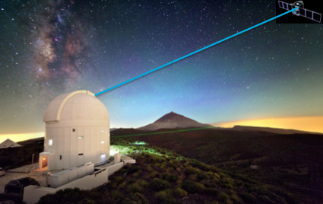
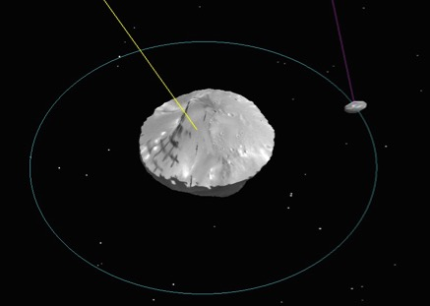
AIM “FIRSTS”
First mission to demonstrate interplanetary optical communication and deep-space inter-satellite links with CubeSats and a lander in deep-space.
First mission to measure and characterize asteroid deflection by determining the “ejecta momentum amplification factor” of a kinetic impactor.
First mission to study a binary asteroid, its origins and sound the interior structure providing clues of its formation process.
Notes:
AIM is a small mission of opportunity with a triple set of objectives: scientific, technology demonstration, e.g. optical communications, inter-satellite links, platform technologies, navigation by payload, e.g. the GPR, etc. and planetary defence relevant to the SSA programme, NEO segment.

Slide 6
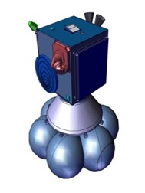
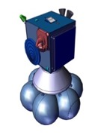
AIM MISSION OBJECTIVES
Primary objectives
Determine the binary asteroid orbital and rotation dynamics, as well as the mass, geophysical properties, and surface and subsurface structure;
Carry out a Telecommunication Engineering eXperiment (TEX) and deploy the MASCOT-2 asteroid lander;
Test inter-satellite network link with COPINS (Cubesat Opportunity Payload Intersatellite Network Sensors) and the MASCOT-2 lander.
Secondary objectives
Determine the momentum transfer resulting from the impact of the DART, by measuring the variation of the asteroid´s period, its rotation state and by imaging of the resulting impact crater. An optional extension of this objective is the imaging the asteroid ejecta resulting from the impact.
Characterise the asteroid deep interior structure.

Slide 7
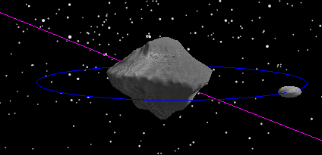
The Target: 65803 Didymos
Didymos | Spectral type Xk
Primary rotation | 2.26 hr
Binary orbit period | 11.91 hr
Binary orbit semi-major axis | 1.05 km
Primary diameter | 800 m
Secondary diameter | 150 m
Magnitude H | 18
Heliocentric Orbit
Eccentricity | 0.384
Inclination | 3.41°
Semi-major axis | 1.645 AU
Heliocentric period | 2.11 yr
Aphelion | 2.28 AU
Perihelion | 1.01 AU
Pole Direction
Ecliptic Lat: 19°
Ecliptic Lon: 157°
Orbital velocity: 15.4 cm/s
Escape velocity from primary at 1.05 km: 21.8 cm/s

Slide 8
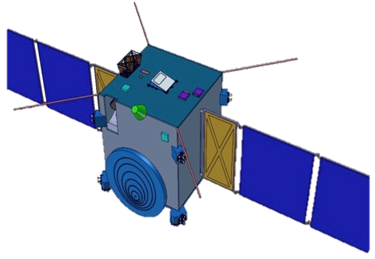
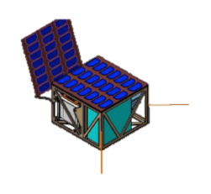
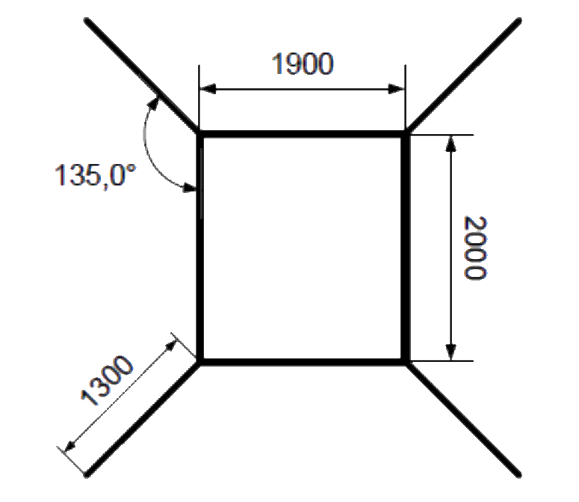
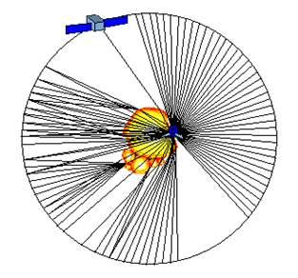
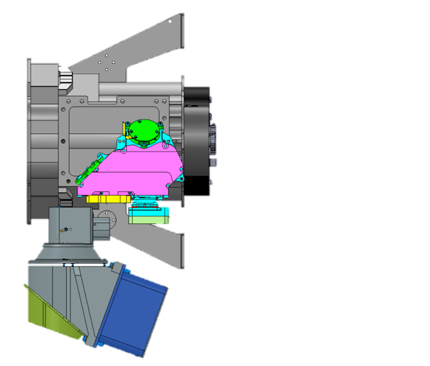
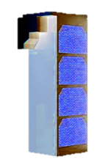
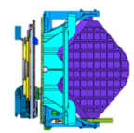
AIM PAYLOAD
High Frequency
Monostatic Radar
(HFR)
MASCOT-2
+
Low Frequency
bistatic Radar
(LFR)
VIS
(Navigation)
Radio Science
Experiment
(TT&C s/s)
Cubesat
Opportunity
Payloads
(COPINS)
Optel-D
Optical comms
Terminal
Built-in AIM
S/C
(subsystem)
TIR Imager
(TIRI)
AIM
payload

Slide 9
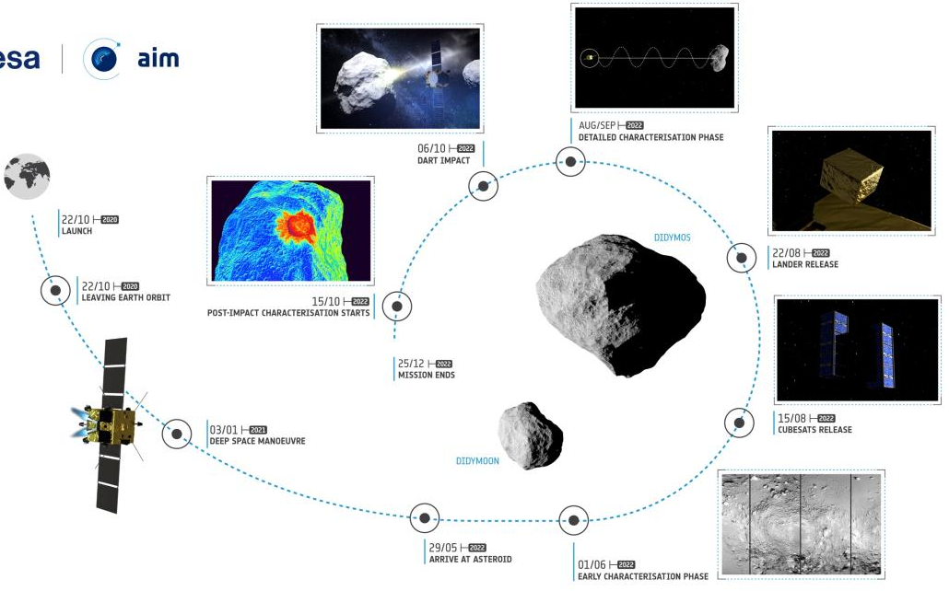
AIM MISSION SCENARIO

Slide 10
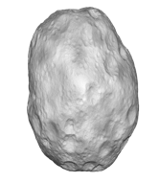
CLOSE PROXIMITY ASTEROID OPERATIONS 29 May 2022 – 25 December 2022
P1
Rendezvous phase with Didymos transition P2 co-flying position.
P2
“Early” characterization:
High-resolution surface images
Optical communication experiment
35 km
10 km
P3
First detailed characterization:
Thermal Infrared imaging
High-frequency radar sounding of surface and shallow-subsurface
<<1 km
P4
Lander phase:
Deploy MASCOT2 lander
1.1 km
10 km
~100 km
P6
Second detailed characterization:
- High-frequency radar
- Low-frequency radar to sound deep interior structure
- Crater imaging
P5
DART impact observation

Slide 11
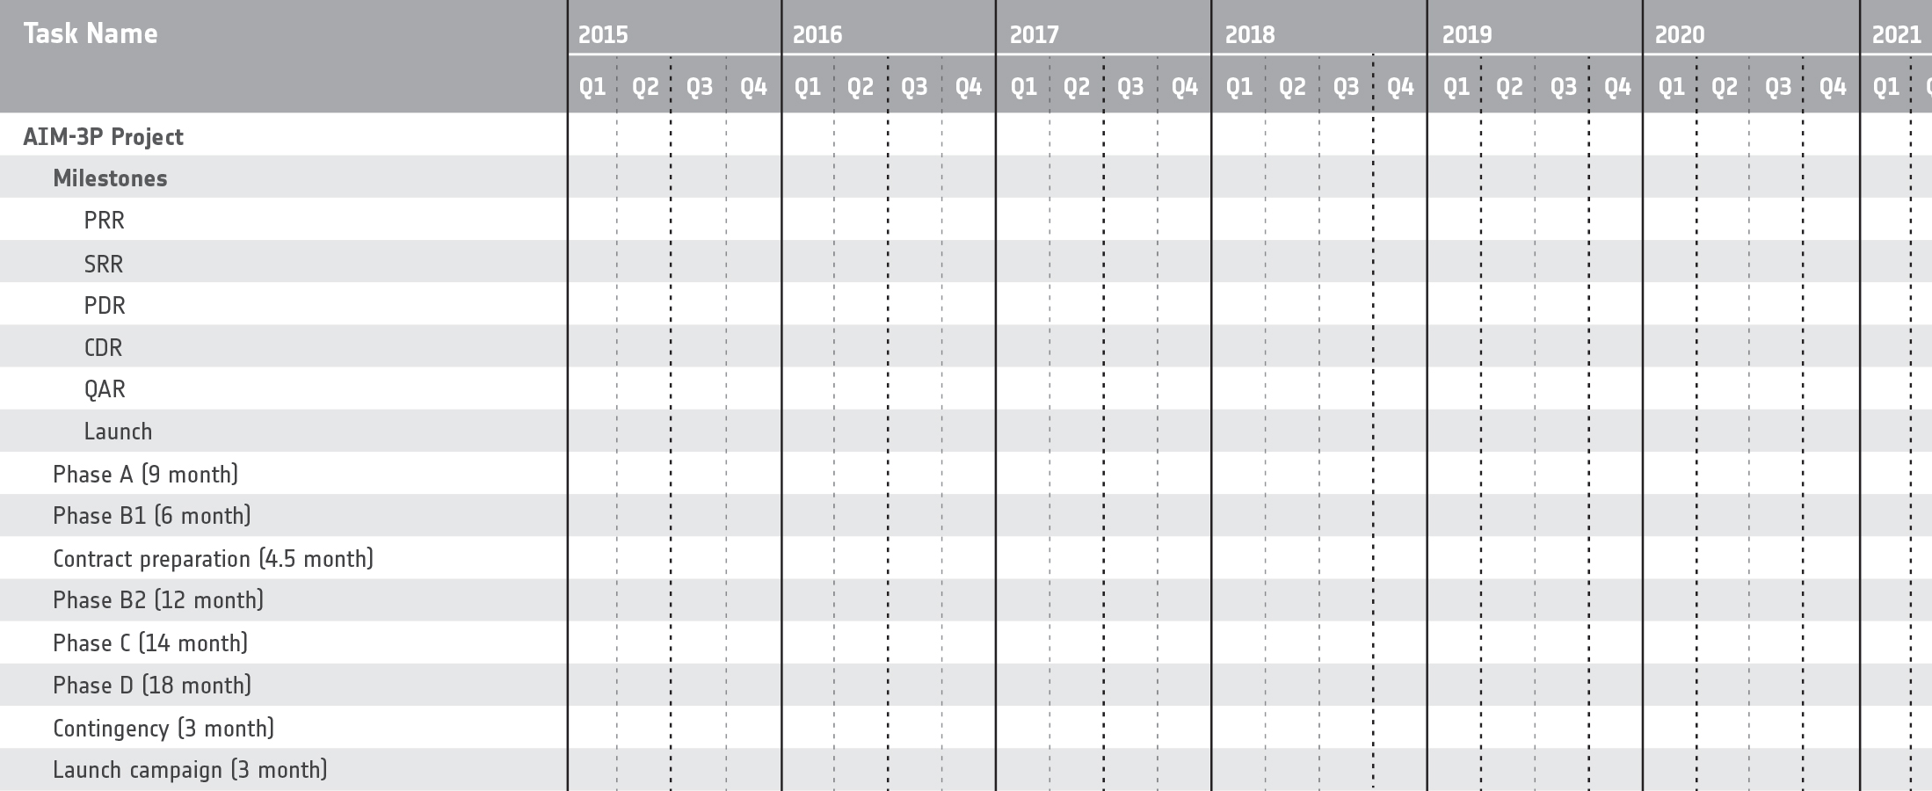
AIM BASELINE SCHEDULE
20/11
20/05
21/08
19/10
17/04
16/10
PRR
Jan 2016
B2
C
SRR
July 2016
D
Phase A/B1
Mission approval decision (C-Min’16)
Phase B2 bridge
Under mandatory budget
Optional ESA budgets

Slide 12
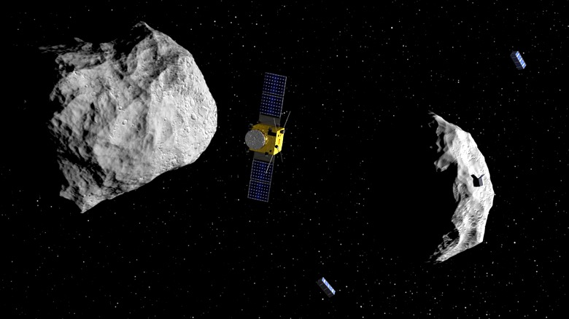
CONCLUSIONS
Small mission of opportunity:
Investigation of kinetic impactor technique for asteroid deflection
Asteroid Science (binary formation and physical properties of of small asteroids)
Technology demonstration
Optical telecommunications in interplanetary space
Inter-satellite links
Cubesats in an interplanetary mission
Landing on a small asteroid moon
More information in splinter meeting today, 17:45-19:15, Room Mars
Presentation of AIDA Science: Tomorrow, 29th Sep., 14:00, Session SB8

