Slide 1
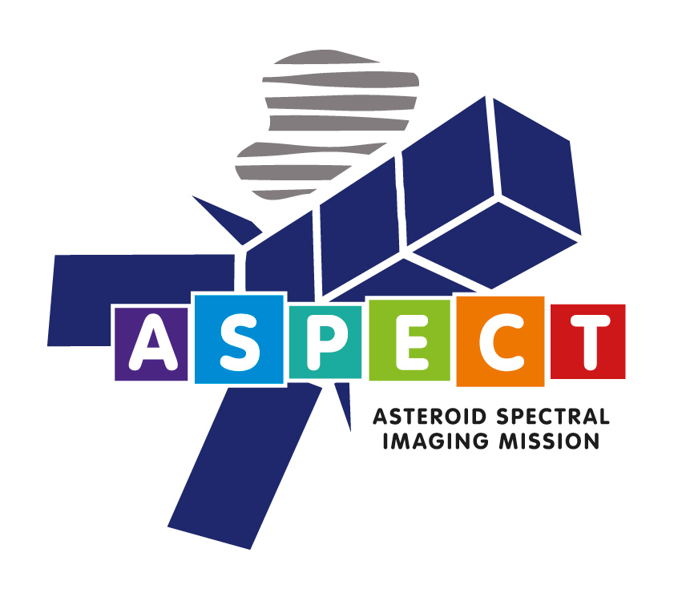



Tomas Kohout, Antti Näsilä, Tuomas Tikka, Mikael Granvik, Antti Kestilä, Antti Penttilä, Janne Kuhno, Karri Muinonen, Kai Viherkanto, Esa Kallio
VTT Technical Research Centre of Finland
Aalto University, Espoo, Finland
Department of Physics, University of Helsinki, Finland
Reaktor Space Lab Ltd
Institute of Geology, The Czech Academy of Sciences, Prague, Czech Republic

Slide 2
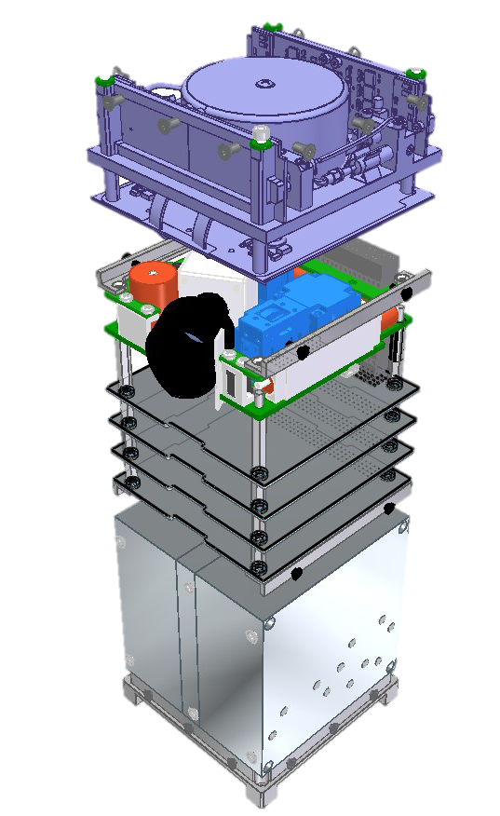
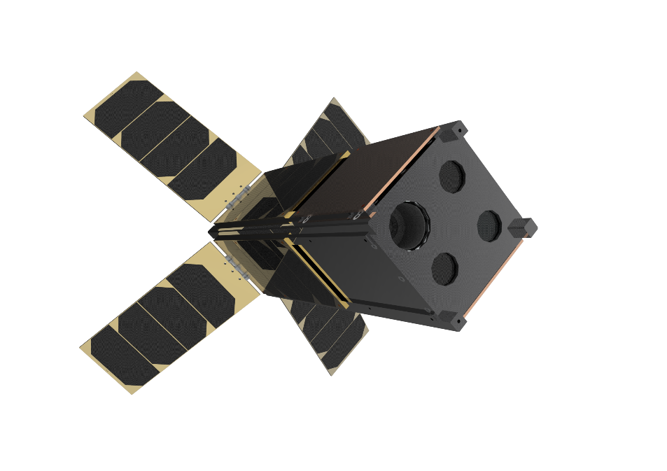
ASPECT
3 unit CubeSat equipped with
a spectral imager/spectrometer
Originally developed for AIDA mission
Radiation-hardened platform
Semi-autonomous navigation and operations
Option to carry other payloads
Aalto-1 and Aalto-2 heritage (launched June 2017)
  Propulsion
  Avionics
  Payload: VIS-NIR spectral imager

Slide 3
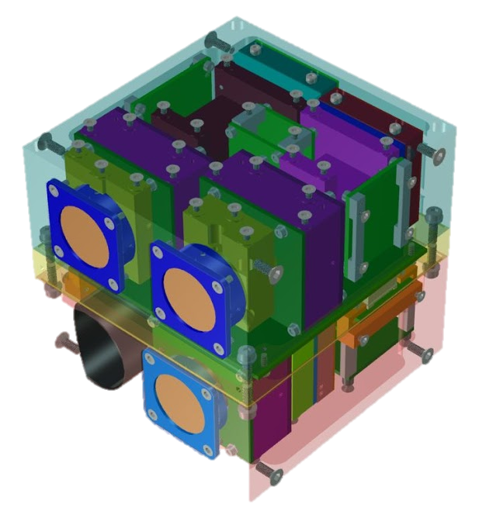
Spectral imager concept
1U envelope
3 measurement channels:
  VIS (500–900 nm) spectral imager (614 x 614 pixels)
  NIR (900–1600 nm) spectral imager (256 x 256 pixels)
  SWIR (1600–2500 nm) spectrometer (1 pixel)
Aalto-1 Spectral Imager heritage
Based on VTT’s tunable filter technology
(Fabry-Perot Interferometers)
Freely selectable wavelength bands
On-board data processing

Slide 4
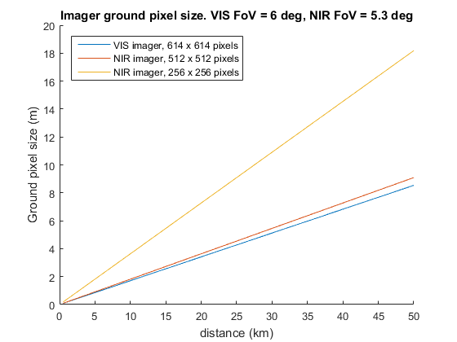
Sepctral imager resolution

Slide 5
Payload capabilities
Global compositional mapping and imaging sub-meter resolution
Detection of common silicate minerals (1000, 1300 and 2000 nm absorption)
Hydrated minerals as serpentine are detectable through 700 nm absorption feature
Direct evidence of -OH an H₂O can be detected at 1400 and 1900 nm respectively
Spectral slope is diagnostic of material maturity (fresh vs. old)
Regolith roughness can be estimated from phase curve

Slide 6
ASPECT ISRU objectives
ASPECT prospecting objectives and expected results
Objective 1 | Map the surface composition of the target
Result | Composition and homogeneity of the target surface
Result | Identification and distribution of volatiles
Objective 2 | Photometric observations and modelling of the target
Result | Surface roughness / particle size distribution
Objective 3 | Characterize possible landing sites
Result | Detailed composition and surface roughness information on potential landing sites
Objective 4 | Evaluate surface areas and objects suitable for sample return or ISRU
Result | Identification of areas and objects with desired properties

Slide 7
Hydrated features
Bus et al. 1999

Slide 8
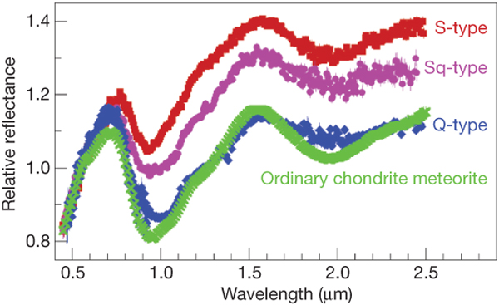
Fresh vs. old surface
Binzel et al. 2010

Slide 9
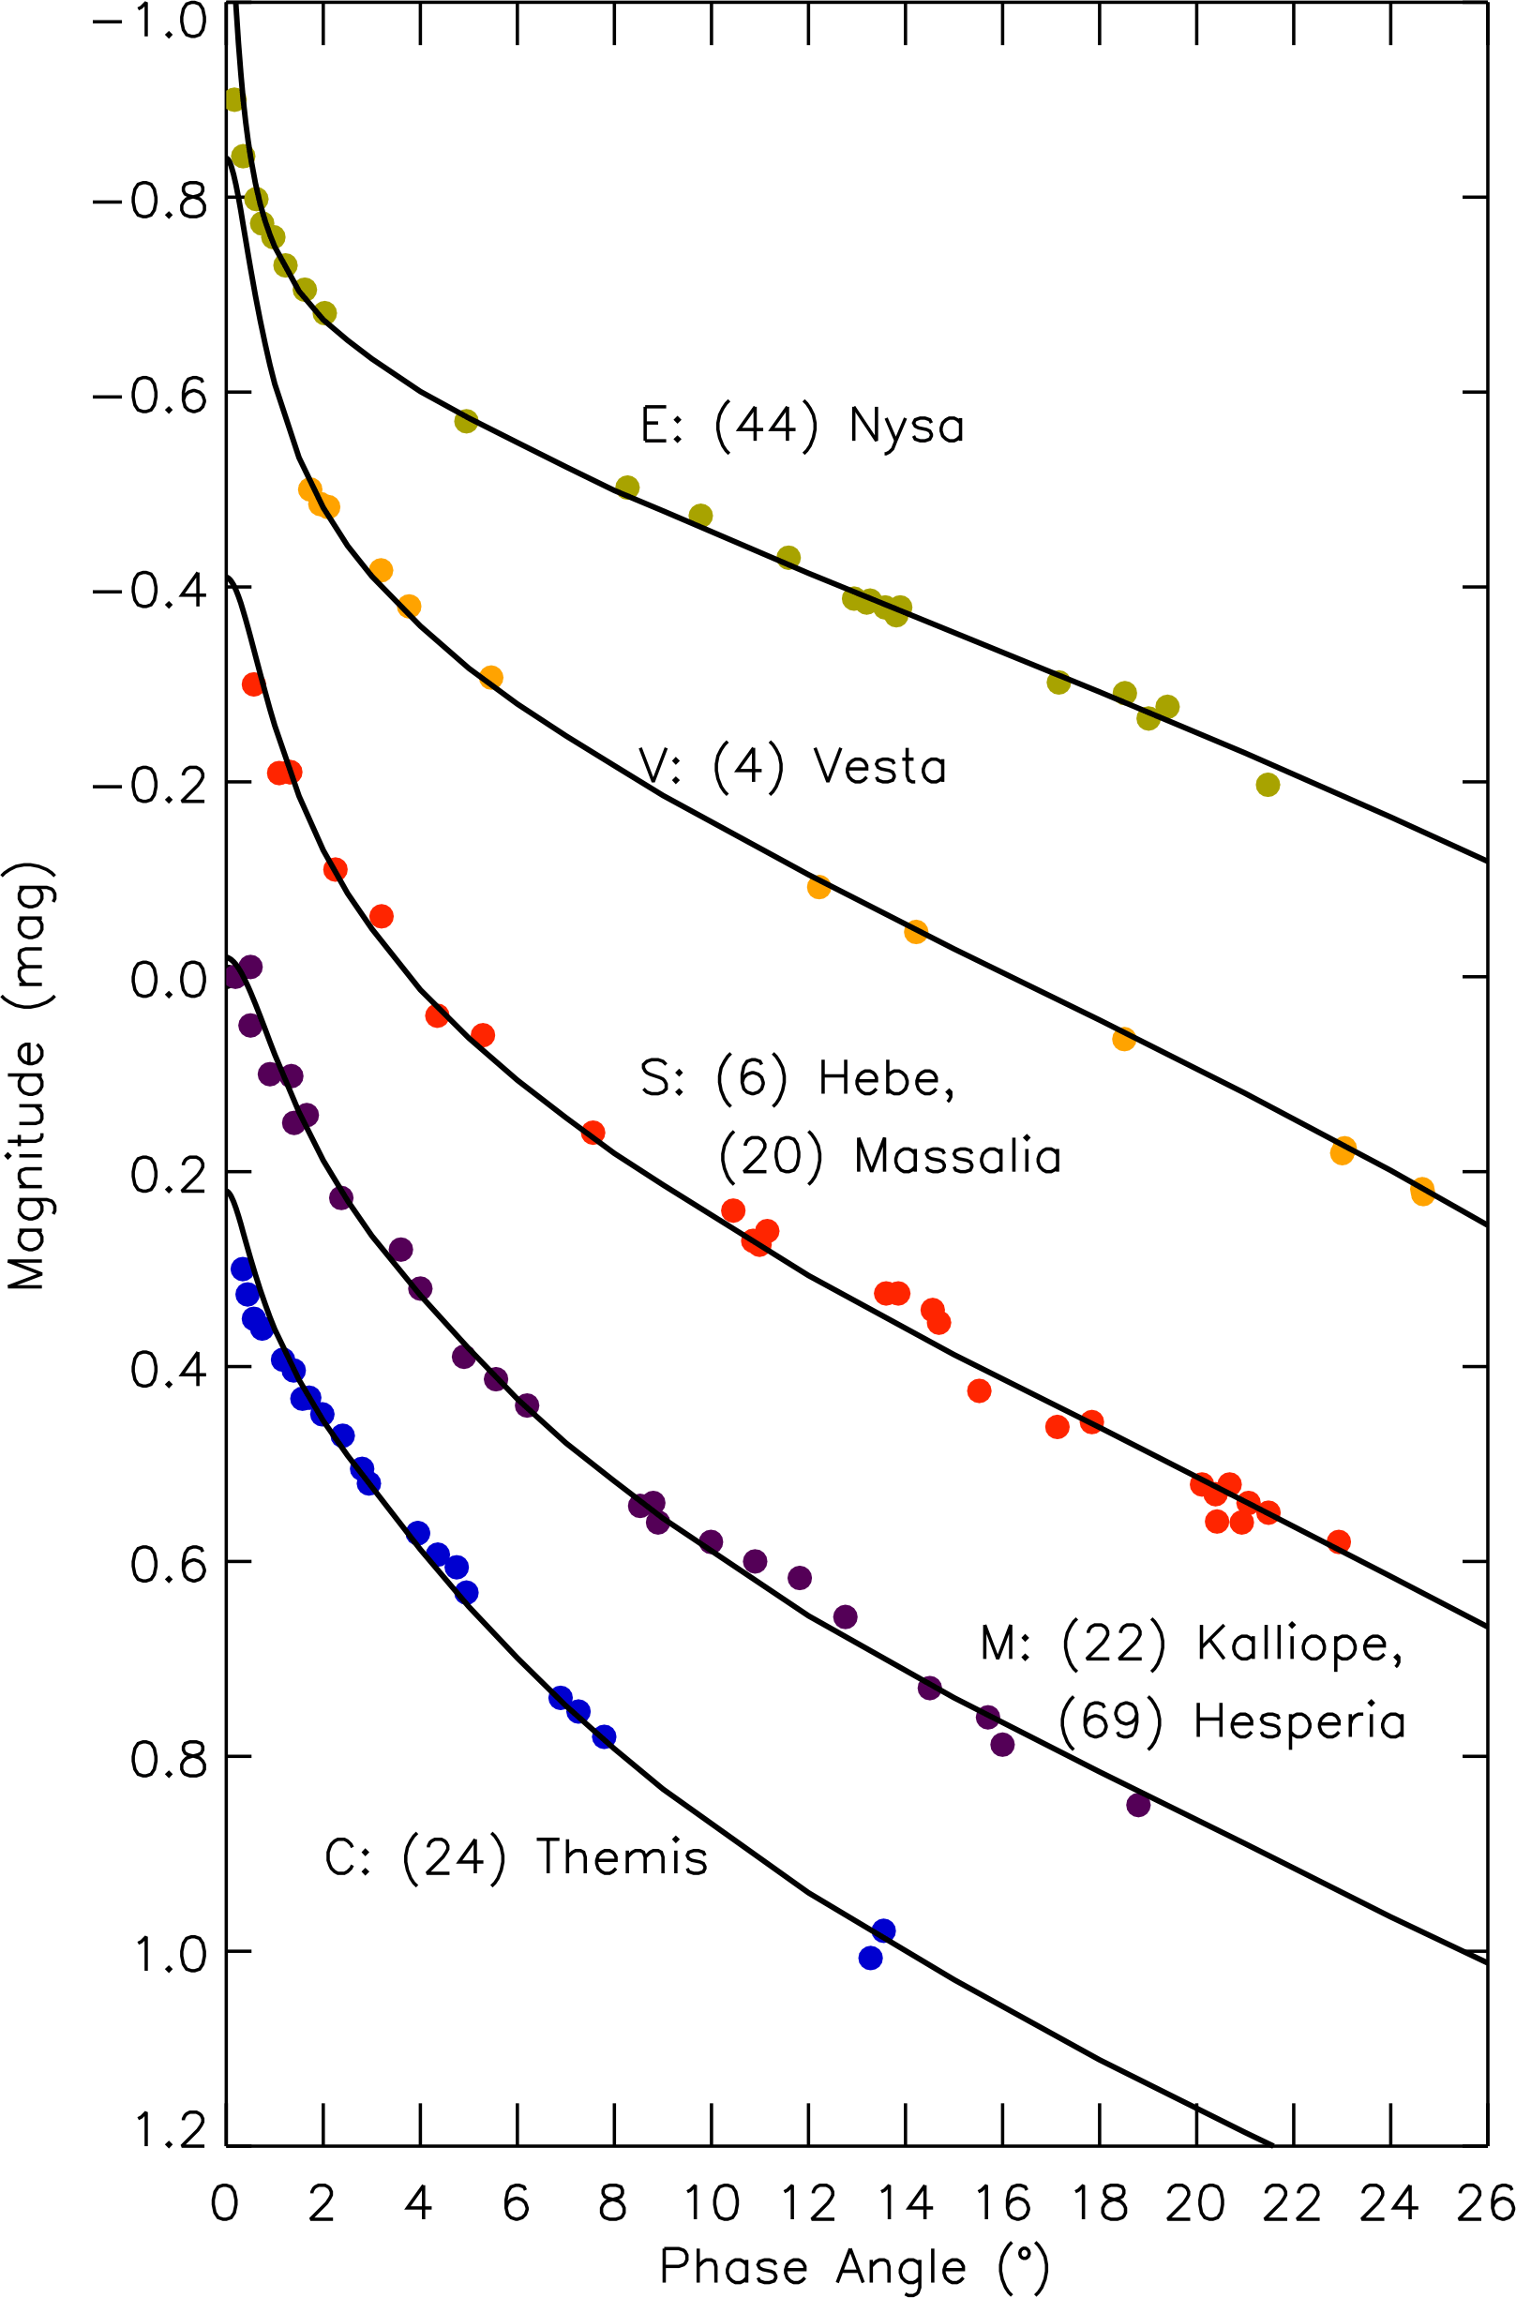

Photometric observations and regolith roughness
Sun

Slide 10
Summary
ASPECT is a 3U asteroid CubeSat with an VIS-NIR imaging spectrometer
Main science objectives are to characterize target surface composition and identify areas of potential interest (landing, sampling, ISRU)
ASPECT can be deployed to lower, more risky orbit to achieve high resolution
Scalable to 6 or 12U
Versatile platform - may carry additional payloads
Fleet of simple CubeSats with dedicated payloads can provide complex target characterization with increased redundancy and lower risk / cost

