Slide 1
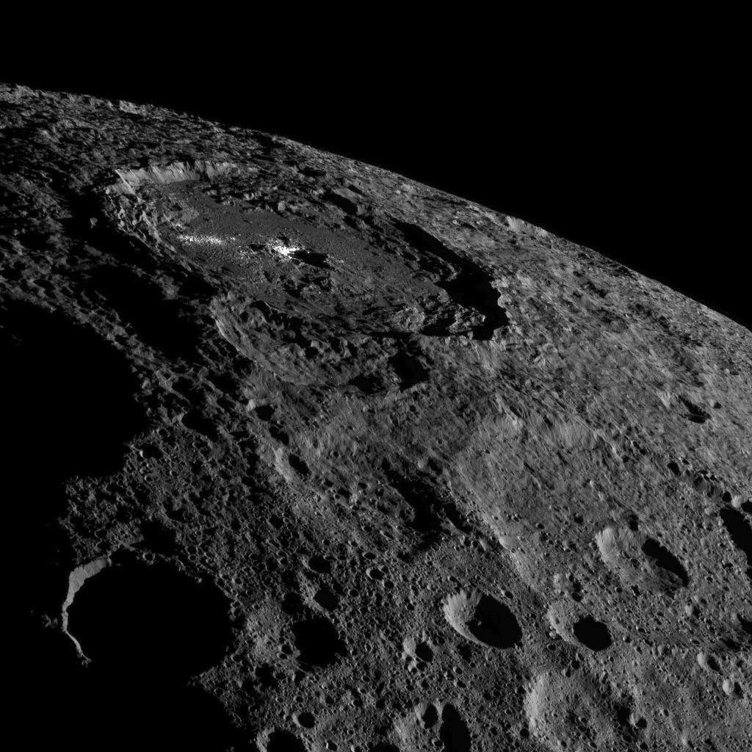



Continuum definition for Ceres absorption bands at 3.1, 3.4 and 4.0 μm
A. Galiano^{1,2}, E. Palomba¹, A. Longobardo¹, A. Zinzi^{3,4}, M.C. De Sanctis¹, A. Raponi¹, F.G. Carrozzo¹, M. Ciarniello¹, F. Dirri¹
¹INAF-IAPS, Rome, Italy
²Università degli Studi di Roma Tor Vergata, Rome, Italy
³ASI Science Data Center
⁴INAF-OAR

Slide 2
NASA Dawn spacecraft orbits around dwarf planet Ceres since 2015, acquiring hyperspectral data (by mean of VIR) and color images (by mean of FC) by performing several mapping orbits
Mapping Orbit | Dawn code name | Dates | Altitude (km) | Resolution (m/pixel)
1 | RC3 | April 23 – May 9 | 13,600 | 1,300
2 | Survey | June 6-30 | 4,400 | 410
3 | HAMO | Aug 17 – Oct 23 | 1,470 | 135
4 | LAMO | Dec 16 – end of mission | 385 | 35

Slide 3
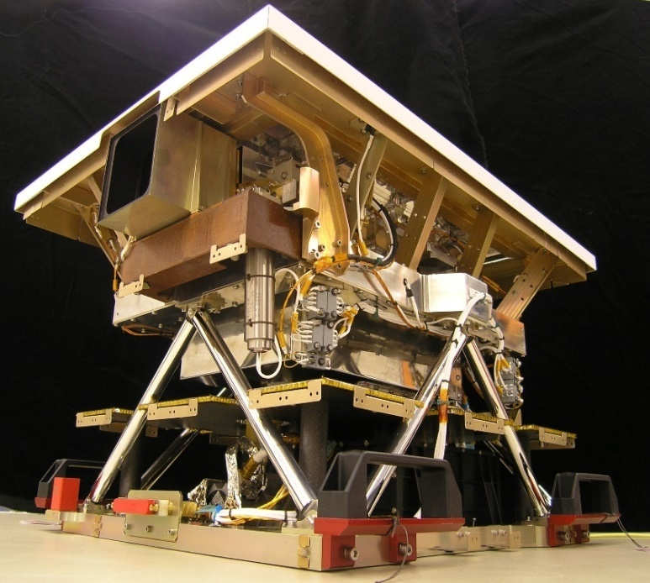
Visible and Infrared Spectrometer (VIR)
acquires images and reflectance spectra in the visible and near-infrared range: 0.25-5.1 µm
VIS channel: 0.25-1.05 µm
VIR channel: 1.05-5.1 µm
Spectral sampling VIR VIS=1.8 nm/band
Spectral sampling VIR IR = 9.8 nm/band
Developed by the National Institute of Astrophysics (INAF)

Slide 4
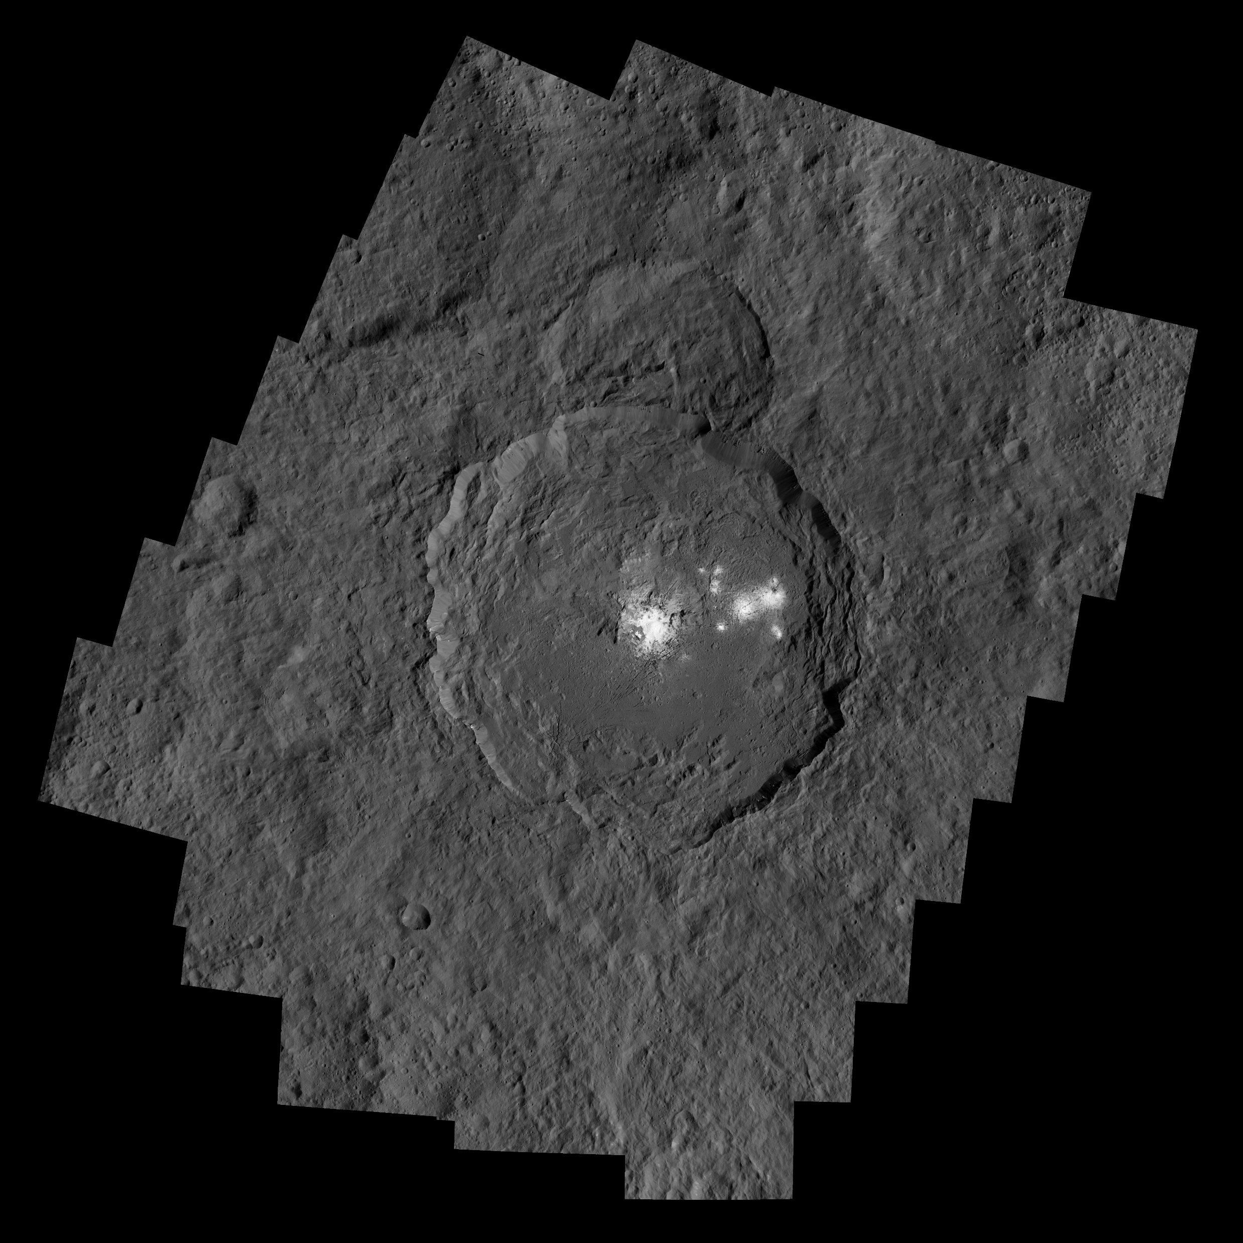
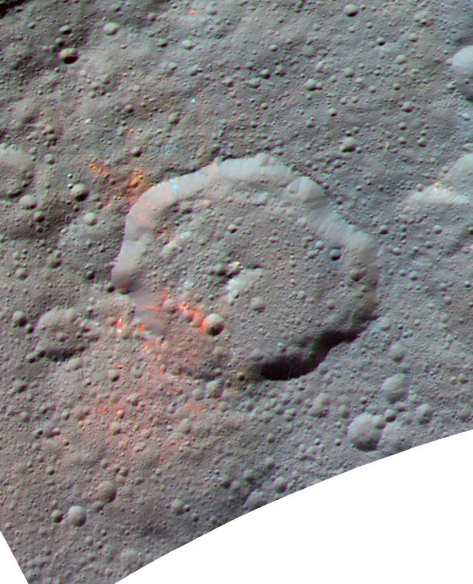
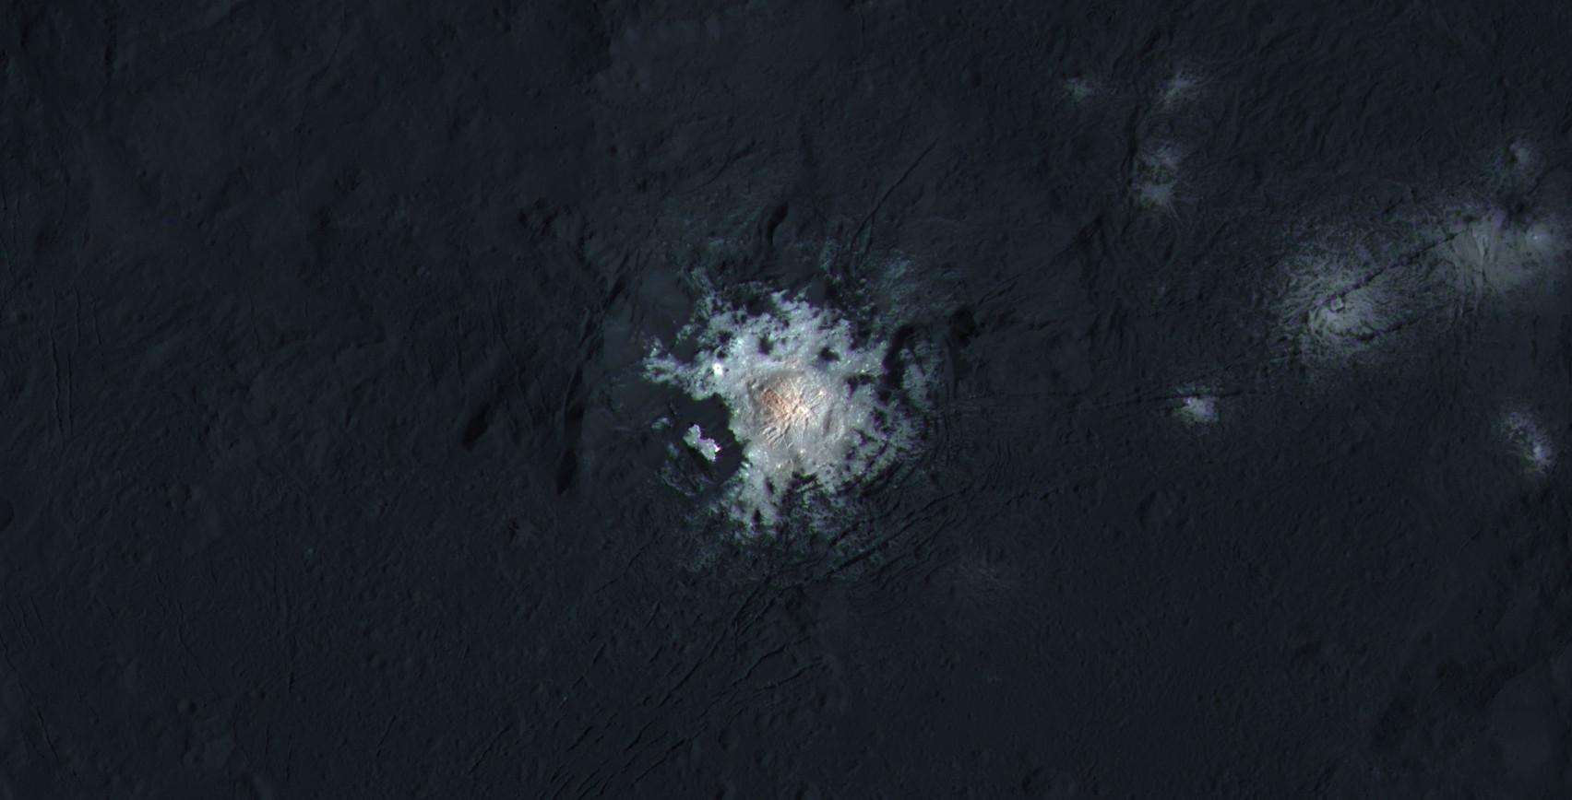
Occator crater
Ceres is a dark object with bright areas detected on the surface, termed as «bright spots»
Ernutet crater
Ceres equigonal albedo=0.033
Cerealia and Vinalia Faculae
Equigonal albedo 8 times brighter than mean Ceres value (Palomba et al., 2017)
Occurrence of organics
(De Sanctis et al., 2017)

Slide 5
Differences in albedo connected with a heterogeneous mineralogy of Ceres
Mean Ceres | Ernutet | Occator
2.72 µm Mg-phyllosilicates | 2.72 µm Mg-phyllosilicates | 2.76 µm Al-phyllosilicates
3.1 µm NH₄ -phyllosilicates | 3.1 µm NH₄ -phyllosilicates | ---
3.4 µm Mg/Ca-carbonates | 3.4 µm Organics | 3.2-3.5 µm Carbonates and other phases
4.0 µm Mg/Ca-carbonates | 4.0 µm Mg/Ca-carbonates | 4.01 µm Na-carbonates
4.0 µm
2.72 µm
3.4 µm
3.1 µm
2.2 µm
4.0 µm
2.72 µm
3.1 µm
3.4 µm
4.01 µm
2.86 µm
2.76 µm
3.2-3.5 µm
De Sanctis et al., 2017

Slide 6
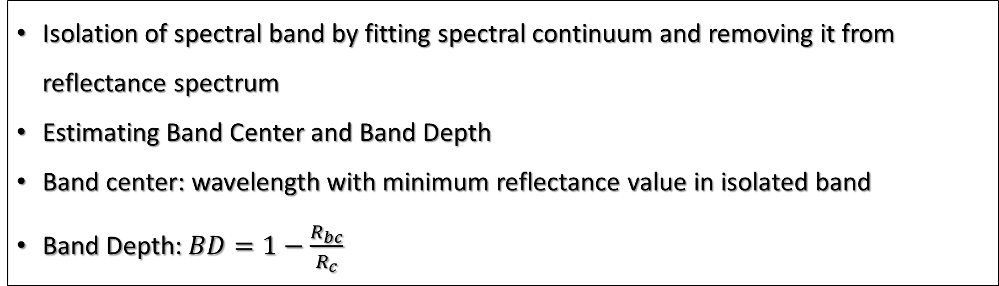
How to perform a mineralogical analysis:
Isolation of spectral band by fitting spectral continuum and removing it from reflectance spectrum
Estimating Band Center and Band Depth
Band center: wavelength with minimum reflectance value in isolated band
Band Depth: $BD=1−\frac{R_{bc}}{R_{c}}$

Slide 7
Search for one unique method for continuum removal, well-working in:
Spectra with different band shapes
Spectra with shift of 3.4 µm band’s left shoulder
VIR spectra with different spatial resolution
(Survey, HAMO and LAMO phases)
Regions with different equigonal albedo
Dark: <0.03
Intermediate: 0.03-0.037
Bright: 0.037-0.05
Occator (Cerealia Facula): >0.05

Slide 8
Method applied to define the most appropriate spectral continuum
Selection of representative spectra for dark, intermediate, bright and Occator BS region for Survey, HAMO and LAMO phase
Application of a smoothing procedure on reflectance spectra to reduce noise in the signal, i.e., by replacing the reflectance at each VIR spectral band with the average of the reflectance among the five closest VIR spectral bands
Fitting the spectral continuum of 3.1, 3.4 and 4.0 µm band by applying three different methods: Linear Continuum, Continuum 1, Continuum 2.

Slide 9
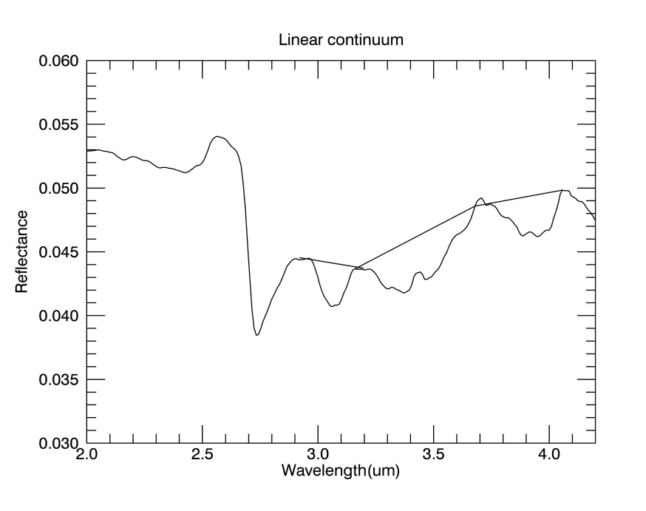
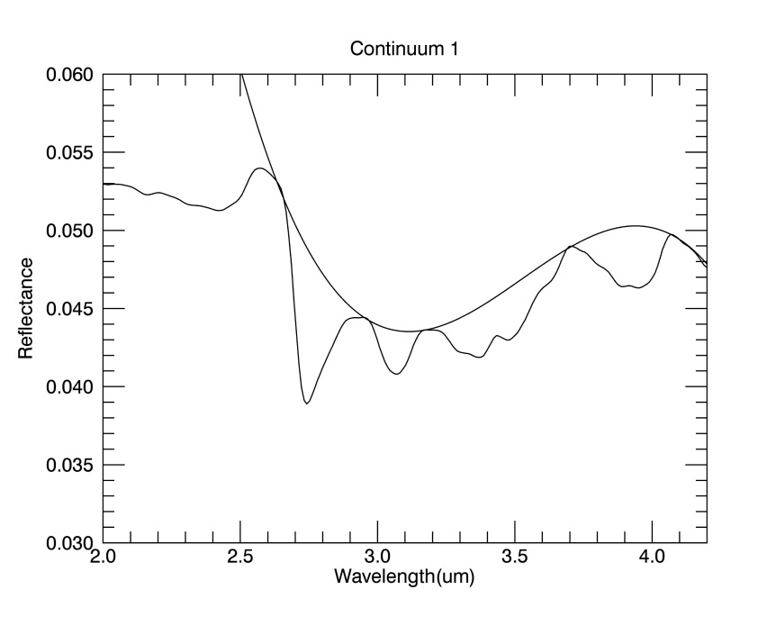
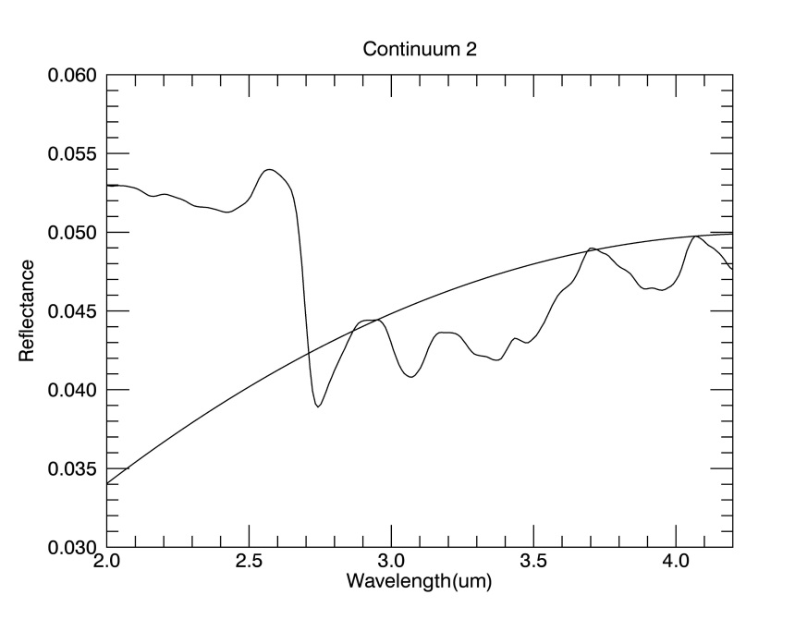
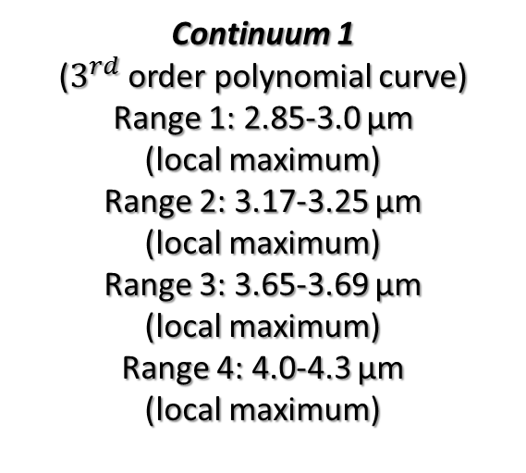
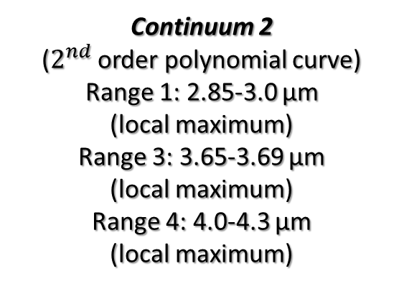
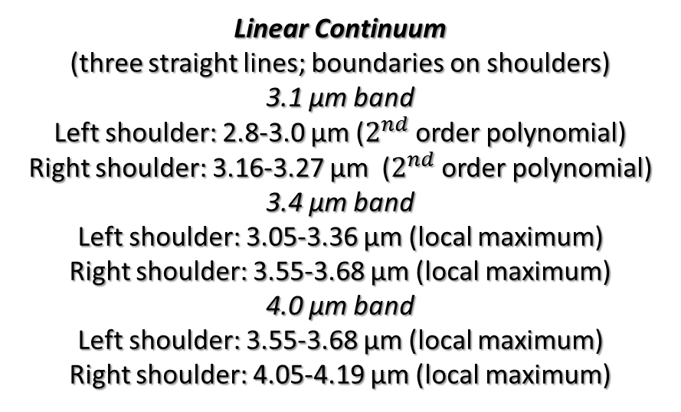
Linear Continuum
(three straight lines; boundaries on shoulders)
3.1 µm band
Left shoulder: 2.8-3.0 µm ($2^{nd}$ order polynomial)
Right shoulder: 3.16-3.27 µm ($2^{nd}$ order polynomial)
3.4 µm band
Left shoulder: 3.05-3.36 µm (local maximum)
Right shoulder: 3.55-3.68 µm (local maximum)
4.0 µm band
Left shoulder: 3.55-3.68 µm (local maximum)
Right shoulder: 4.05-4.19 µm (local maximum)
Continuum 1
($3^{rd}$ order polynomial curve)
Range 1: 2.85-3.0 µm
(local maximum)
Range 2: 3.17-3.25 µm
(local maximum)
Range 3: 3.65-3.69 µm
(local maximum)
Range 4: 4.0-4.3 µm
(local maximum)
Continuum 2
($2^{nd}$ order polynomial curve)
Range 1: 2.85-3.0 µm
(local maximum)
Range 3: 3.65-3.69 µm
(local maximum)
Range 4: 4.0-4.3 µm
(local maximum)

Slide 10
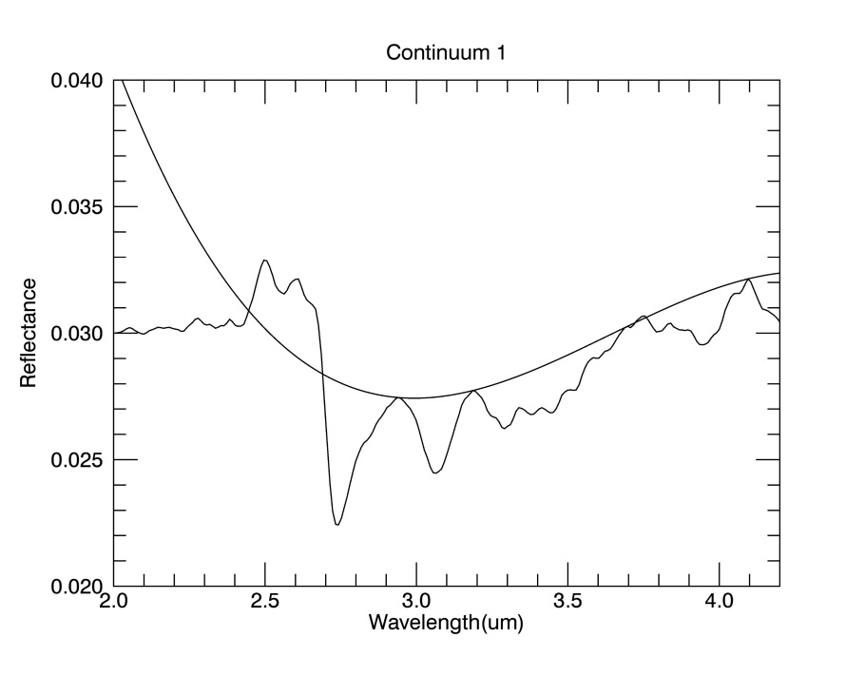
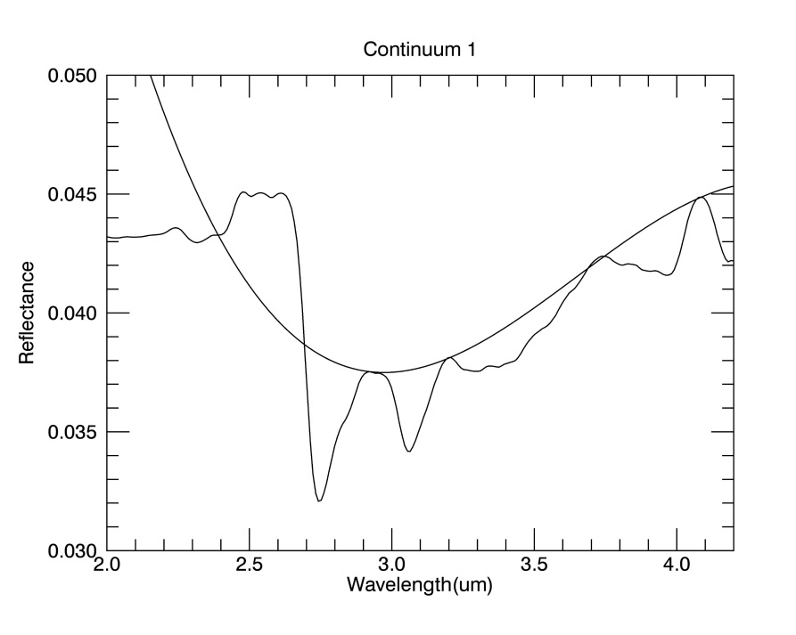

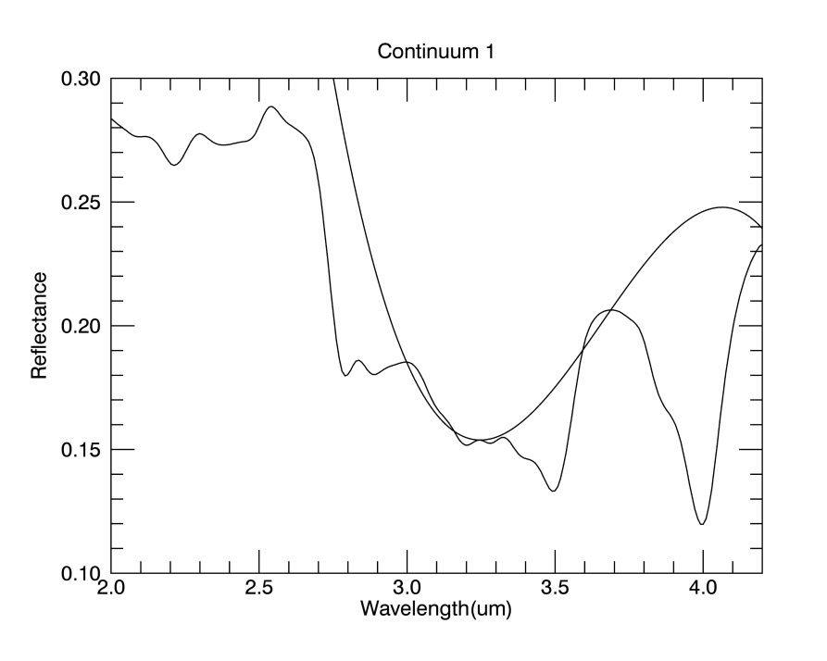
Continuum 1- HAMO phase
Dark region
Intermediate region
Pros
Bands: 3.1, 3.4 and 4.0 µm
Regions: Dark, Intermediate, Bright
Cons
Bands: 3.4 (convex curve);
4.0 (concave curve)
Regions: Occator BS
Bright region
Occator BS
Spectral parameters of Occator-BS spectra can be altered

Slide 11
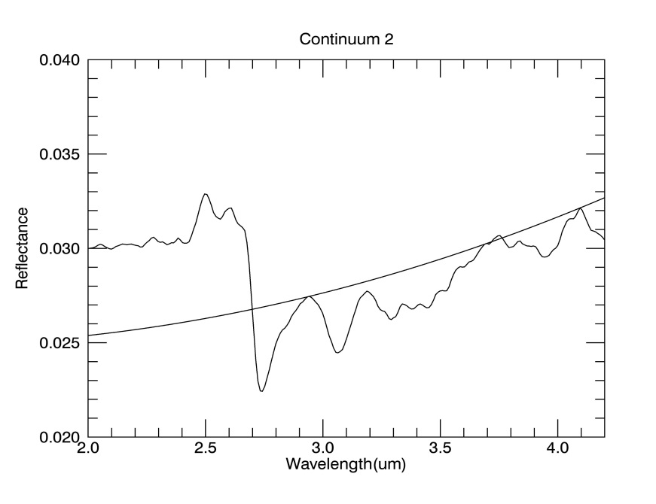
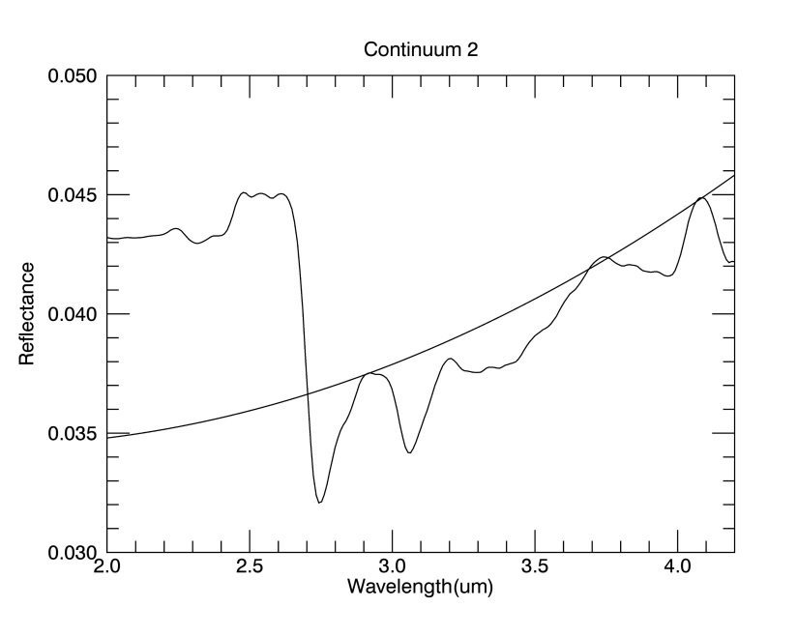

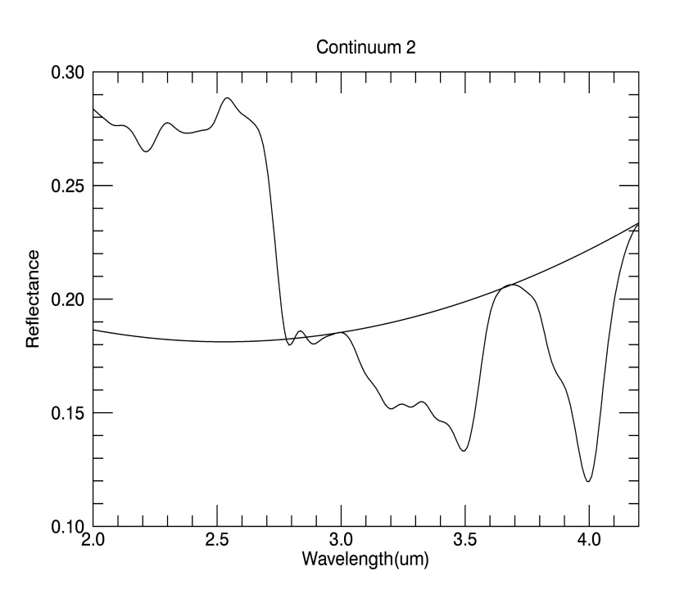
Continuum 2- HAMO phase
Pros
Bands: 4.0 µm/3.4 µm
Regions: all/Occator BS
Dark region
Intermediate region
Cons
Bands: 3.1 and 3.4 µm
Regions: Dark, Intermediate and Bright regions
Bands: 3.1 µm
Regions: Occator-BS
Bright region
Occator BS
3.1 and 3.4 µm band depth can be overestimated in dark, intermediate and bright regions and the 3.1 µm band is wrongly detected in Occator-BS spectra

Slide 12
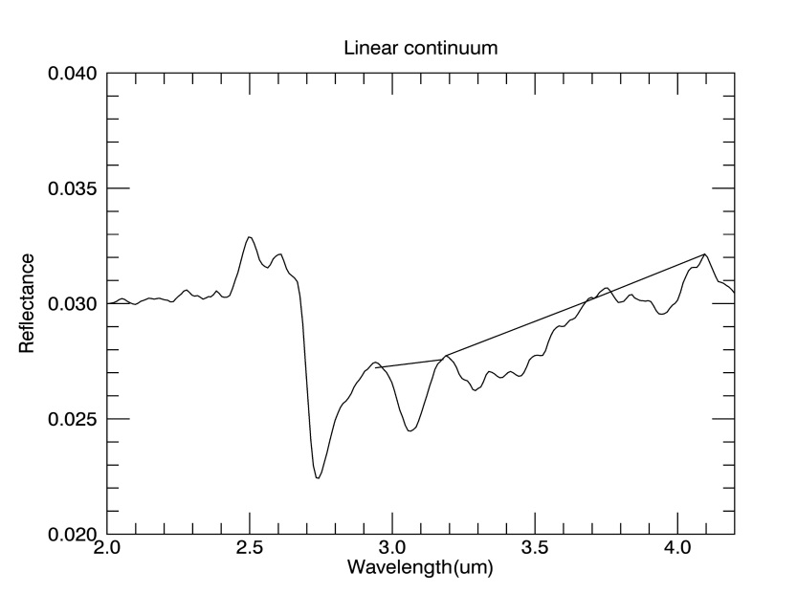
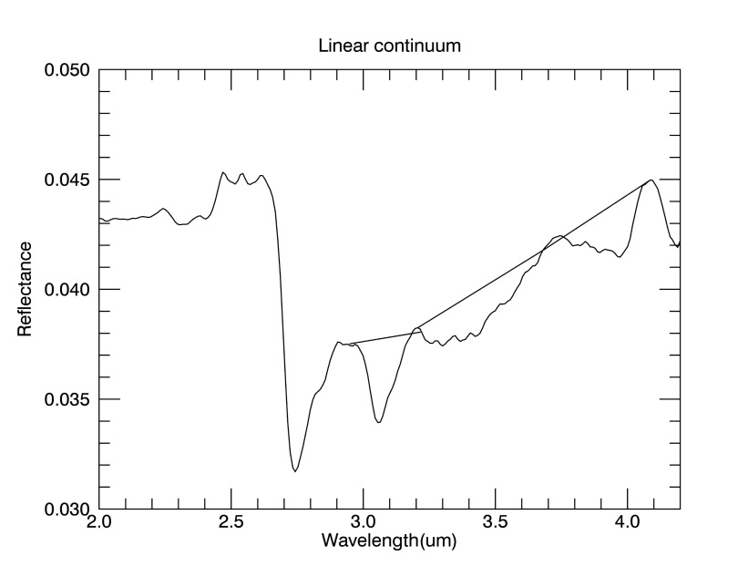
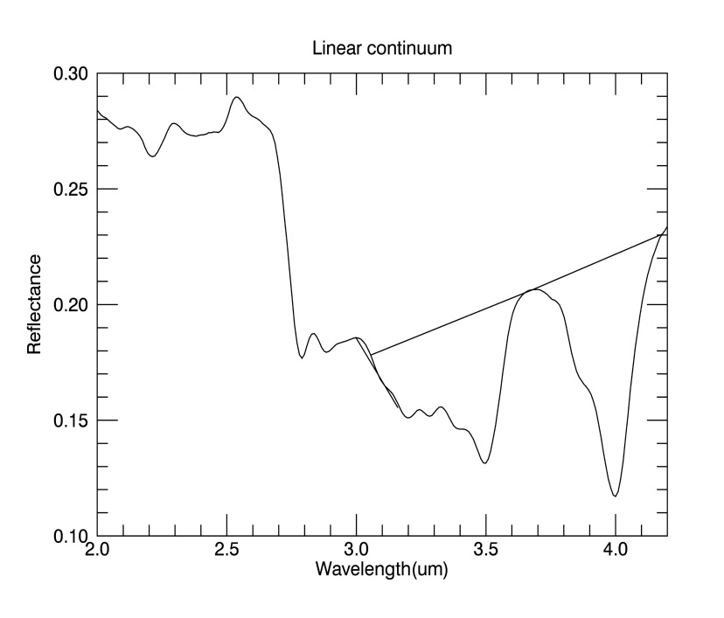
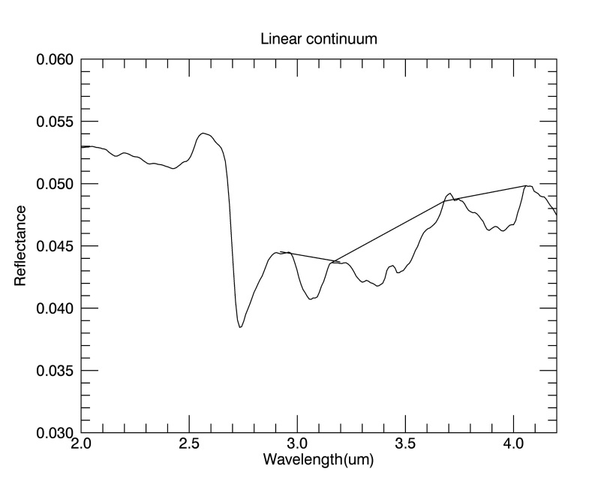
Linear Continuum- HAMO phase
Dark region
Intermediate region
Pros
Bands: lack of 3.1 µm
Regions: Occator-BS spectra
Bands: 3.1, 3.4, 4.0 µm
Regions: all
Bright region
Occator BS
The linear continuum is the most appropriate method to fit Ceres spectral behavior

Slide 13
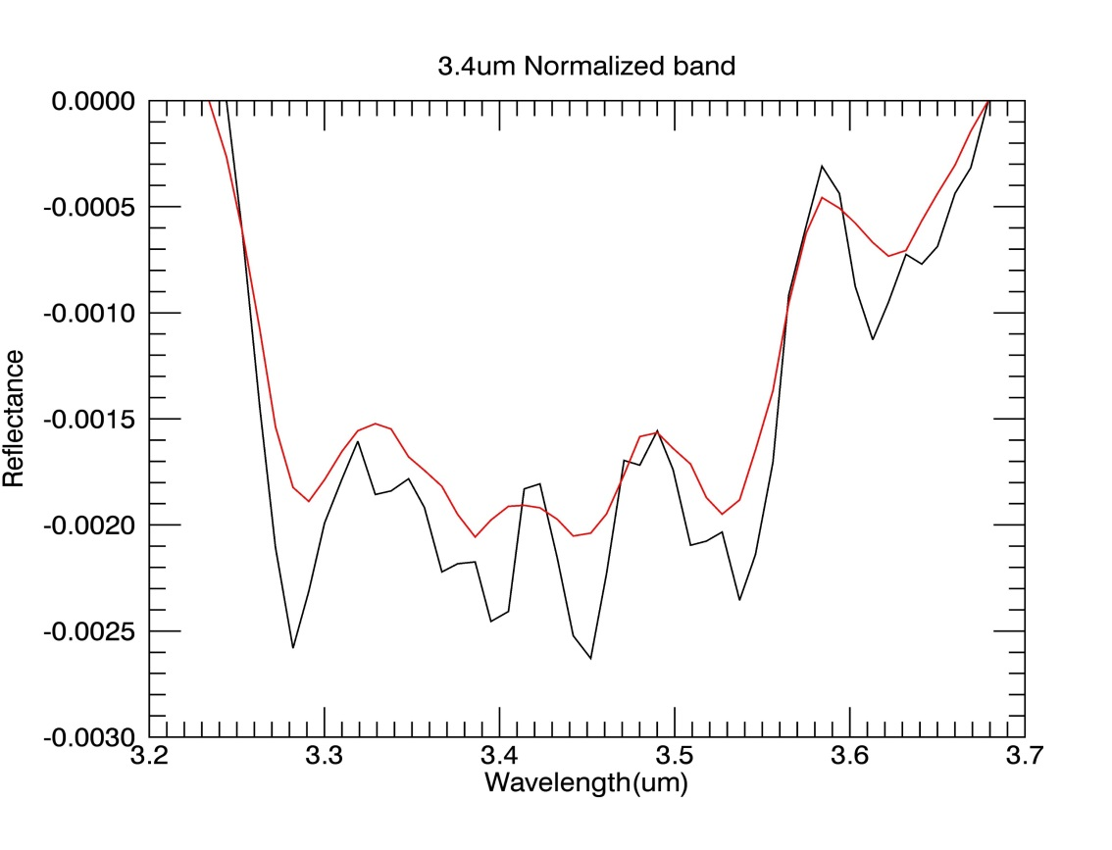
Effects of smoothing procedure on spectral parameters
Bright region (LAMO)
The smoothing procedure is applied on reflectance spectra to reduce noise in the signal
An alteration of spectra can be produced with respect to the unsmoothed spectra
Spectral parameters estimated on smoothed spectra can be different from those measured in unsmoothed spectra

Slide 14
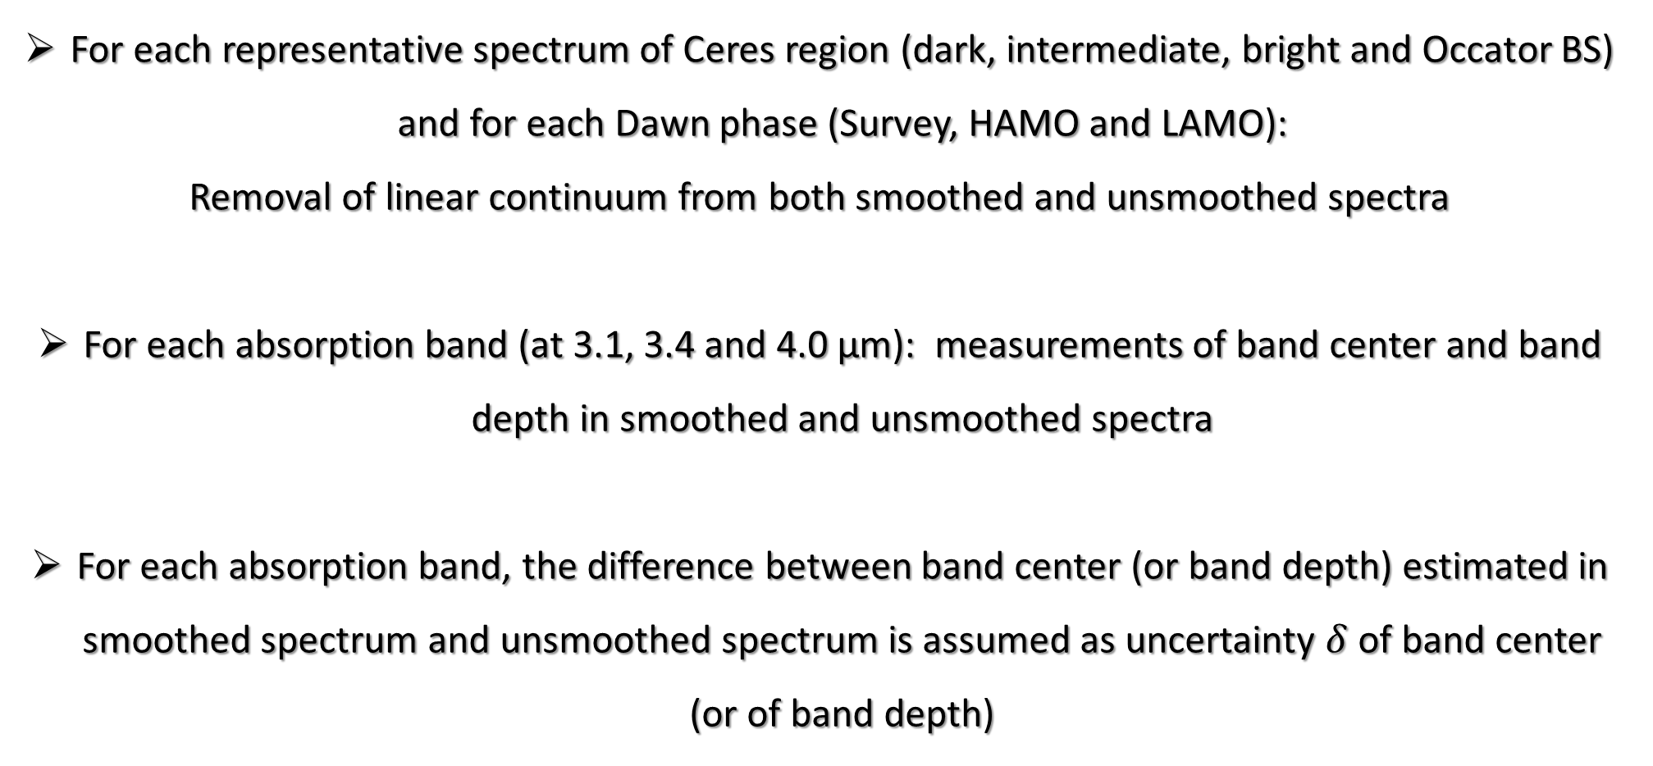
Error evaluation on spectral parameters
For each representative spectrum of Ceres region (dark, intermediate, bright and Occator BS) and for each Dawn phase (Survey, HAMO and LAMO):
Removal of linear continuum from both smoothed and unsmoothed spectra
For each absorption band (at 3.1, 3.4 and 4.0 µm): measurements of band center and band depth in smoothed and unsmoothed spectra
For each absorption band, the difference between band center (or band depth) estimated in smoothed spectrum and unsmoothed spectrum is assumed as uncertainty $δ$ of band center (or of band depth)

Slide 15
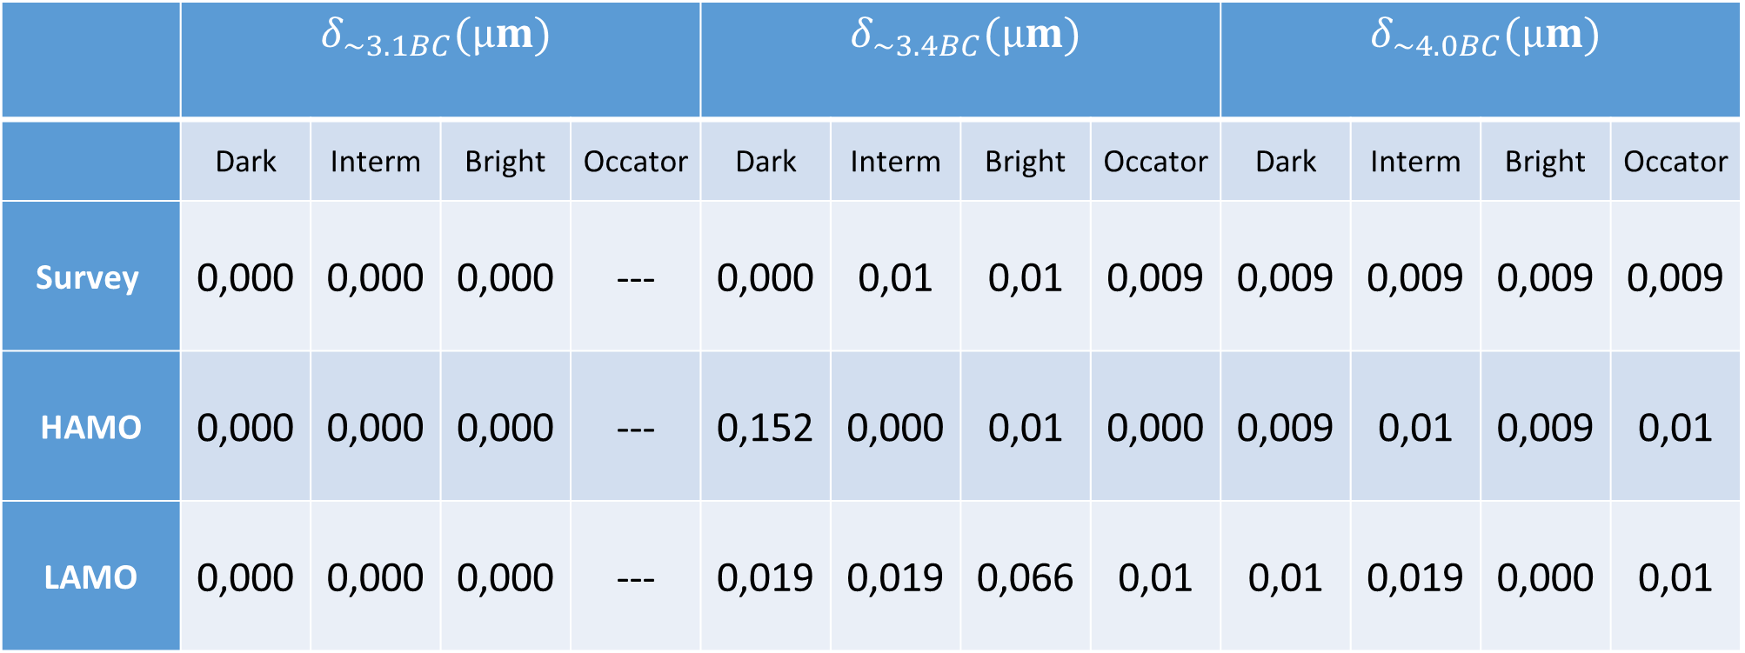
Error on band centers
 | $δ_{\sim 3.1BC}(µm)$ |  |  |  | $δ_{\sim 3.4BC}(µm)$ |  |  |  | $δ_{\sim 4.0BC}(µm)$
 | Dark | Interm | Bright | Occator | Dark | Interm | Bright | Occator | Dark | Interm | Bright | Occator
Survey | 0,000 | 0,000 | 0,000 | --- | 0,000 | 0,01 | 0,01 | 0,009 | 0,009 | 0,009 | 0,009 | 0,009
HAMO | 0,000 | 0,000 | 0,000 | --- | 0,152 | 0,000 | 0,01 | 0,000 | 0,009 | 0,01 | 0,009 | 0,01
LAMO | 0,000 | 0,000 | 0,000 | --- | 0,019 | 0,019 | 0,066 | 0,01 | 0,01 | 0,019 | 0,000 | 0,01

Slide 16
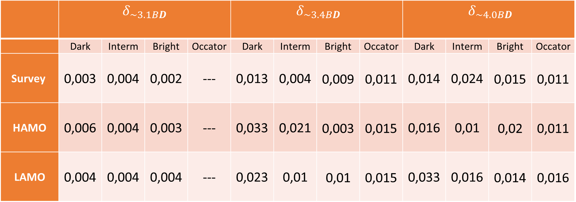
Error on band depths
 | $δ_{\sim 3.1BD}$ |  |  |  | $δ_{\sim 3.4BD}$ |  |  |  | $δ_{\sim 4.0BD}$
 | Dark | Interm | Bright | Occator | Dark | Interm | Bright | Occator | Dark | Interm | Bright | Occator
Survey | 0,003 | 0,004 | 0,002 | --- | 0,013 | 0,004 | 0,009 | 0,011 | 0,014 | 0,024 | 0,015 | 0,011
HAMO | 0,006 | 0,004 | 0,003 | --- | 0,033 | 0,021 | 0,003 | 0,015 | 0,016 | 0,01 | 0,02 | 0,011
LAMO | 0,004 | 0,004 | 0,004 | --- | 0,023 | 0,01 | 0,01 | 0,015 | 0,033 | 0,016 | 0,014 | 0,016

Slide 17
Results on method for continuum removal
The linear continuum is the most suitable method to fit the spectral continuum of 3.1, 3.4 and 4.0 µm absorption bands in spectra of different Ceres regions.
The uncertainties on spectral parameters are independent of the spacecraft phases.
The errors on band center are independent of the Ceres regions.
The band depths are mainly affected by error in dark regions, because of low S/N.
In Occator and bright regions, uncertainties on band depths are smaller for high S/N.

