Slide 1
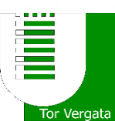
Spectral analysis of crater central peak material (ccp) on Ceres
A. Galiano^{1,2}, E. Palomba^{1,3}, A. Longobardo¹, M.C. De Sanctis¹, F.G. Carrozzo¹, A. Raponi¹, F. Tosi¹ , E. Ammannito⁴, C.A. Raymond⁵, C.T. Russell⁶ and the VIR team
¹INAF-IAPS, Rome, Italy
²Università degli Studi di Roma Tor Vergata, Rome, Italy
³ASDC-ASI, Rome, Italy
⁴ASI-URS, Rome, Italy
⁵JPL, California Inst. Tech, Pasadena, CA, USA
⁶UCLA, Los Angeles, CA, USA

Slide 2
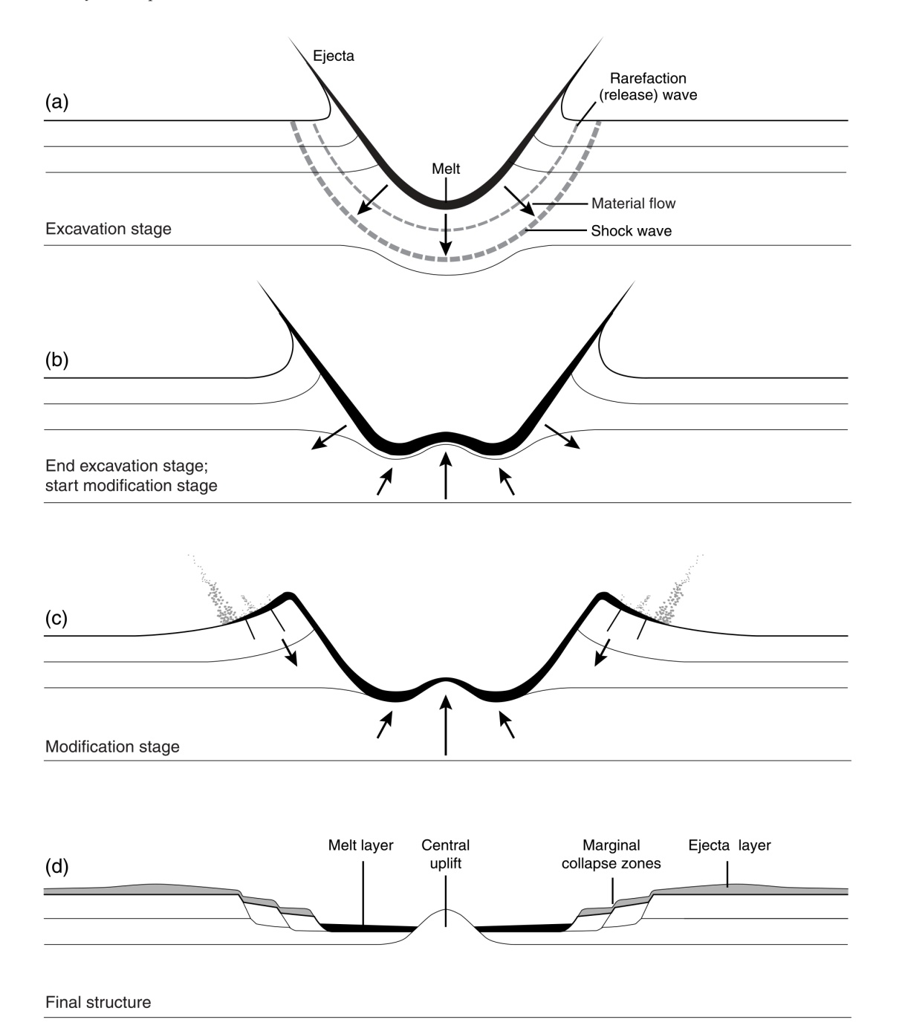
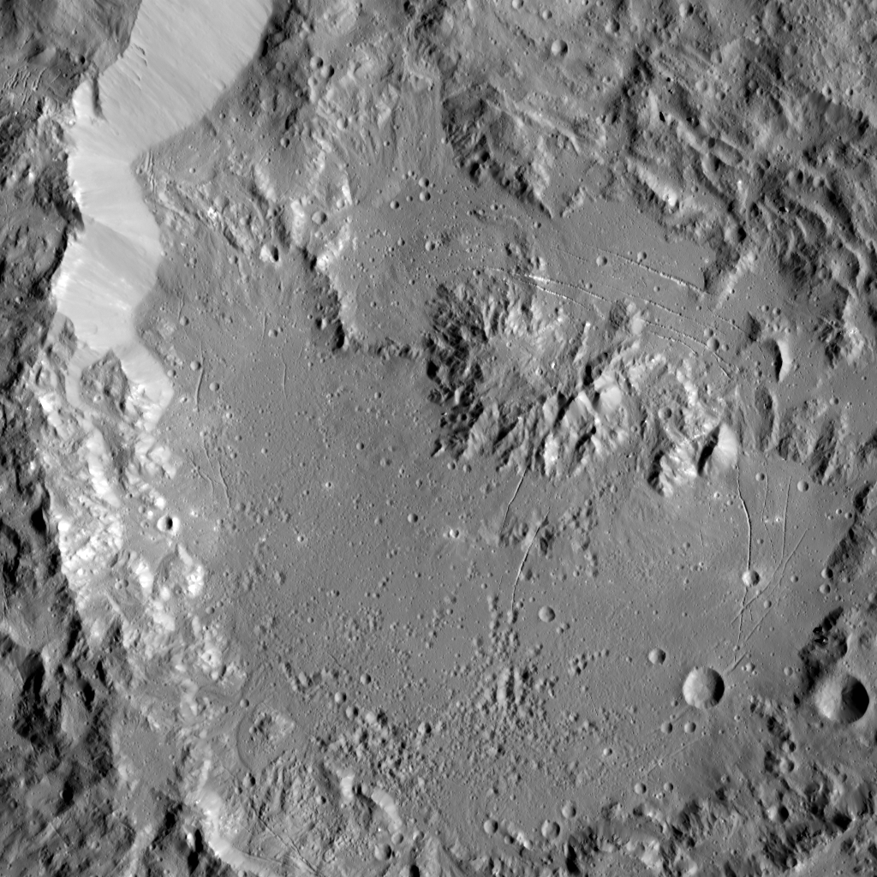
Complex craters
Central uplift
Flat floor
Inward collapse around the rim
CCP
material of central uplift of complex craters
fresher material coming from the subsurface as a consequence of the impact
Complex craters formation
Large impact events release enough energy to overcome fundamental strengths of rock beneath transient cavity
Low shock-wave pressures, rarely producing melted or shocked material
Interactions between shock wave effects, gravity and rock’s properties
Large volume of rock beneath central part of transient cavity rises to form central uplif
Ikapati
French, B. M. (1998)
Notes:
L’elevazione è circa 1/10 del diametro finale

Slide 3
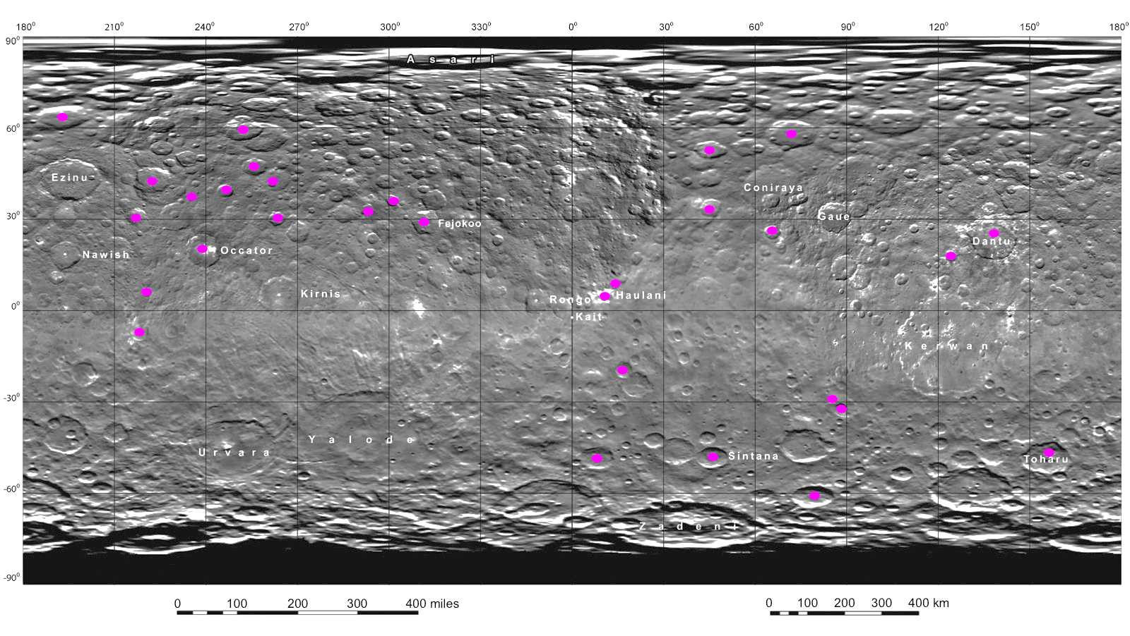
Distribution of CCP on Ceres surface
Name-Feature | Quadrangle | Diameter (km) | Lat | Lon
CCP1 | Ezinu |  | 62,8/64,23 | 192/196
Datan | Ezinu | 60 | 59,5/60 | 250,8/253
Omonga | Coniraya | 77 | 57,63/58,83 | 70,02/74,35
Ernutet | Coniraya | 53,4 | 52,07/53,6 | 43,9/46,2
CCP5 | Ezinu |  | 46,76/48,34 | 254,9/256,8
Kaikara | Ezinu | 72 | 41,48/43,77 | 221,8/224,47
CCP7 | Ezinu |  | 41,4/42,05 | 261,5/262,2
CCP8 | Ezinu |  | 38,6/40,77 | 245,7/247,5
CCP9 | Ezinu |  | 36,65/37,09 | 234,56/235,49
Victa | Fejokoo | 32 | 35,6/36,3 | 301,2/302,16
Ikapati | Coniraya | 50 | 32,9/34,3 | 44,2/46,2
Abellio | Fejokoo | 32 | 32,6/33,7 | 292,8/293,5
CCP13 | Ezinu |  | 30,5/31,64 | 216,04/217,5
Ninsar | Ezinu | 40 | 29/30,6 | 262,6/264,5
Fejokoo | Fejokoo | 68 | 28/30 | 310/312,7
Achita | Coniraya | 40 | 25,03/26,5 | 65,27/66,3
Dantu | Dantu | 170 | 23,46/26 | 136,88/140,18
Occator | Occator | 92 | 19,11/20,13 | 237,49/238,61
CCP19 | Kerwan |  | 17,35/18,87 | 124/125,4
CCP20 | Haulani |  | 8,06/9,06 | 13,9/14,4
Nepen | Occator | 26,4 | 5,89/6,47 | 220,1/221,14
Haulani | Haulani | 34 | 5,37/6,24 | 10,05/11,41
Azacca | Occator | 49,91 | -6,95/-6 | 217,73/219,35
Kondos | Haulani | 44 | -20,19/-19,11 | 16/17,8
CCP25 | Sintana |  | -29,15/-28,39 | 85,02/85,77
Tupo | Sintana | 36 | -32,57/-31,4 | 87,37/88,8
Annona | Sintana | 60 | -48,94/-47 | 7,21/9,89
Toharu | Toharu |  | -49,4/-47,4 | 154,3/159,2
Sintana | Sintana | 58 | -49,61/-48,29 | 46,07/47
Hamori | Sintana | 60 | -61,3/-60,2 | 77,04/81,06
Diameters of complex craters span from 26,4 km (Nepen) to 170 km (Dantu)

Slide 4
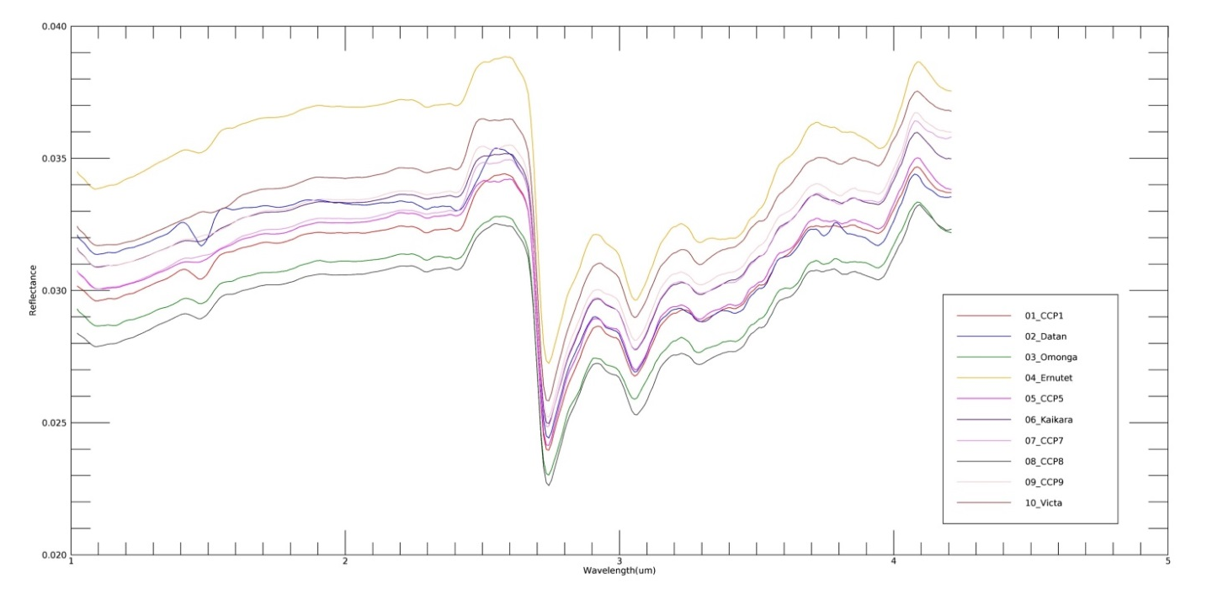
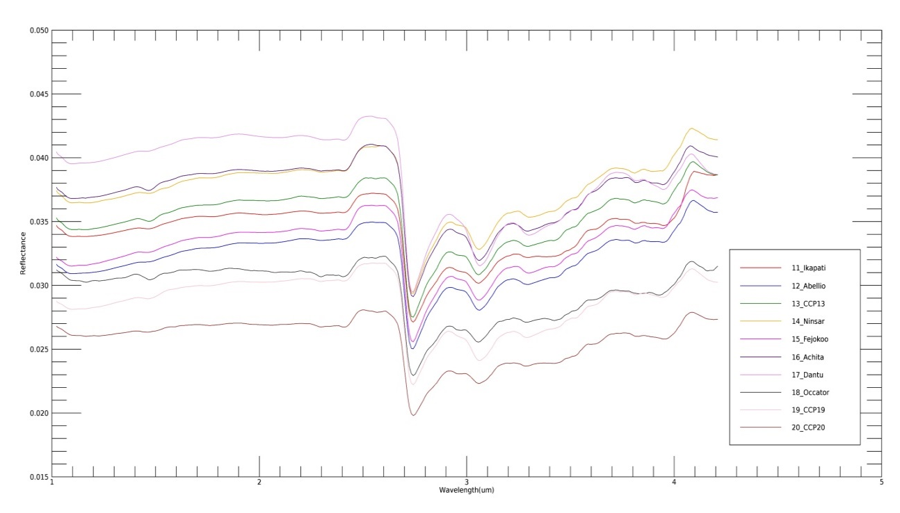
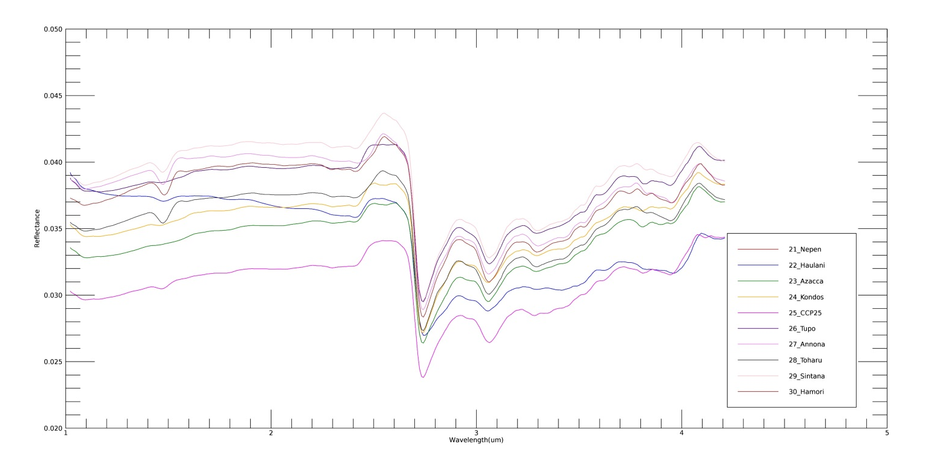
Absorption bands in ccps mean spectra
2.7 µm (Mg-phyllosilicates)
3.1 µm (NH₄-phyllosilicates)
3.4 µm (mainly carbonates)
4.0 µm (carbonates)
Haulani: bluer slope
The largest spectral difference is exposed in Haulani ccp

Slide 5
Method applied to retrieve spectral parameters on ccps
Delimitation of ccp region
Isolation of bands by applying a linear continuum method (Galiano, A. et al., SB9 session)
Adoption of polynomial curves to fit the 3.1 and 3.4 µm absorption bands
Evaluations of 2.7, 3.1 and 3.4 µm band centers and band depths as mean values of reflectance spectra included in the ccp region
Evaluation of slope as mean value of reflectance spectra included in the ccp region
Polynomial curve not suitable to fit 4.0 µm absorption band: spectral parameters retrieved by mean spectra
BC= wavelength with the minimum reflectance/fitted value
BD=1-R_{b}/R_{c}
(photometrically corrected at 0° by Longobardo, A. et al., SB5 session)
Slope estimated between 1.2 and 1.9 µm
(photometrically corrected at 0° by Longobardo, A. et al., SB5 session)

Slide 6
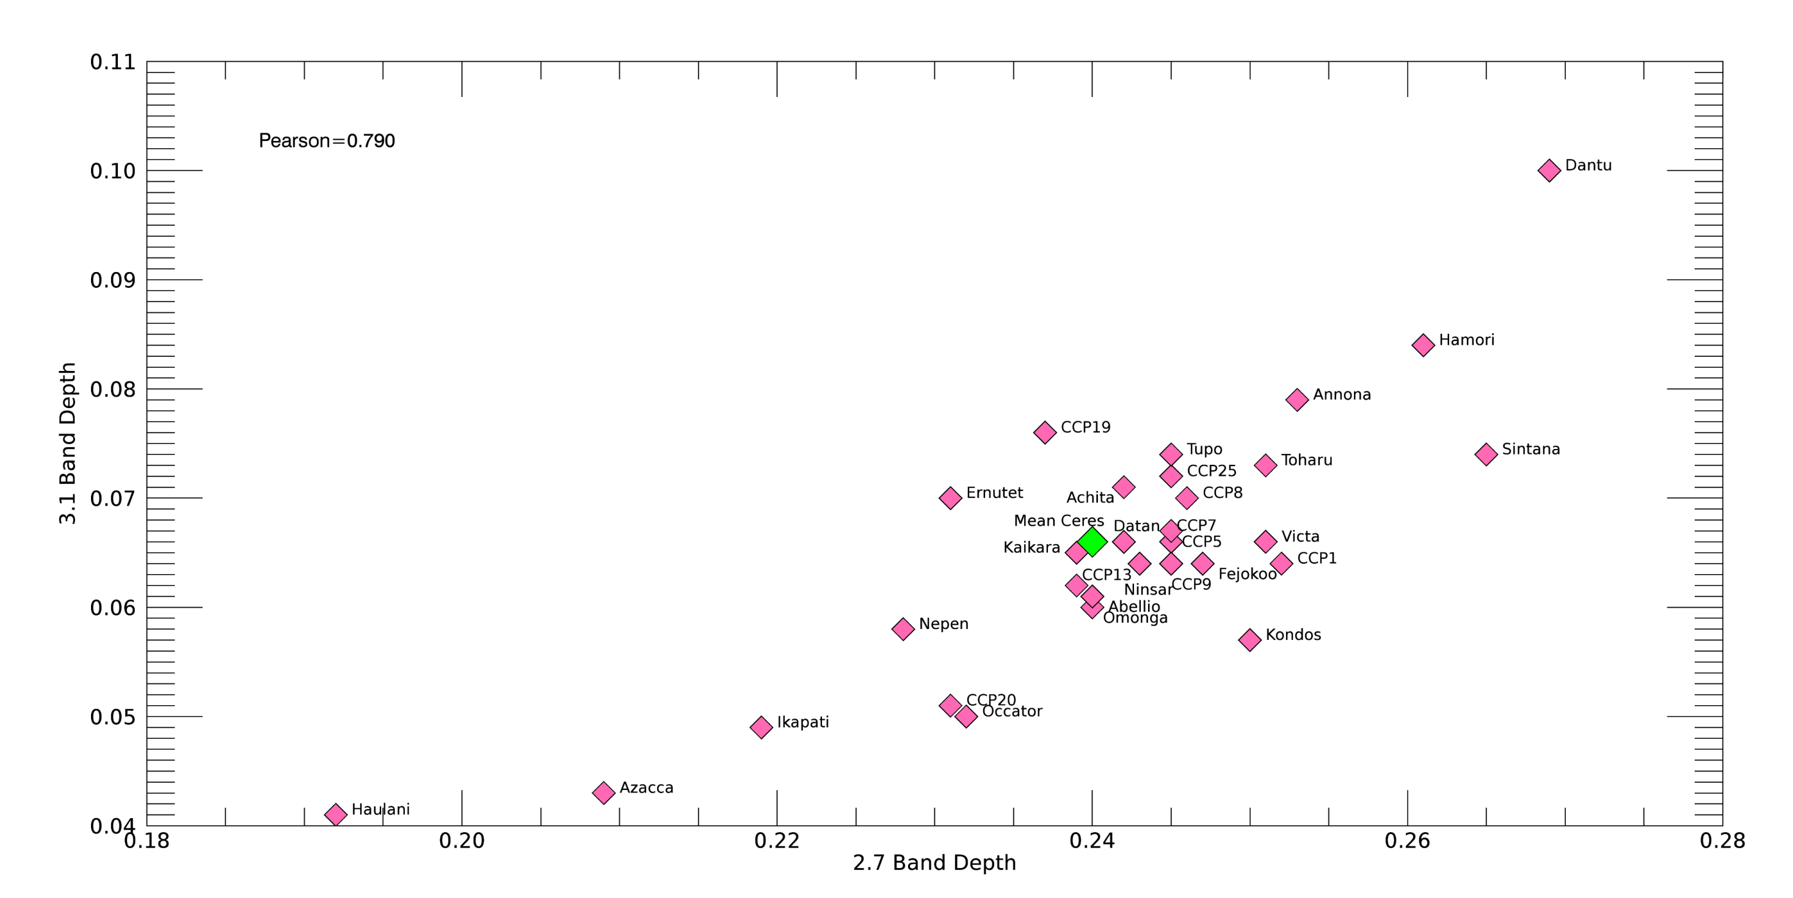
NH₄-phyllosilicates vs Mg-phyllosilicates
Lies on ejecta of a previous impact, riches in phyllosilicates
Uncertainties on band depths are 0.01
Correlation
Poor phyllosilicates sources in the subsurface

Slide 7
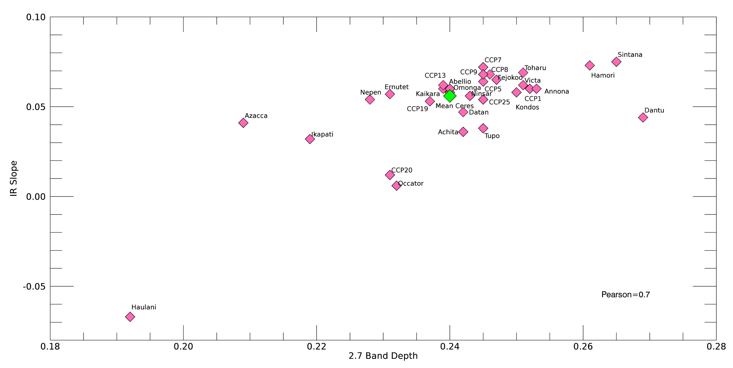
IR Slope vs Mg-phyllosilicates
Correlation
Space weathering produces a redder spectral slope
Bluer slope of Haulani is probably related to younger age or to differences in composition
2.7 µm band depth increases with IR slope, i.e. space weathering
Phyllosilicates exposition
Decreasing in grain size of dark material
Uncertainties on
IR Slope= 0.03
2.7 µm bd=0.01

Slide 8
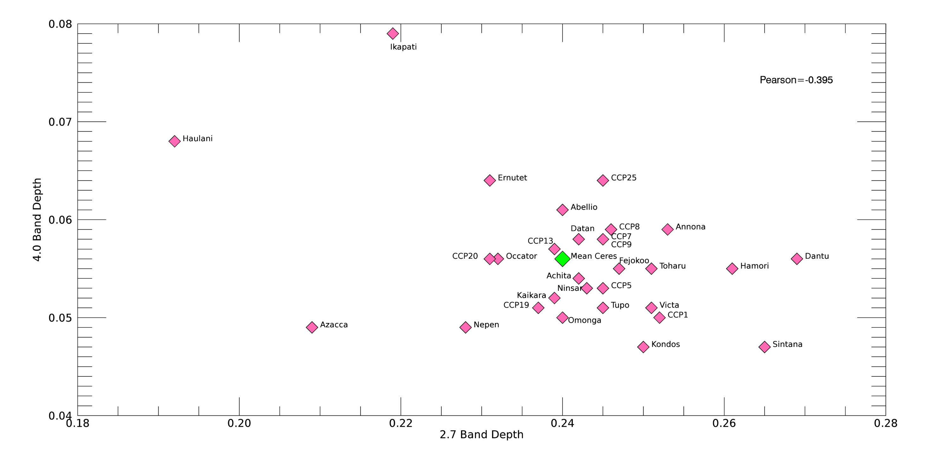
Carbonates (4.0 µm band) vs Mg-phyllosilicates
Na-carbonates
Moderate anti-correlation
Uncertainties on
2.7 µm bd are 0.01
Deeper band depth of Haulani and Ikapati can be explained with a different carbonate
Mg/Ca-carbonates

Slide 9
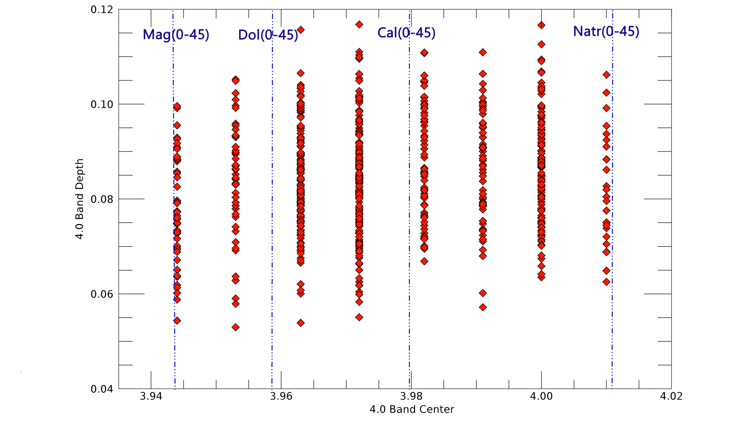
Ikapati ccp- 4.0 µm spectral parameters
Na-carbonates as pure mineral or in mixtures
Notes:
Pixel che compongono il ccp di Ikapati

Slide 10
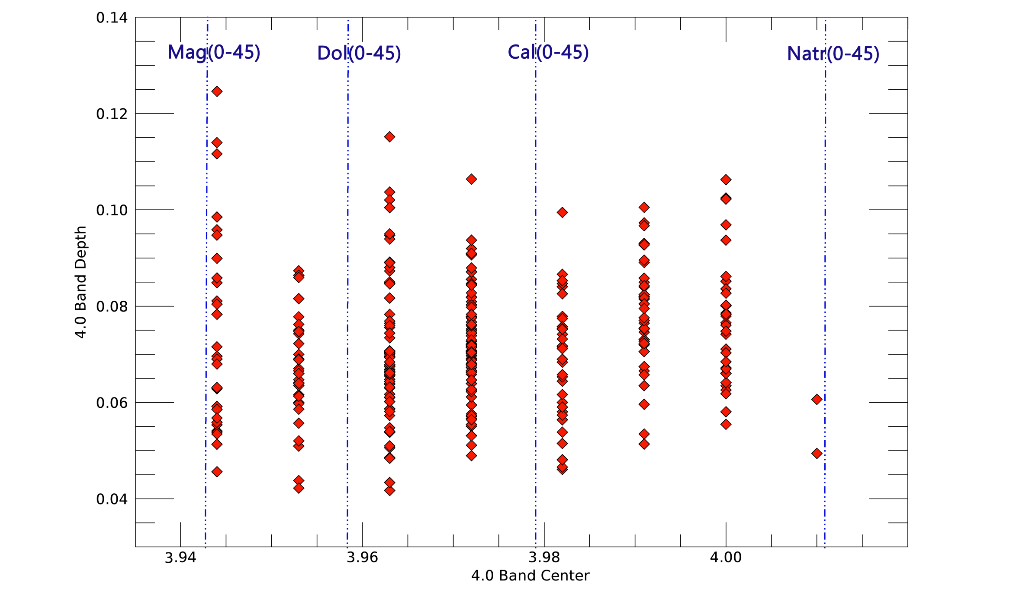
Haulani ccp- 4.0 µm spectral parameters
Na- carbonates in mixtures
Notes:
Pixel che compongono il ccp di Haulani

Slide 11
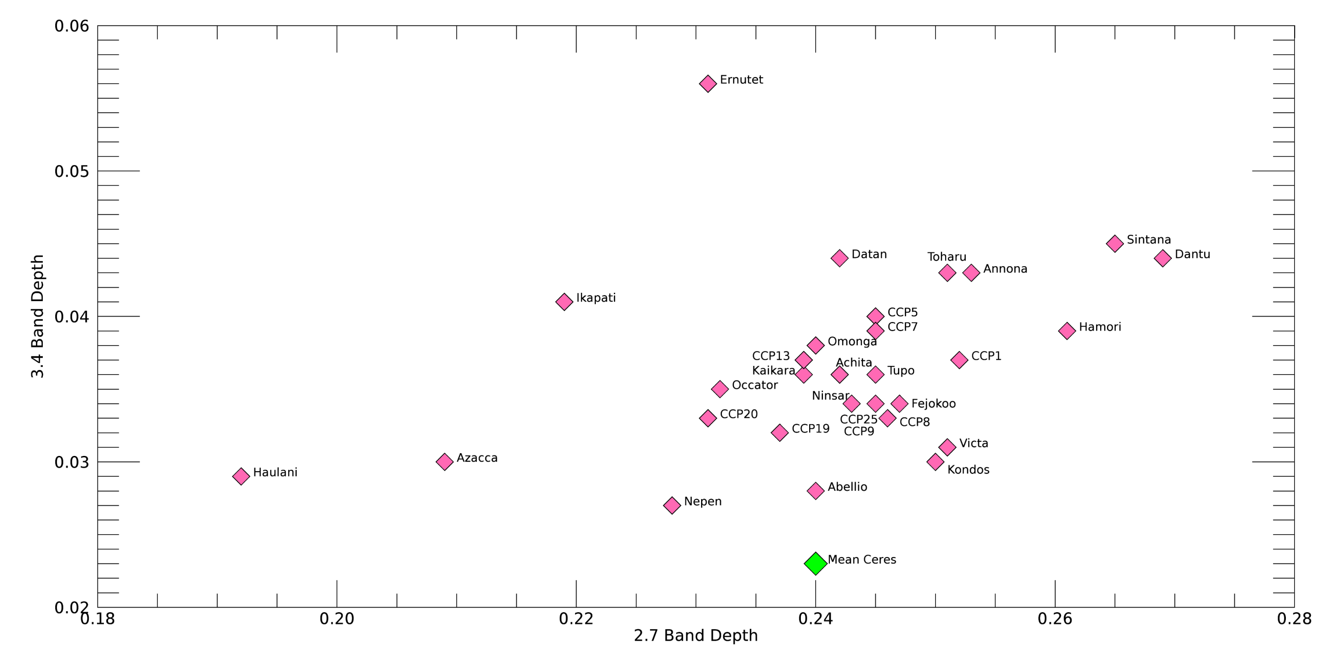
Carbonates (3.4 µm band) vs Mg-phyllosilicates
Occurrence of organics
Correlation
Uncertainties on
band depths are 0.01
Pearson=0.507

Slide 12
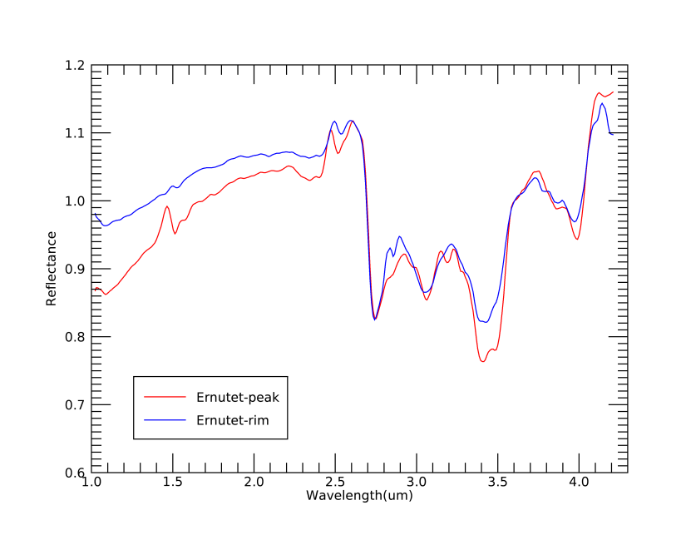
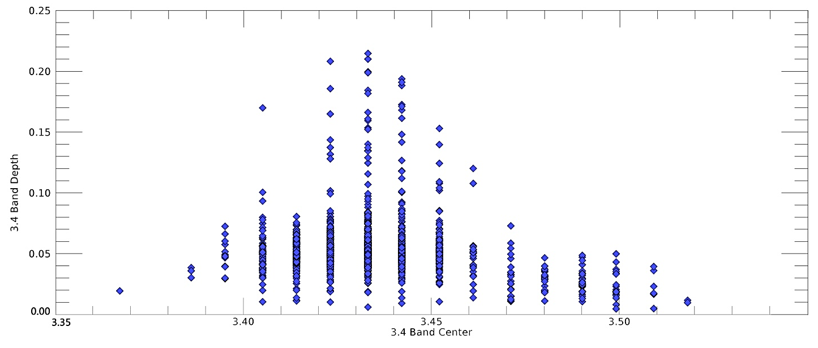
Ernutet ccp- 3.4 µm spectral parameters
Organics in the ccp are less abundant than in the floor and in the BS
Ernutet floor (organics-rich)
Ernutet BS (organics-rich)
Ernutet CCP
(organics-rich)
Notes:
Pixel che compongono il ccp di Ernutet

Slide 13
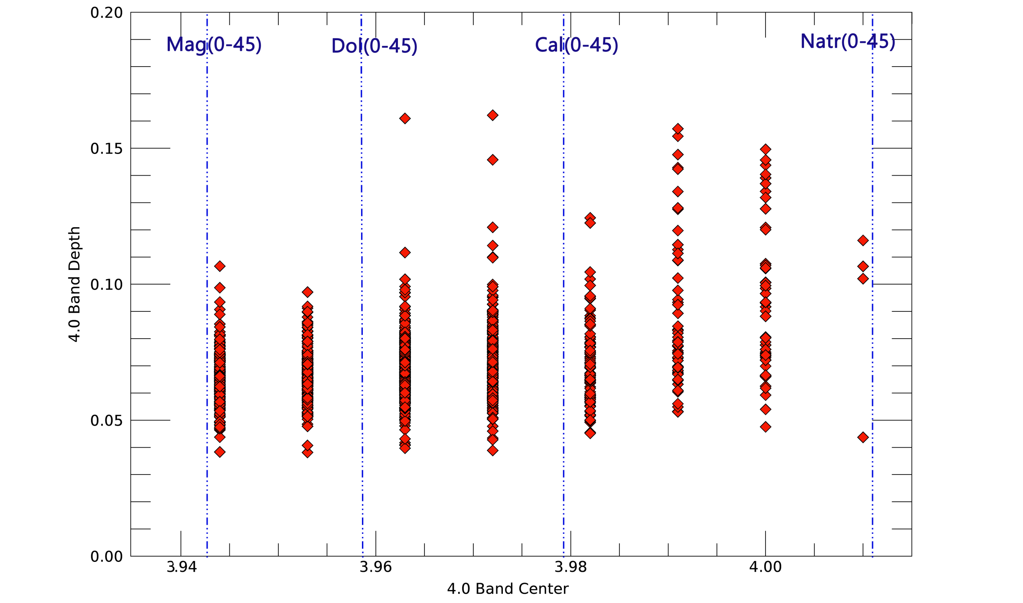
Ernutet ccp- 4.0 µm spectral parameters
Mixture of Ca/Mg- and Na- carbonates
Notes:
Pixel che compongono il ccp di Ernutet

Slide 14
Results
Ccps are composed by Mg-phyllosilicates, NH₄-phyllosilicates, dark material and carbonates
Haulani and Ikapati ccp (young features) are composed by mixture of Na- and Mg/Ca- carbonates and Mean Ceres material
Pure Na-carbonate can occurr on Ikapati ccp
One of the oldest ccp, Ernutet, is composed by organics and mixture of Na- and Mg/Ca- carbonates and Mean Ceres material
Organics in Ernutet ccp are less abundant with respect to Ernutet floor and Ernutet BS
Variation in 2.7 and 3.1 µm band depth can be related to heterogeneity of phyllosilicates sources in the subsurface
Na-carbonates or mixtures of Na- and Ca/Mg- carbonates occurrence seems to be not connected with age: heterogeneity of Na-carbonates sources in the subsurface or particular process during crater formation
Space weathering may increase 2.7 µm band depth of ccps: exposition of poor Mg-phyllosilcates rocks in the surface or decreasing of dark material grain size

