Slide 1
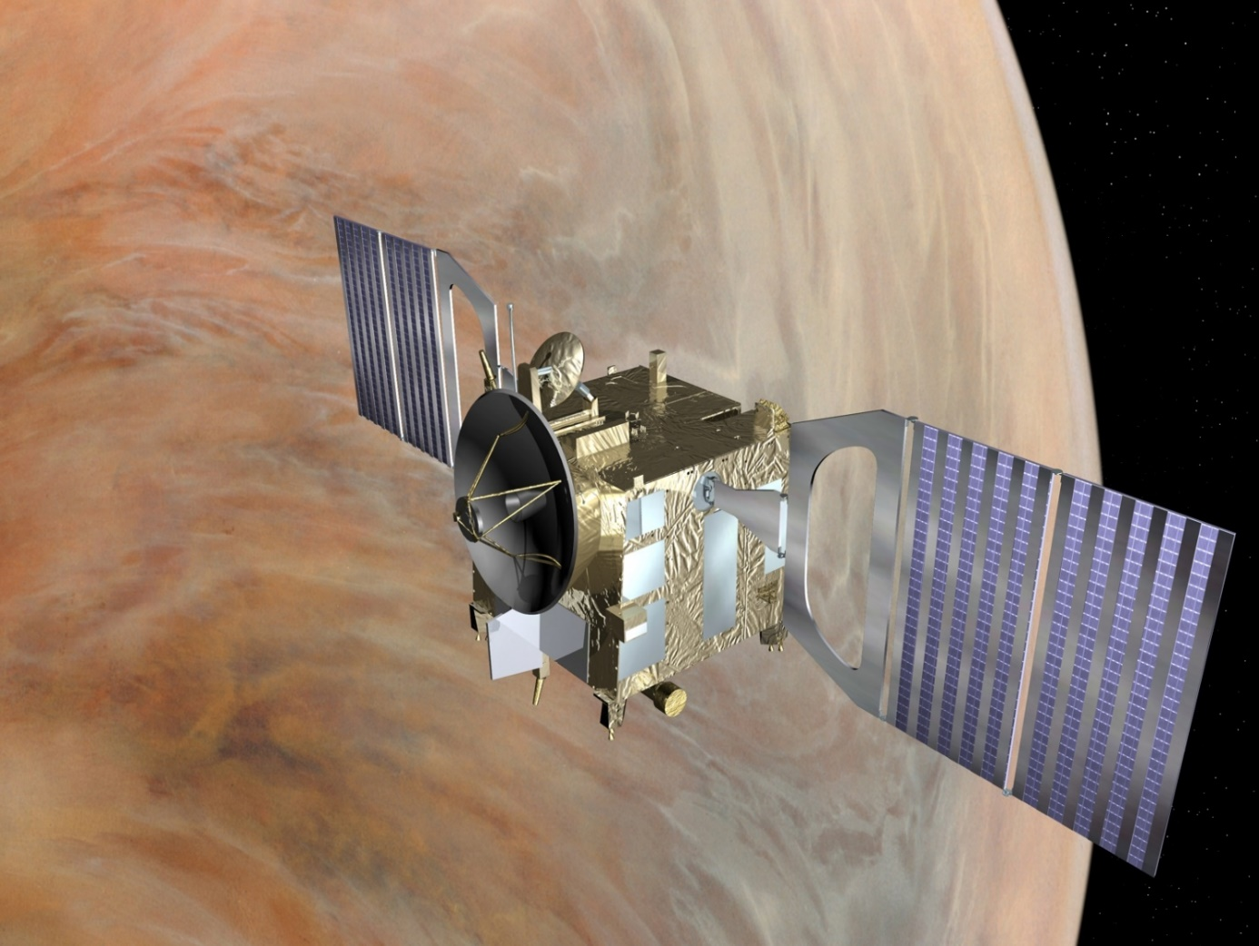
Venus Express as precursor of the Venus Decade
C. Wilson,
D. Titov,
A.G. Straume

Slide 3
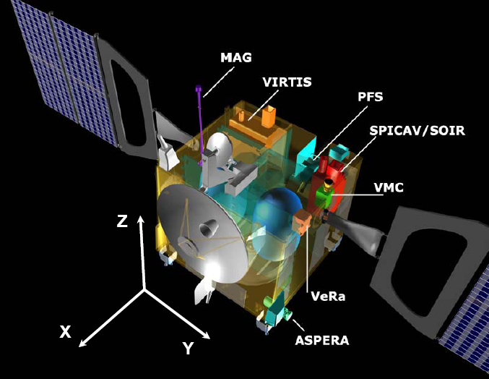
Venus Express payload
VIRTIS: UV-vis-near IR imaging and high resolution spectrometer
SPICAV / SOIR: UV & IR spectrometer for solar/stellar occultations and nadir observations
VMC: Venus Monitoring Camera
( PFS: Planetary Fourier Spectrometer )
VeRa: Radio science experiment
ASPERA: Analyzer of Space Plasmas and Energetic Atoms
MAG: Magnetometer

Slide 4
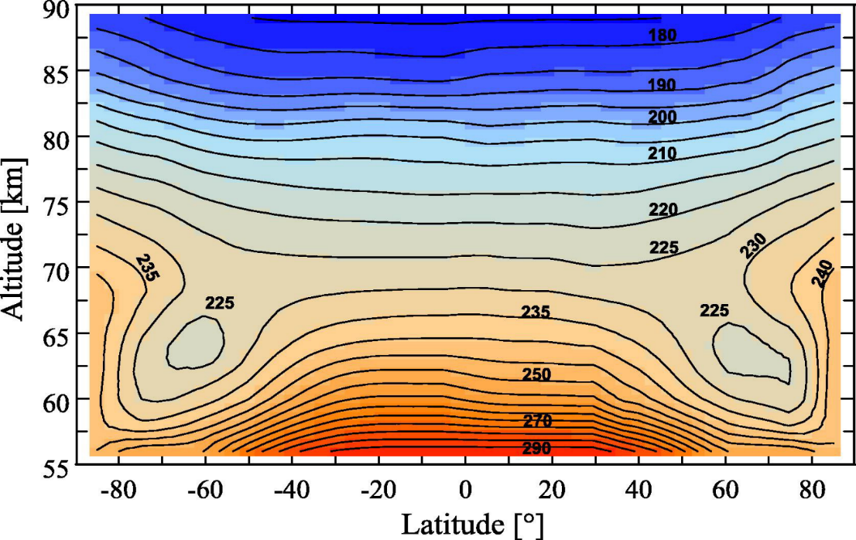
Temperature structure
86
Altitude, km
76
Cloud
65
50
Tellmann et al., 2009 , Haus et al., 2014
Notes:
Fig. 5 Average temperature latitude-altitude cross section in the Venus nighttime hemisphere,
as derived from analysis of the VIRTIS-M dataset. (From Haus et al. 2014)

Slide 5
Stability of the atmosphere
Convection
Turbulence
Stable condition
Piccialli et al, 2011
Notes:
5
Fig. 15. Latitude–height cross section of Richardson number (Eq. (6)). Dotted line follows the approximate altitude of cloud top (Ignatiev et al., 2009).
The Richardson number is an important stability parameter and
it is used to indicate dynamic stability and the formation of turbulence.
It is defined as the ratio of the static stability and the squared
vertical wind shear (Gierasch et al., 1997):
If the boundary layer is unstable (numerator of Eq. (6) is negative), then Ri < 0 and turbulence is sustained by convection.
For stable conditions (numerator is positive) Ri will be greater then zero. Small values of Ri could be an indication of the
formation of turbulence. From the VeRa temperature structure
T(z,/) and corresponding balanced wind field U(z,/) we studied distribution
of the Richardson number in the Venus mesosphere.
Fig. 15 displays meridional cross section of the Richardson number. Note that the calculation of Ri requires the first derivative of a
smoothed temperature and wind field: both the stability and the squared vertical wind shear were smoothed twice over 5 latitude
intervals; therefore, only gross features should be taken in account.
The uncertainty in the Richardson number due to measurement uncertainties is hard to define quantitatively. An approach similar
to that applied to determine uncertainty on zonal wind speed has
been followed. An uncertainty of about 1–5 has been found in the
altitude range 50–60 km. It is possible to observe a layer where Ri
has low values centred at 54 km altitude. This nearly adiabatic
middle cloud layer terminates near 60 km altitude, where Ri increases
rapidly with altitude. Between 60 and 70 km altitude Ri
reaches very large values, this level is characterised by a larger static
stability and it corresponds also to the jet core in the vertical
profile of the derived thermal wind, where @u/@z?0, producing
therefore a large Richardson number. Thus, this region is characterised
by high stability. A similar trend has been observed from
Pioneer Venus radio occultation (Allison et al., 1994). In Fig. 15 is
also shown approximately the UV cloud top altitude as derived
by Ignatiev et al. (2009). Interestingly, the bottom boundary between
layers of low and high values of Ri seems to follow the same
behaviour of the latitudinal profile of the cloud top.

Slide 6
Atmospheric composition

Slide 7
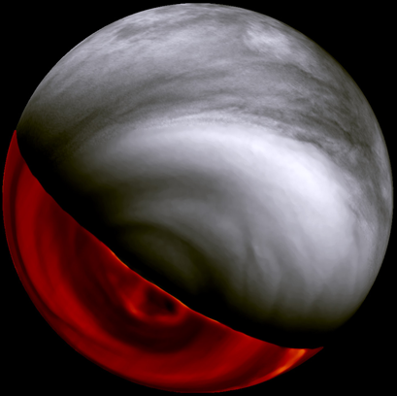
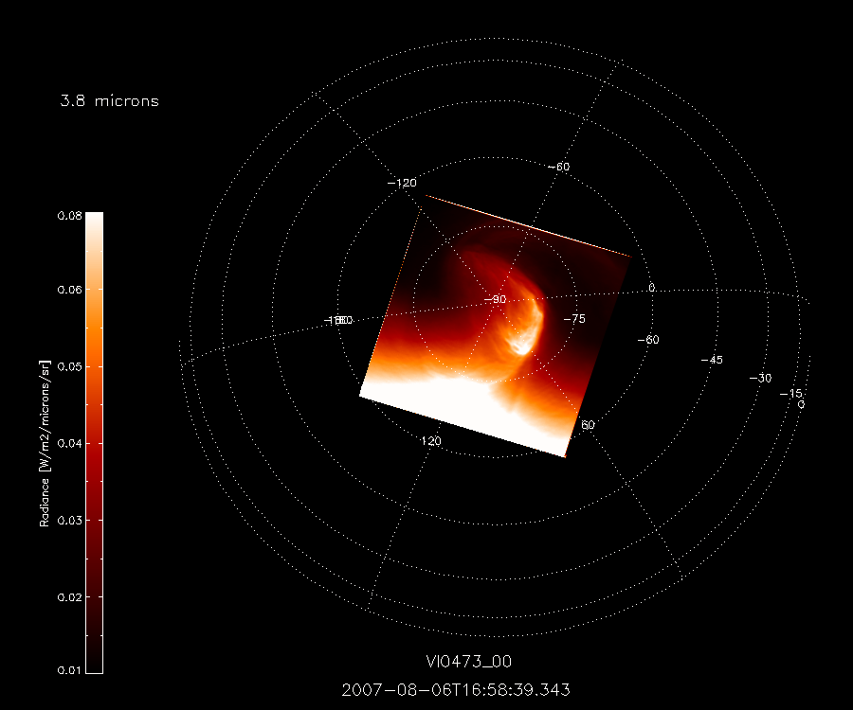
Cloud structure and morphology
0.365 µm
S
1.7 µm
Titov et al., 2012

Slide 8
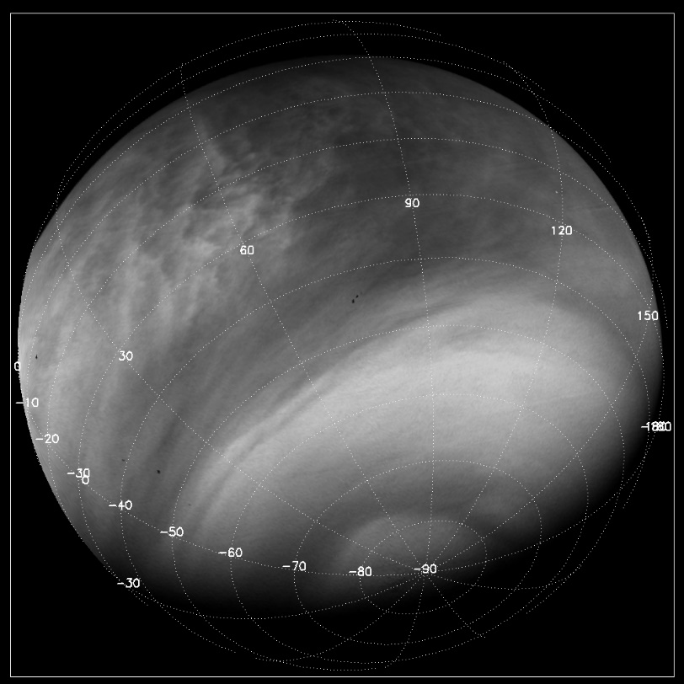
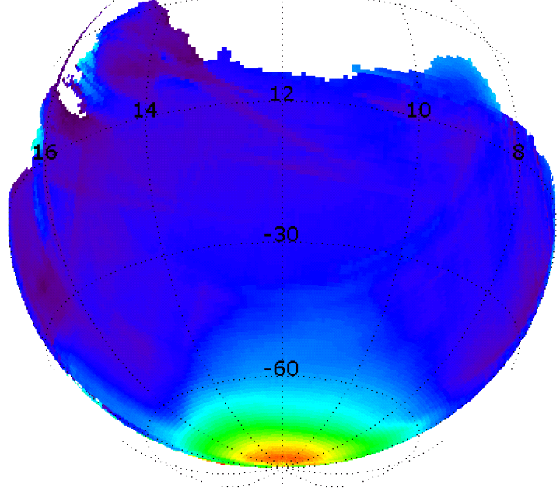
Cloud top altimetry
74 +/- 1 km
66 +/- 3 km
Global polar depression (5-10 km)
Aerosol scale height: 4-5 km → 1 km at the pole
Ignatiev et al., 2009

Slide 9
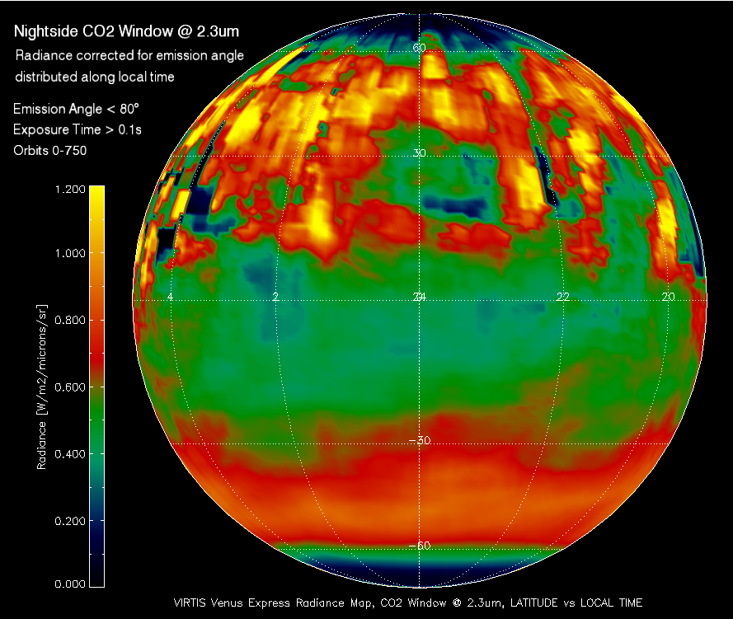
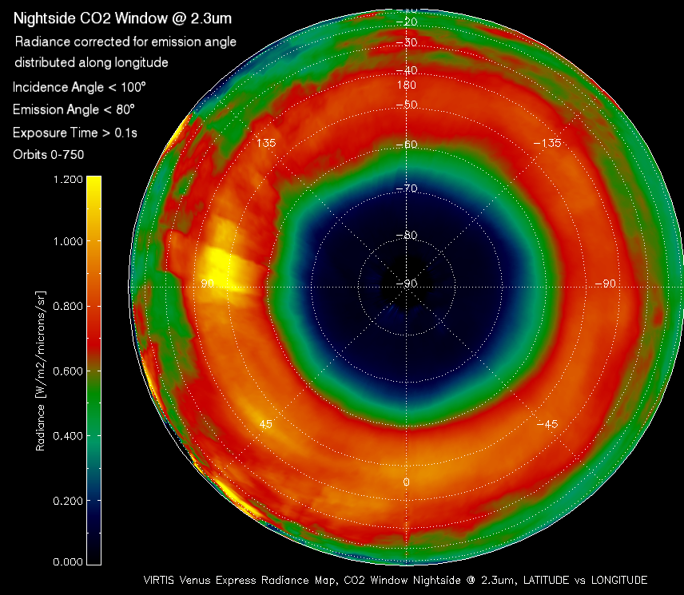
Deep cloud structure
Night side emission at 2.3 µm
Cardesin , 2010

Slide 10
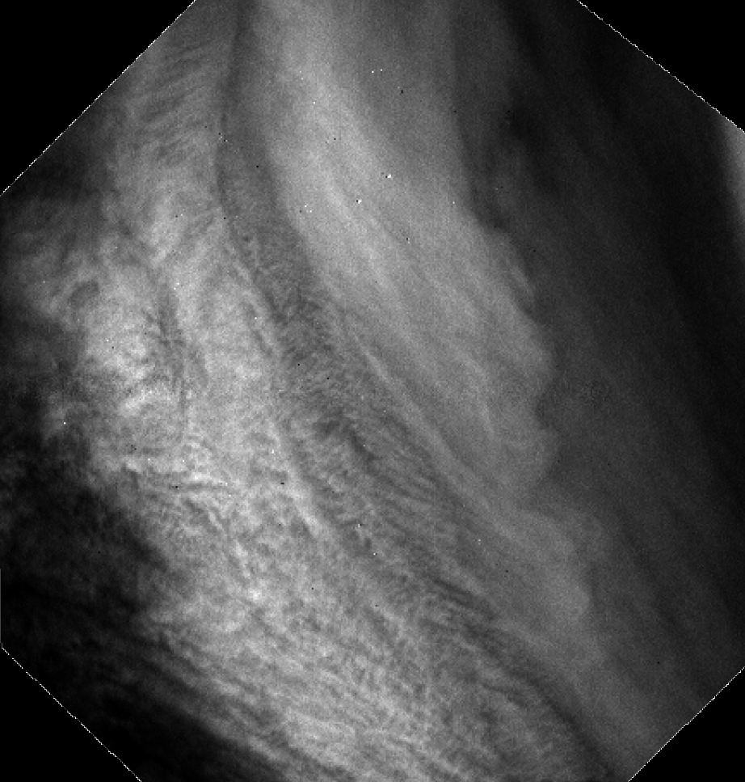
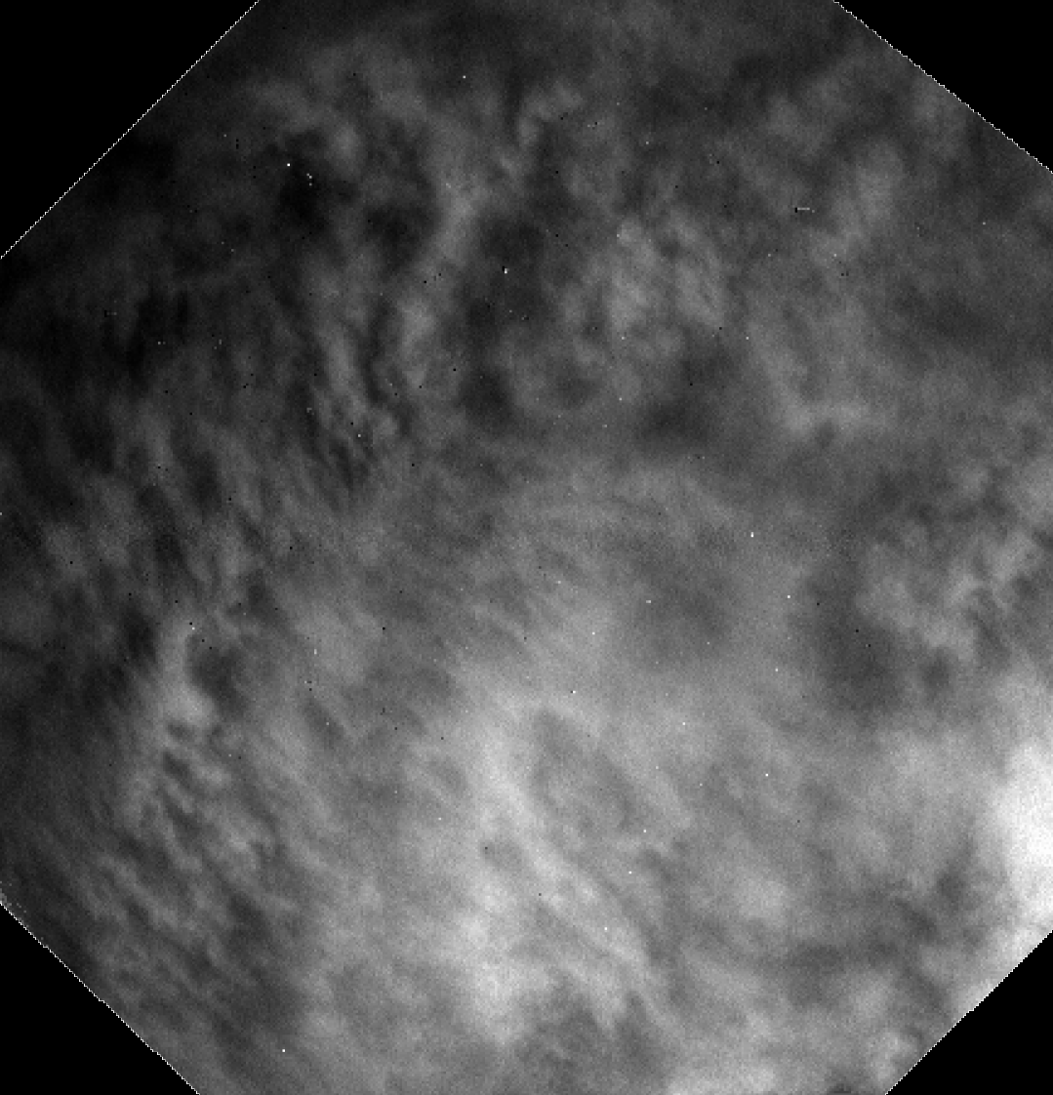
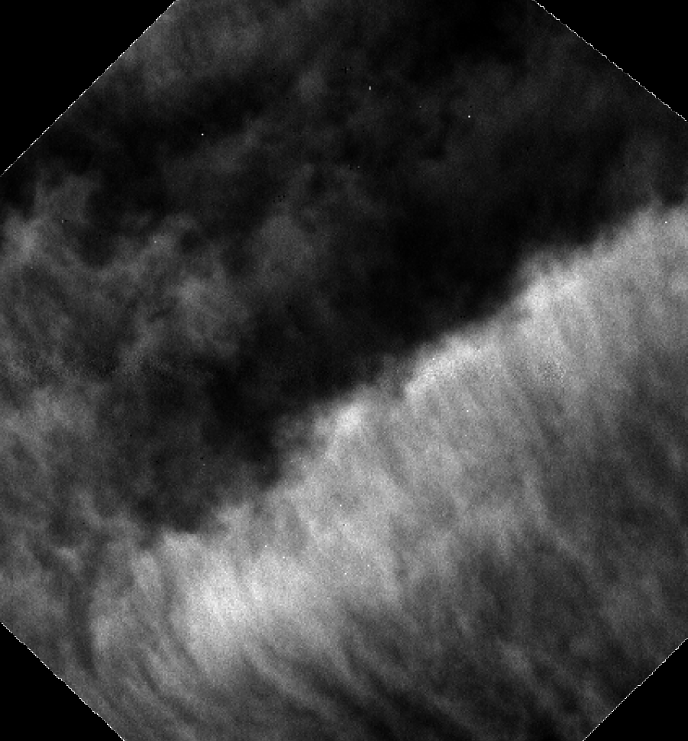
Mesoscale and small scale features
200 km
200 km
100 km

Slide 11
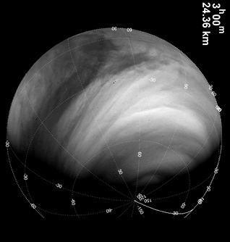
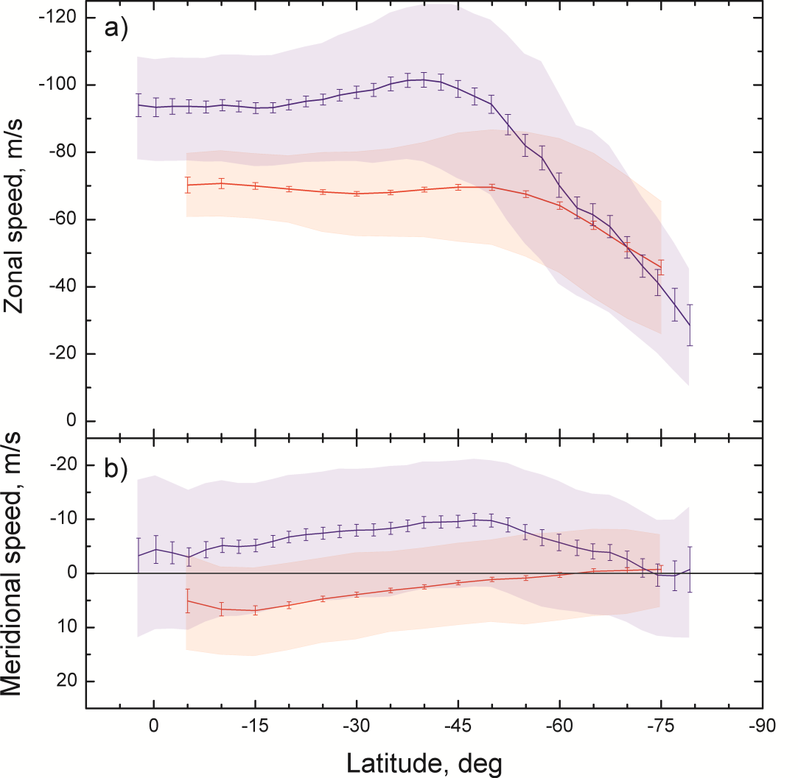
Zonal and meridional winds
67 km
55 km
S
50 km
Vertical wind shear
2-3 m/s per km
No wind shear or dense cloud top ?
Sanchez-Lavega et al., 2016; Khatuntsev et al., 2018

Slide 12
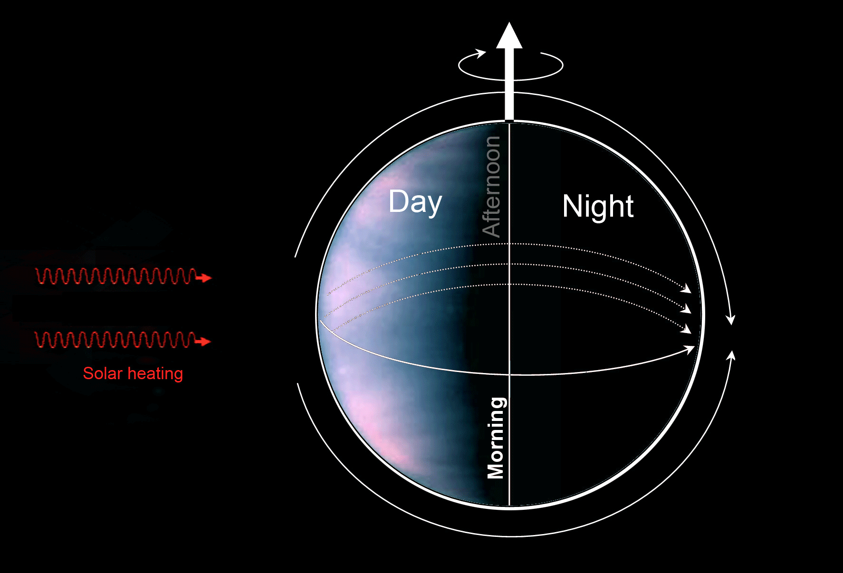
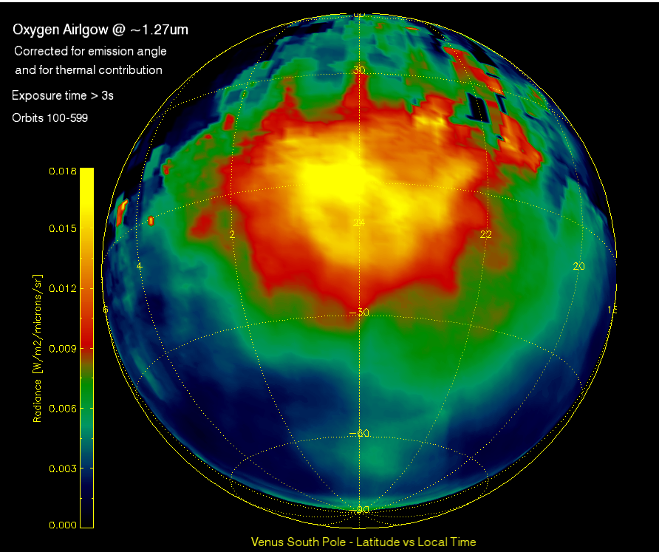
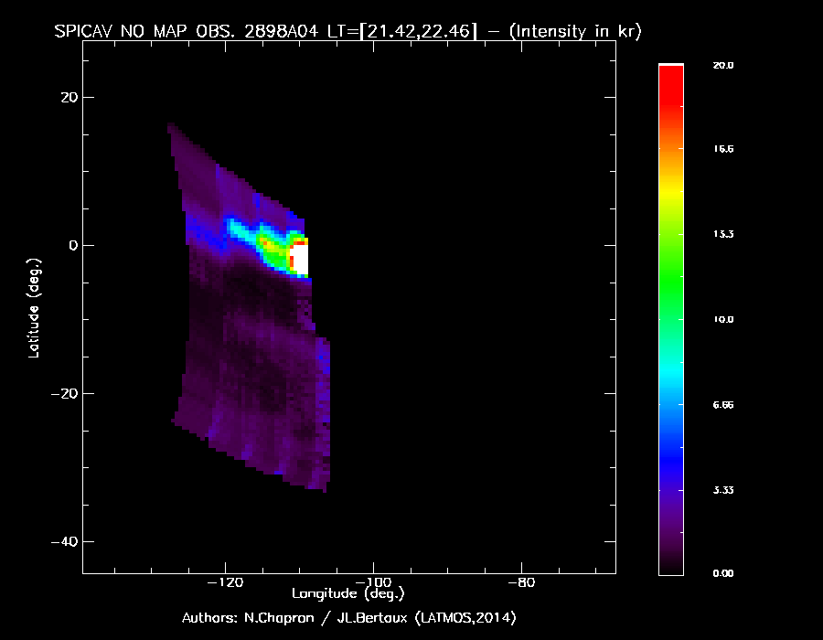
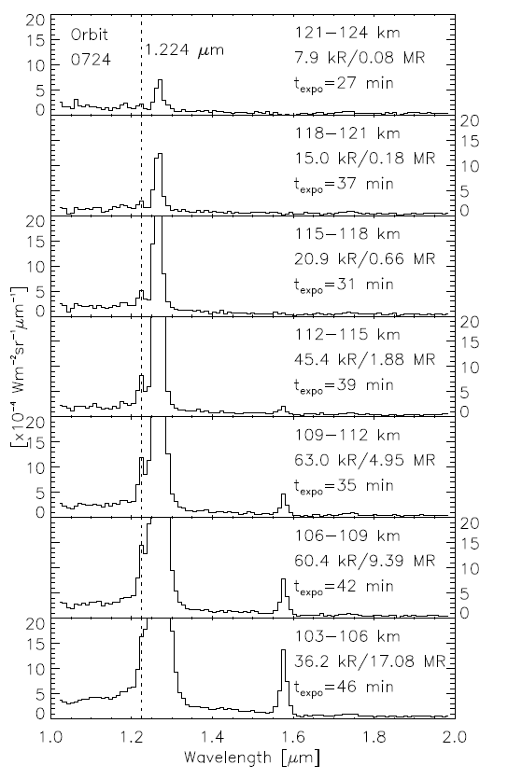
Non-LTE emissions
NO
NO
O₂
O₂
Gerard et al., 2016

Slide 13
Ionosphere and plasma boundaries
Paetzold et al.; Futaana et al., 2016

Slide 14
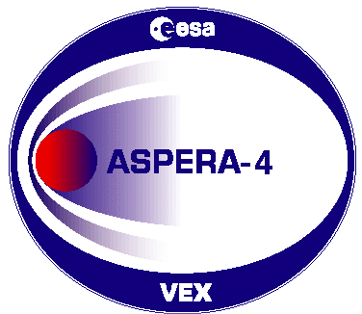
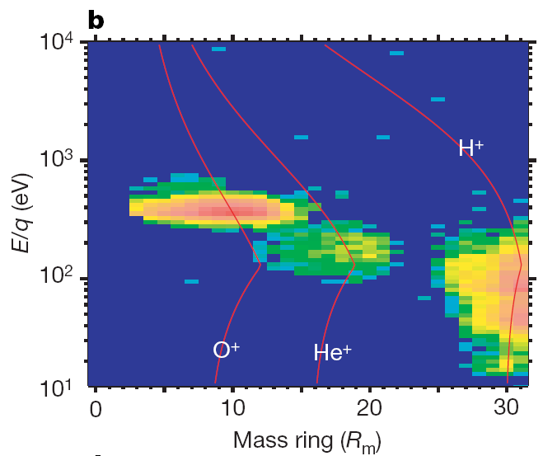
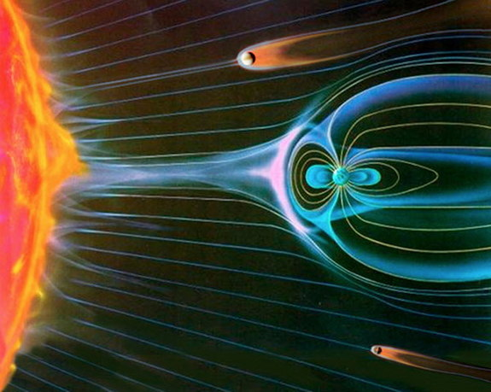
Ion escape (ASPERA)
Energy- mass matrix in the plasma sheet
‘Shielding’ effect of magnetic field?
Escaping ions: H⁺, He⁺, O⁺
Energy ratio O⁺ : He⁺ : H⁺ ~ 4:2:1 → ion pick-up
Flux ratio H⁺:O⁺ ~ 2:1→ H₂O
Escape occurs though the plasma sheet and induced magnetosphere boundary
Notes:
The ion distribution in the tail are well organized by theconvectional electrical filed. The slide shows distribuiotn of fluxes across tail in the electrci field related frame (Z is parallel with electric field). In the tail The highest fluxes are observed inside the plasma sheet and around the IMB which is coincides with the optical shadow. As previously reported the enegy increase with the distance from the central Venus - sun axes. Integrating such maps over the space one may get the total escape rate.

Slide 15
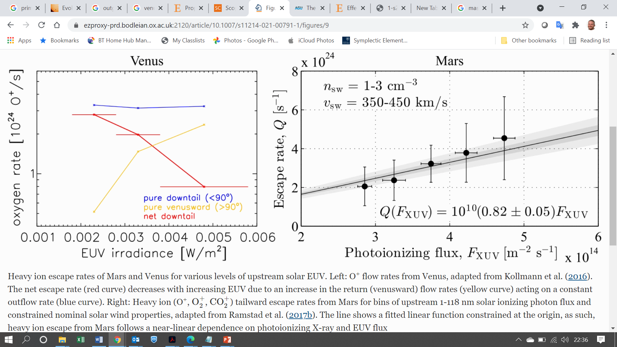
Ion escape (ASPERA)
‘Shielding’ effect of magnetic field? Not so simple…
Ramstad et al Spa Sci Rev 2021
Notes:
The ion distribution in the tail are well organized by theconvectional electrical filed. The slide shows distribuiotn of fluxes across tail in the electrci field related frame (Z is parallel with electric field). In the tail The highest fluxes are observed inside the plasma sheet and around the IMB which is coincides with the optical shadow. As previously reported the enegy increase with the distance from the central Venus - sun axes. Integrating such maps over the space one may get the total escape rate.

Slide 16
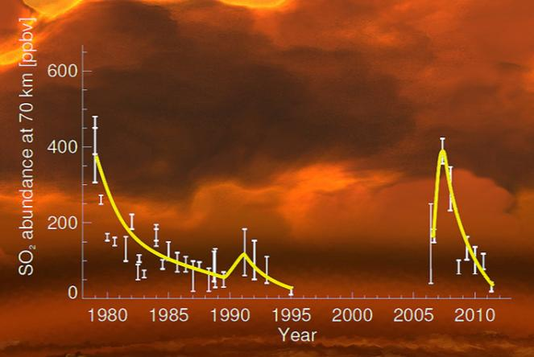
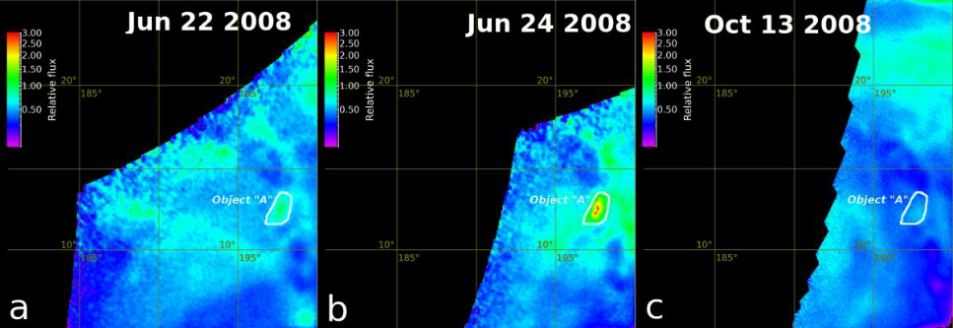
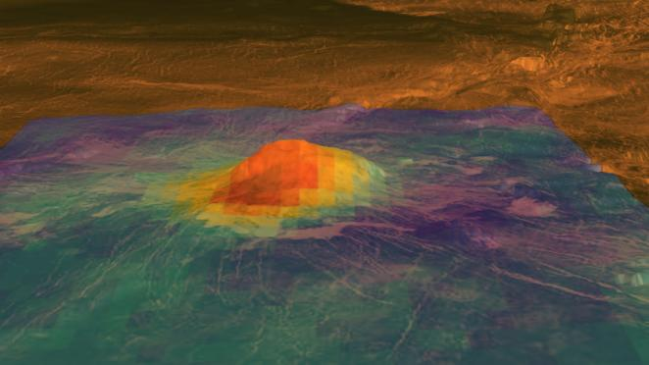
Hints at active volcanism
Episodic variations of mesospheric SO₂
High emissivity near hotspot volcanoes: unweathered lava?
Temporal changes in thermal emission from surface: a volcanic eruption caught in the act?
Marcq et al. 2016, Smrekar et al. 2010, Shalygin et al., 2015
Notes:
The questions of whether Venus is geologically active and how the planet has resurfaced over
the past billion years have major implications for interior dynamics and climate change. Nine
“hotspots”—areas analogous to Hawaii, with volcanism, broad topographic rises, and large positive
gravity anomalies suggesting mantle plumes at depth—have been identified as possibly active.
This study used variations in the thermal emissivity of the surface observed by the Visible and
Infrared Thermal Imaging Spectrometer on the European Space Agency’s Venus Express spacecraft to
identify compositional differences in lava flows at three hotspots. The anomalies are interpreted as
a lack of surface weathering. We estimate the flows to be younger than 2.5 million years and probably
much younger, about 250,000 years or less, indicating that Venus is actively resurfacing.

Slide 17
The legacy of Venus Express
First look below the clouds
  Chemistry, dynamics, cloud properties
  3-D wind mapping through the cloud layer
Profiling of the mesosphere
  Composition, temperature and haze profiles from cloud-tops up to homopause.
Indirect signs of active volcanism
  Elevated IR surface emission near hotspot volcanoes
  Sulphur dioxide abundances
Escape and solar wind interaction
  in depth study of induced magnetosphere;
  measurement of O⁺ escape.
> 750 published papers
  European leadership of worldwide Venus research
  Partnerships with modellers, ground-based observers
Smrekar et al., 2010
Marcq et al., 2012

Slide 18
Still open questions
Cloud composition and chemistry
Lower atmosphere, and surface-atmosphere interaction
Volcanic and tectonic activity and history
Atmospheric dynamics
Escape processes and evolution of volatiles
Evolution of Venus through time

Slide 19

Thank you
Venus Express !

