Slide 1
Salt constructs in paleo-lake basins as high-priority Astrobiology targets
A case study of two Chilean salars
Michael S. Phillips
Michael.Phillips@jhuapl.edu
Johns Hopkins Applied Physics Lab

Slide 2
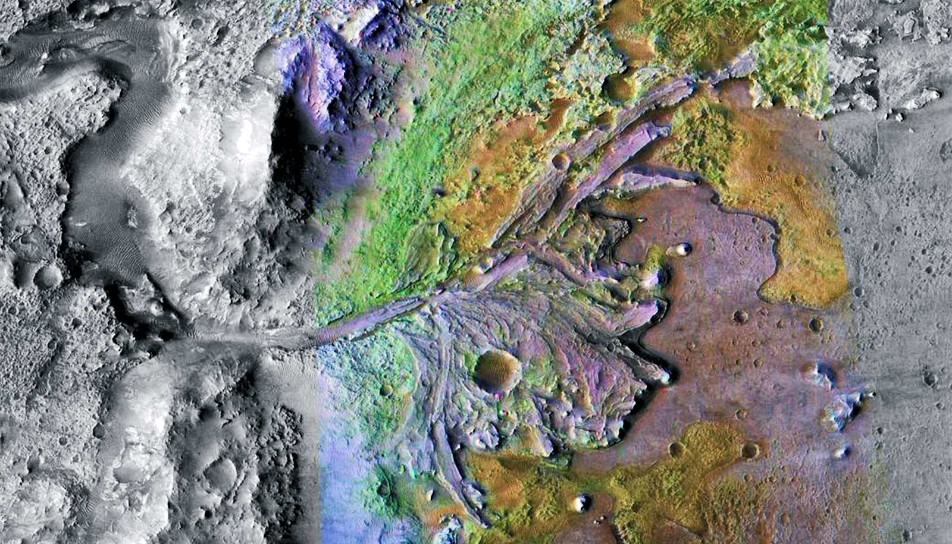


Closing the gap between orbital observations and on-the-ground exploration is an open problem for astrobiological exploration.
Once a region is characterized as a past habitable environment, how do we locate the specific targets that are most likely to preserve biosignatures?

Slide 3
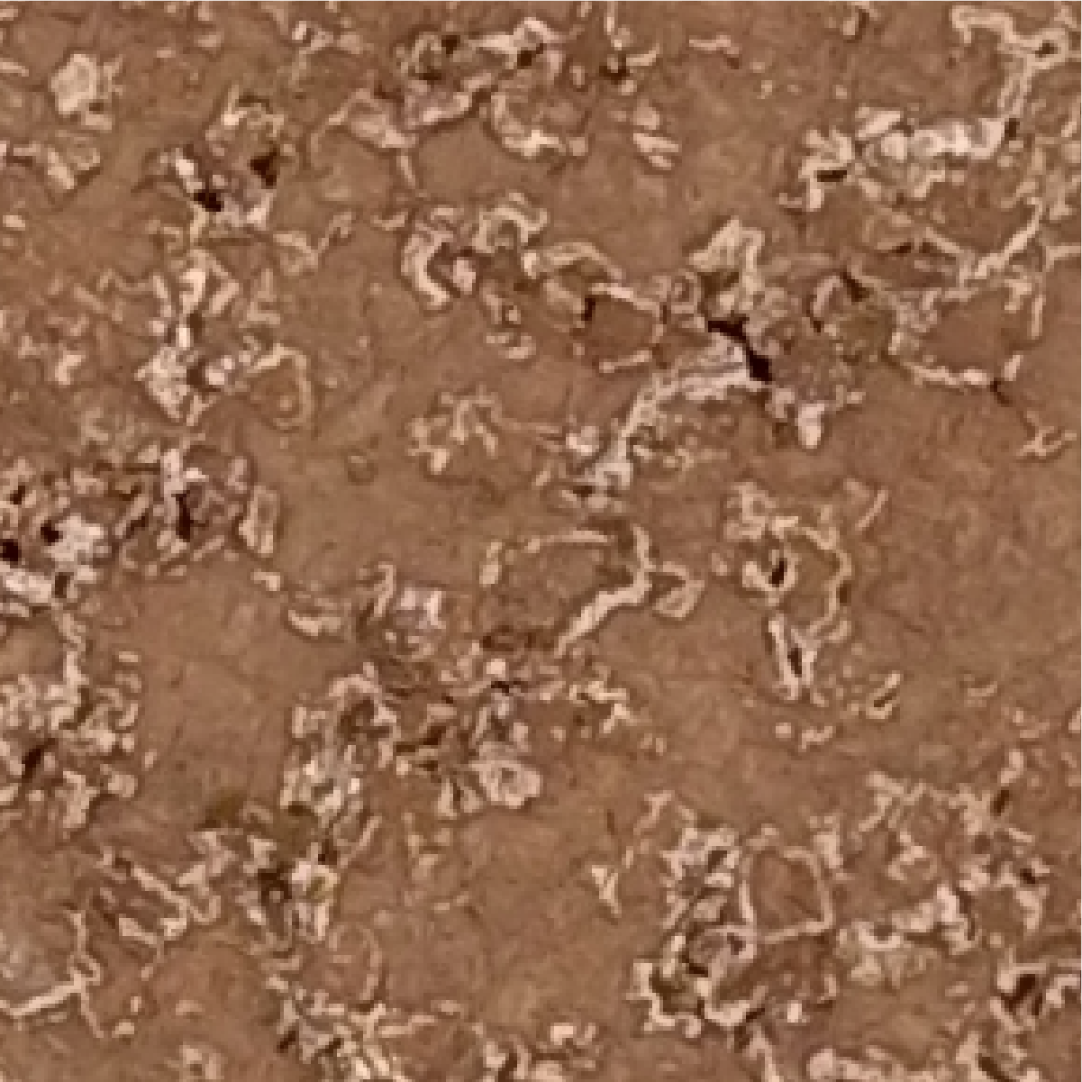
Salt-encrusted basins provide an opportunity to close the gap between orbit- and rover-scale, astrobiological-relevant, target selection.
Notes:
Topographic constructs in salt-encrusted basins because they are specific and targetable, they can host life for long durations even after surface water is gone, and they can preserve unambiguous evidence of life for long durations.

Slide 4
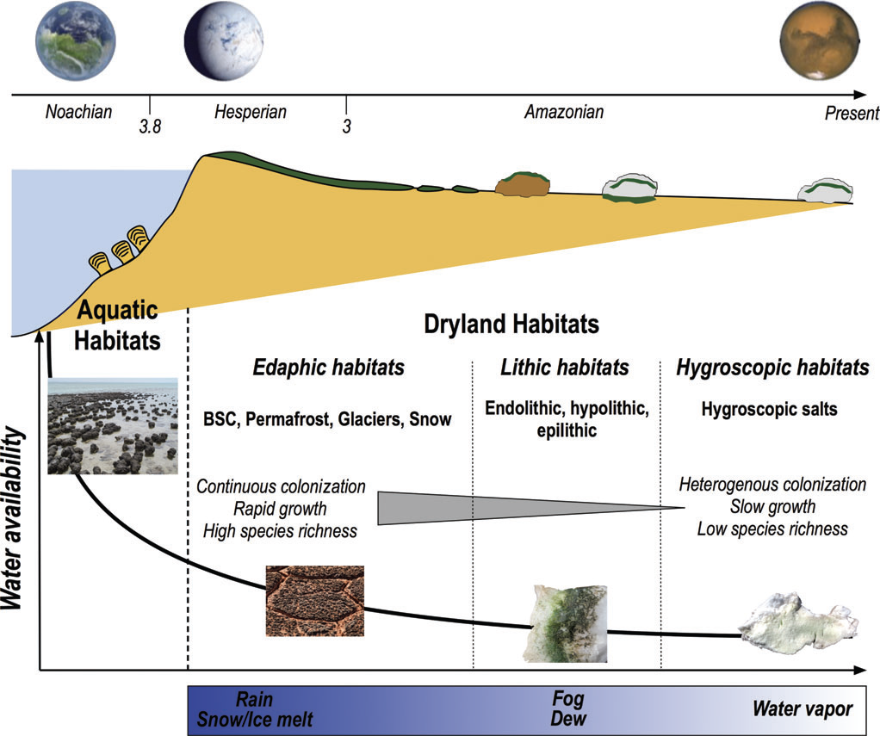
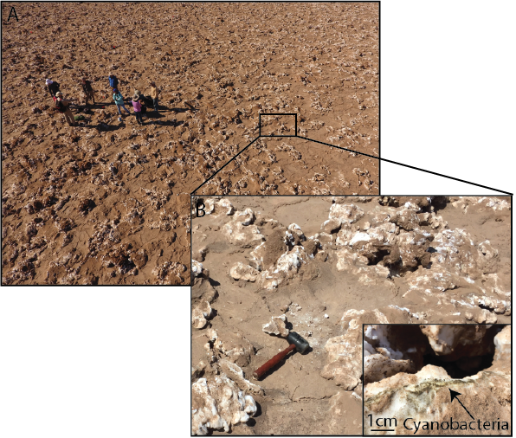
In environments difficult for life, organisms inhabit pockets of locally favorable conditions called refugia.
Davila and Shulze-Makuch, 2010

Slide 5
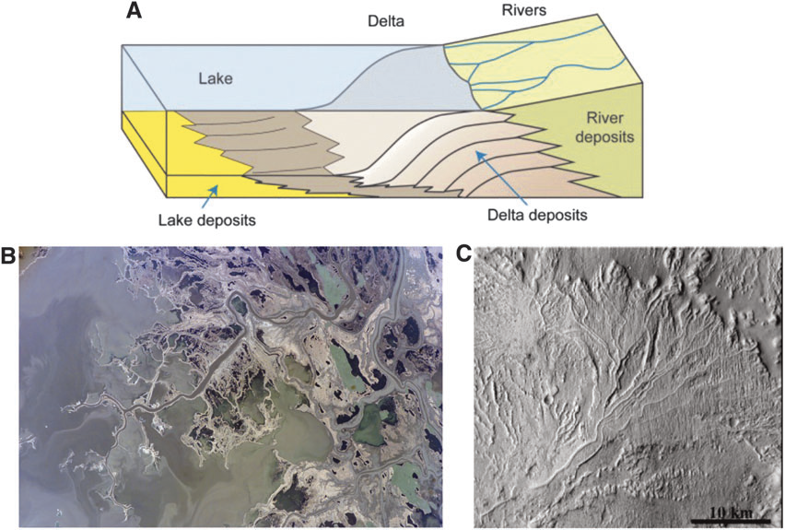
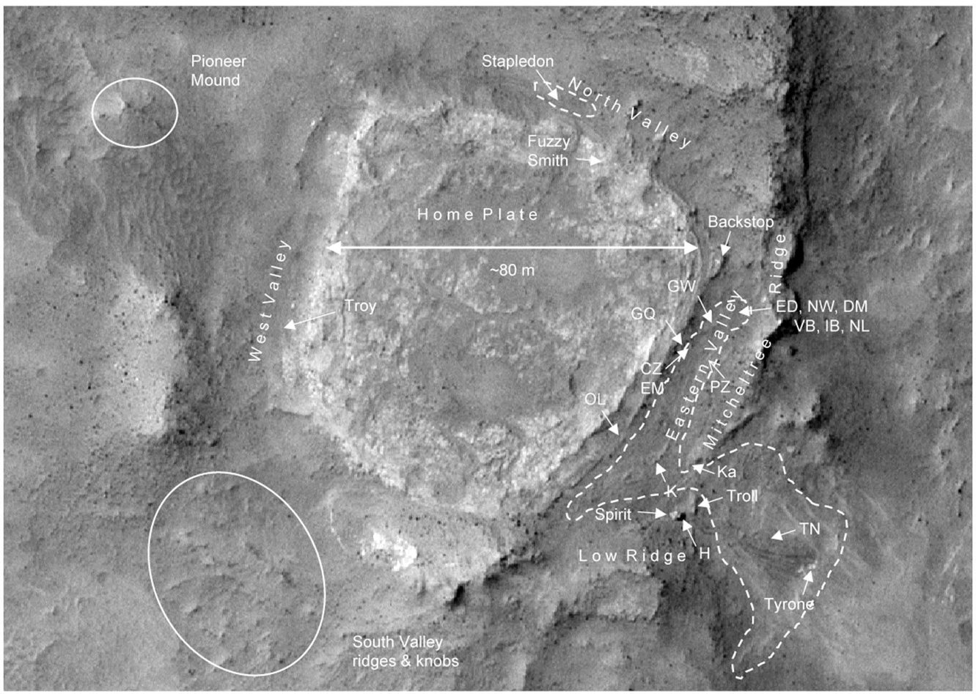
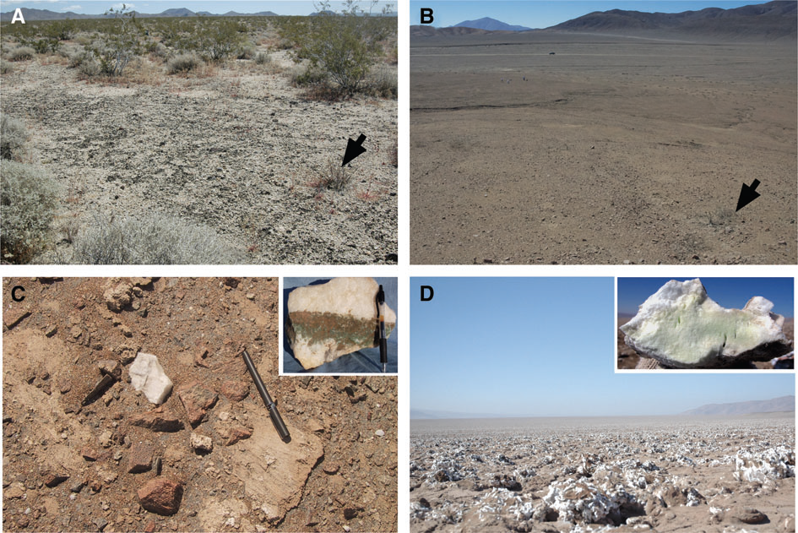
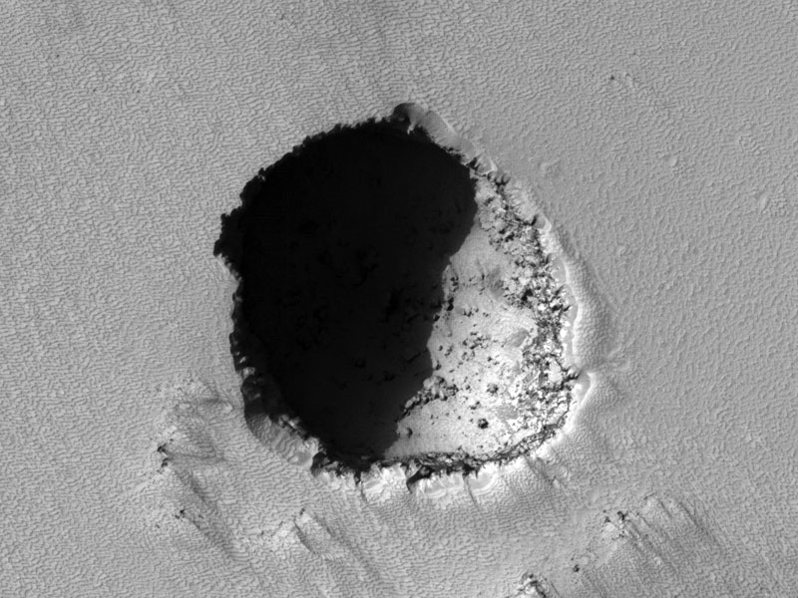
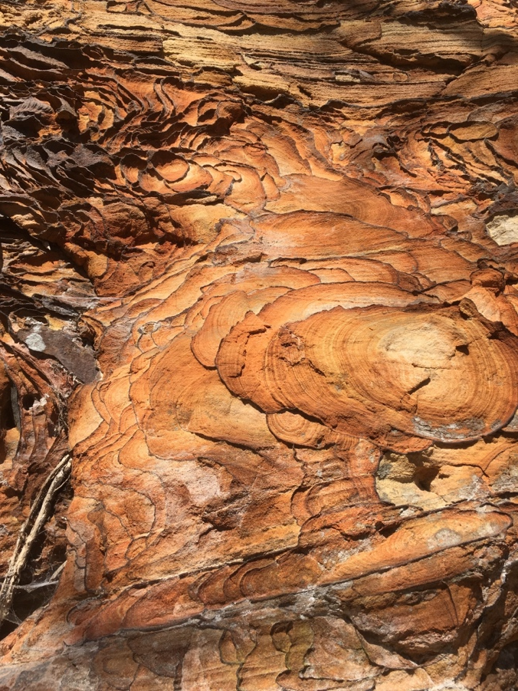
Habitats on Mars occurred in several environmental contexts…
Subaqueous
Hydrothermal
Subaerial
Subsurface (caves) (iron-rich)

Slide 6
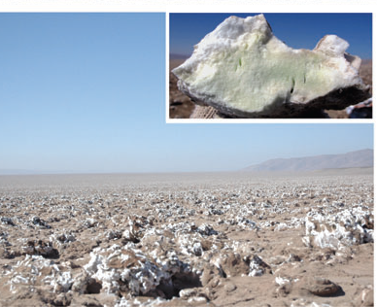

Habitats on Mars occurred in several environmental contexts… but refugia have some advantages.
Salts
Caves
Iron-rich

Slide 7
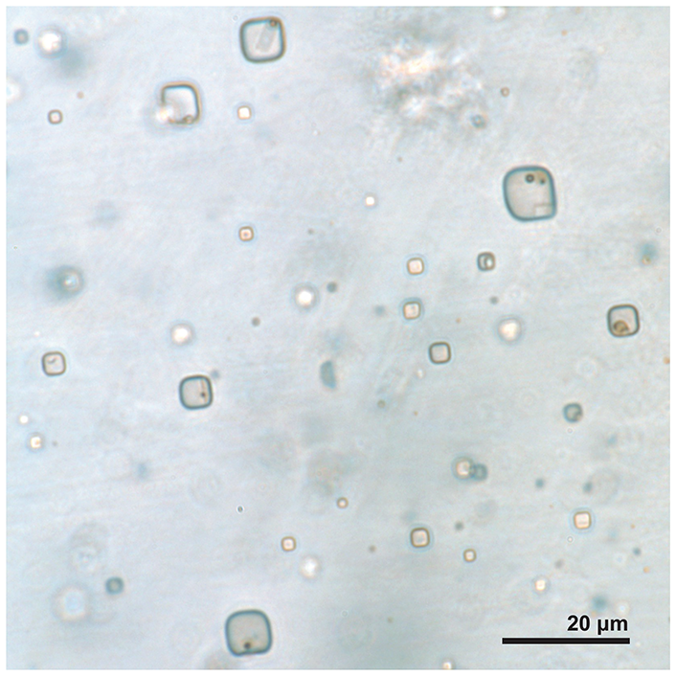
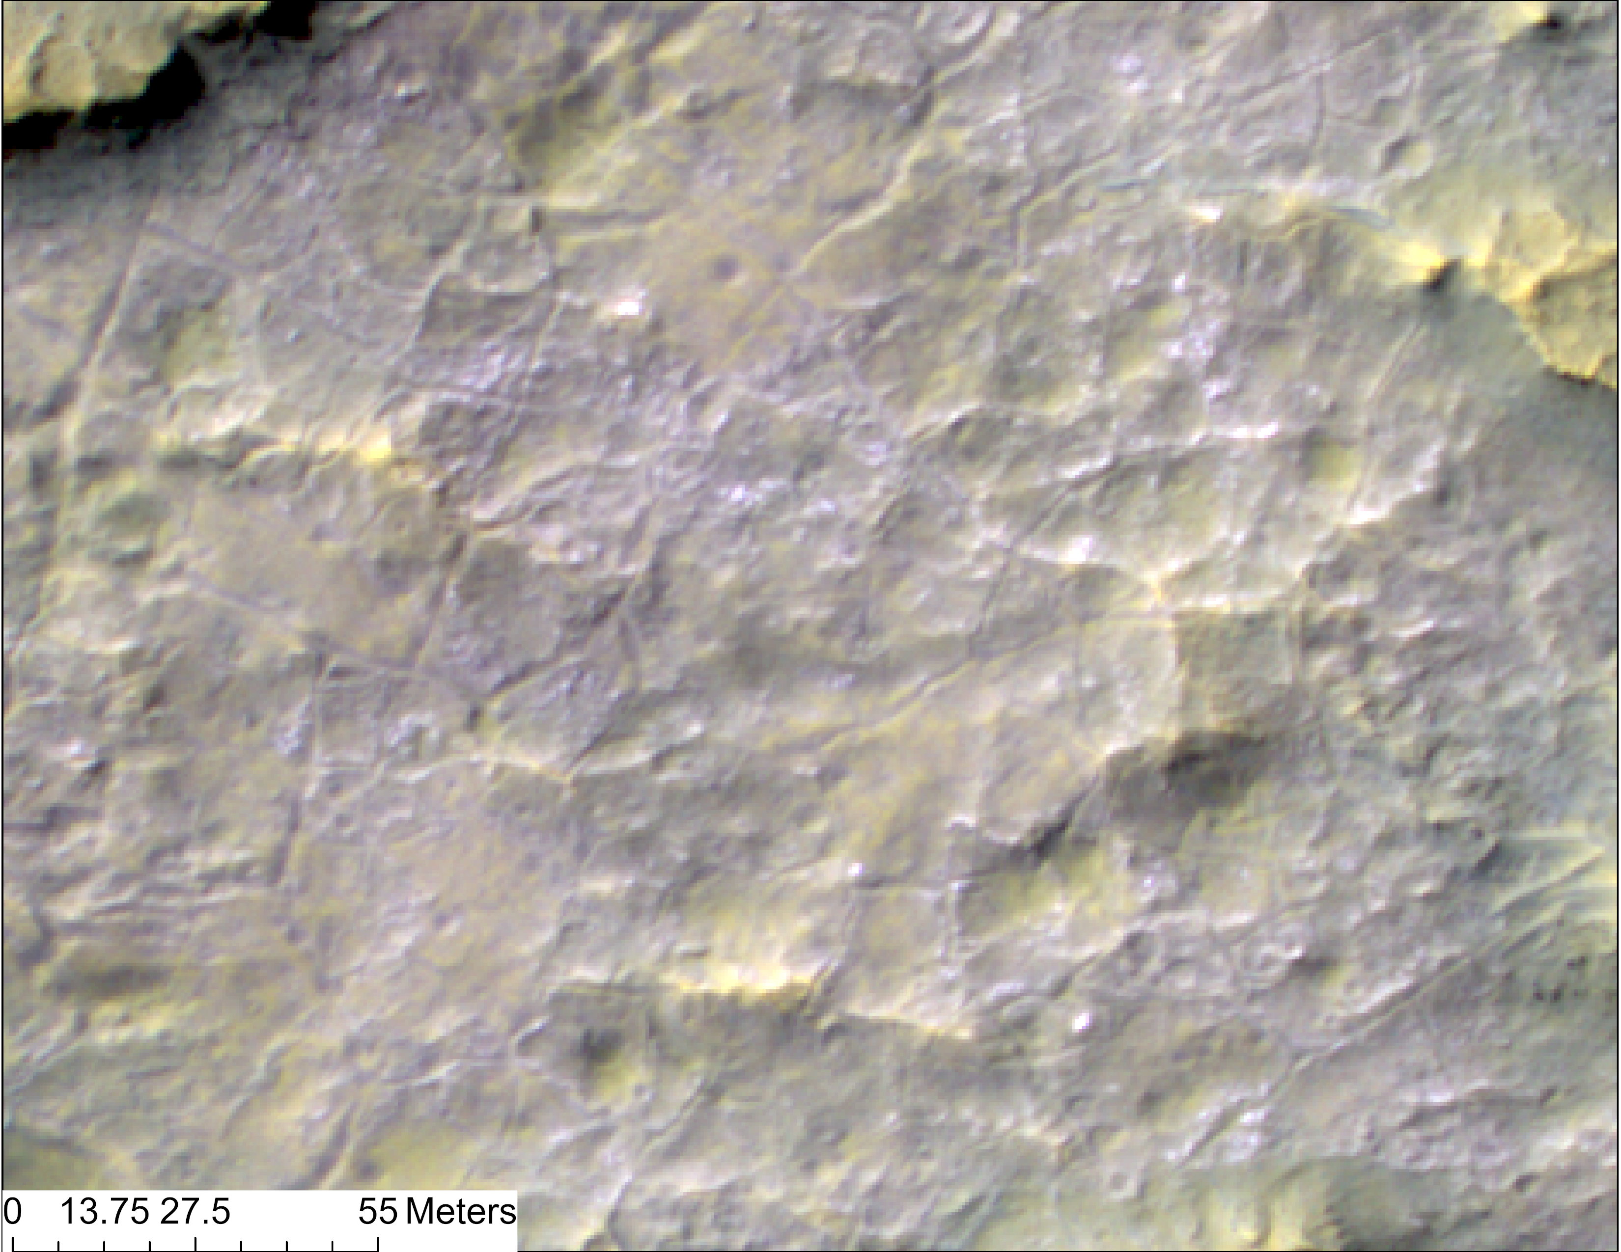
Salt habitats preserve organics exceptionally well and are accessible on the surface
Schreder-Gomes, 2022
Notes:
Topographic constructs in salt-encrusted basins because they are specific and targetable, they can host life for long durations even after surface water is gone, and they can preserve unambiguous evidence of life for long durations.

Slide 8
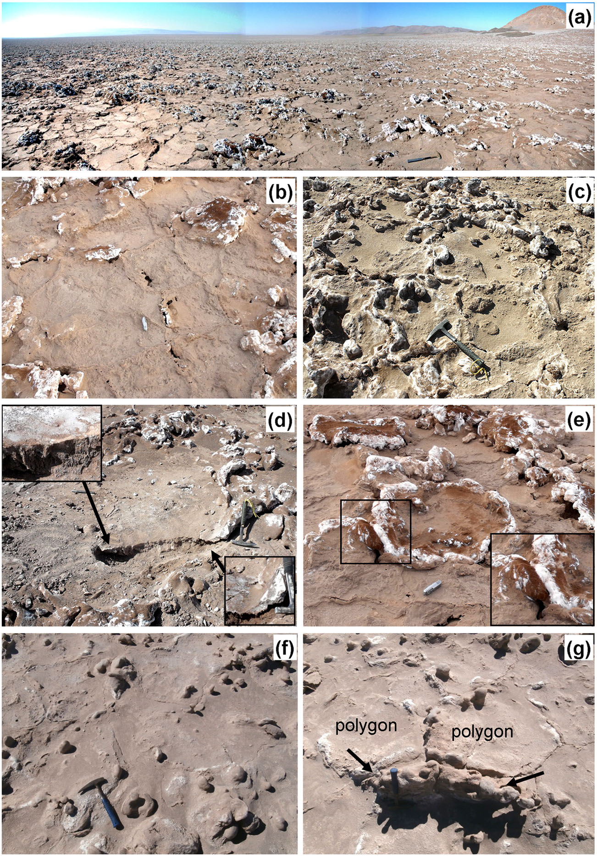
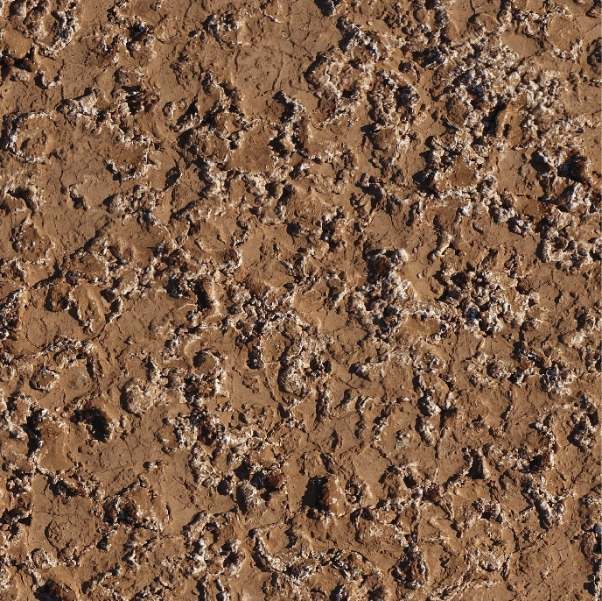
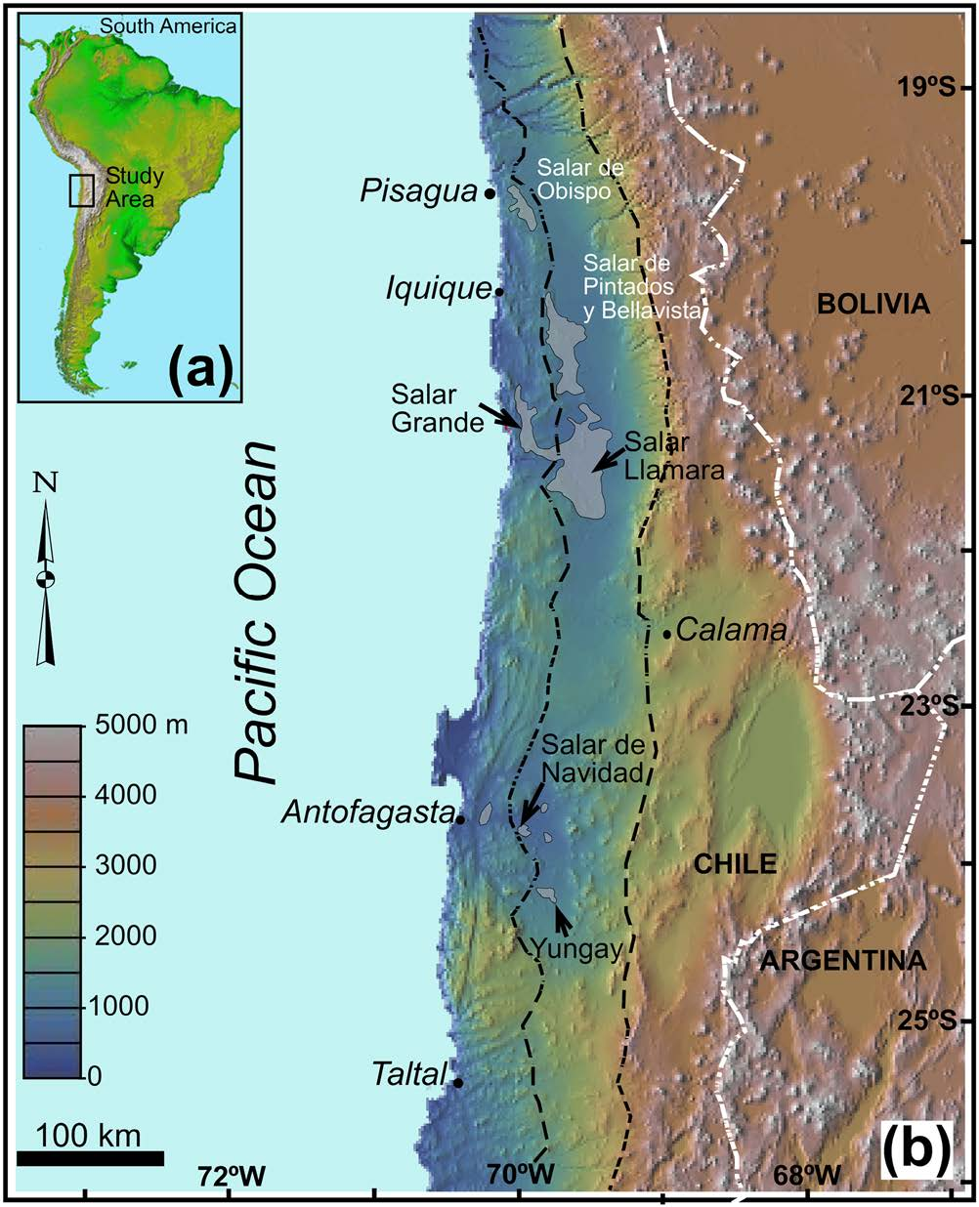
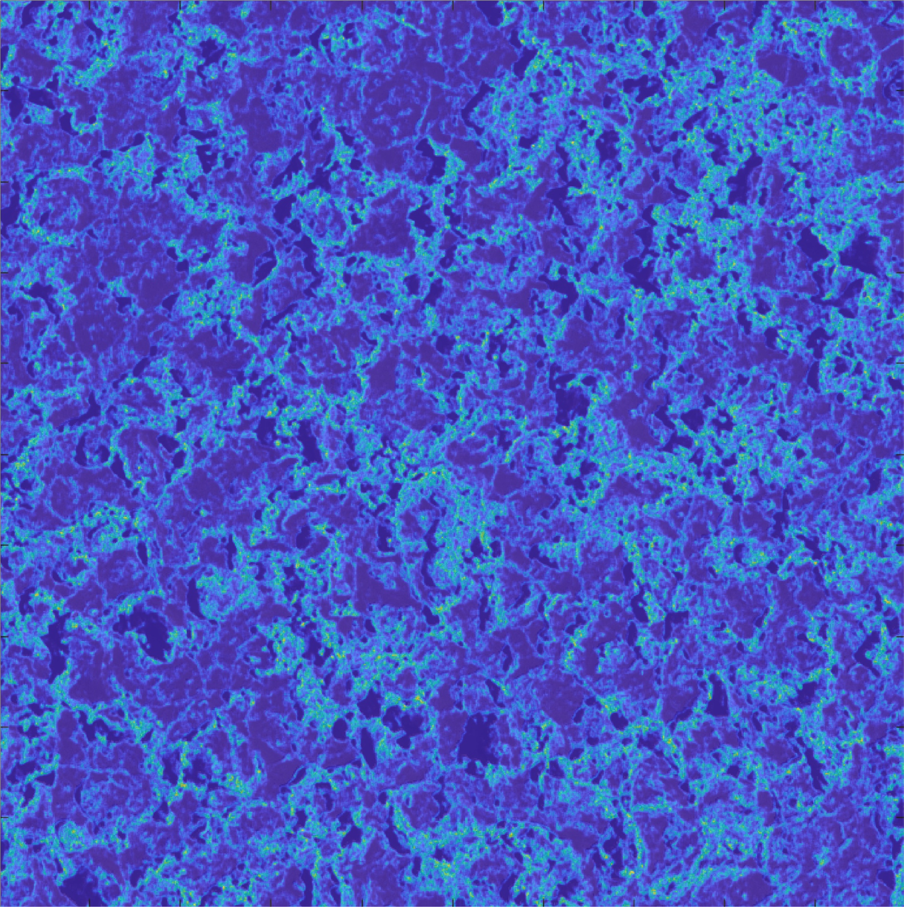
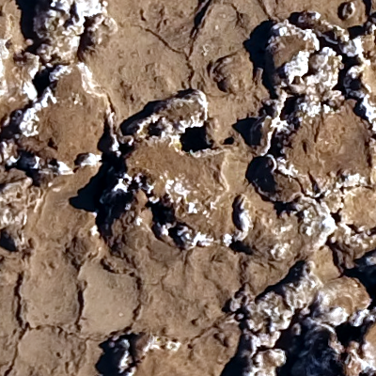
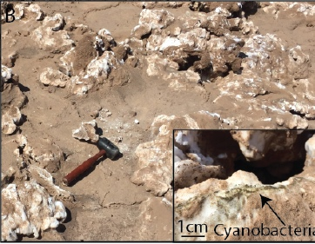
Halite nodules are bulbous growths of halite that form in “fossil” salars of the Atacama.
Artieda et al. 2015; Phillips et al. 2018

Slide 9
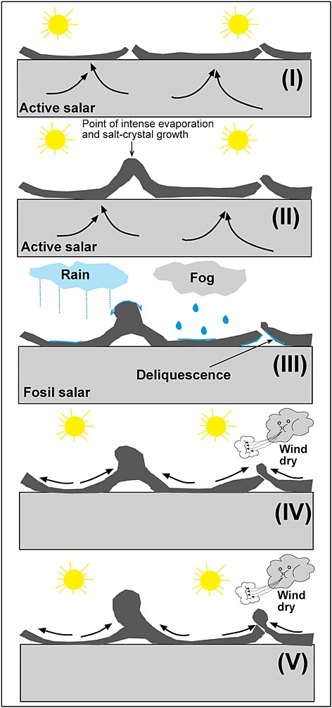
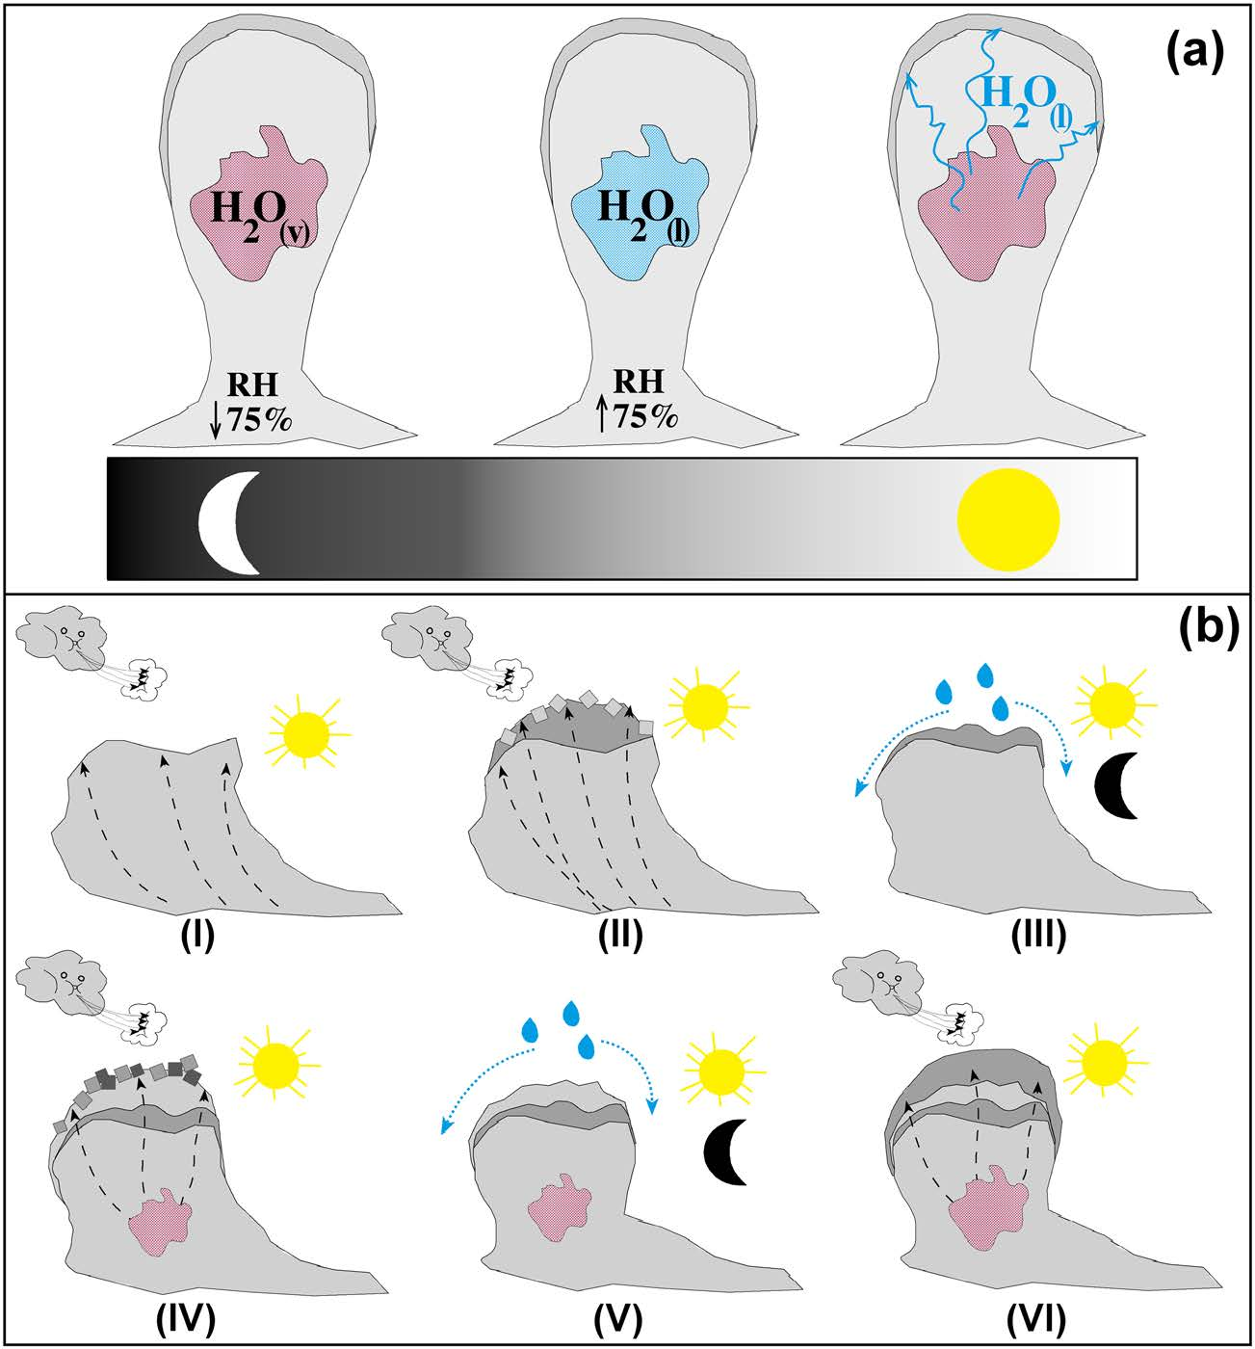
Halite nodules form through hydration-dehydration cycles that precipitate new halite growth.
20 cm
Artieda et al. 2015

Slide 10
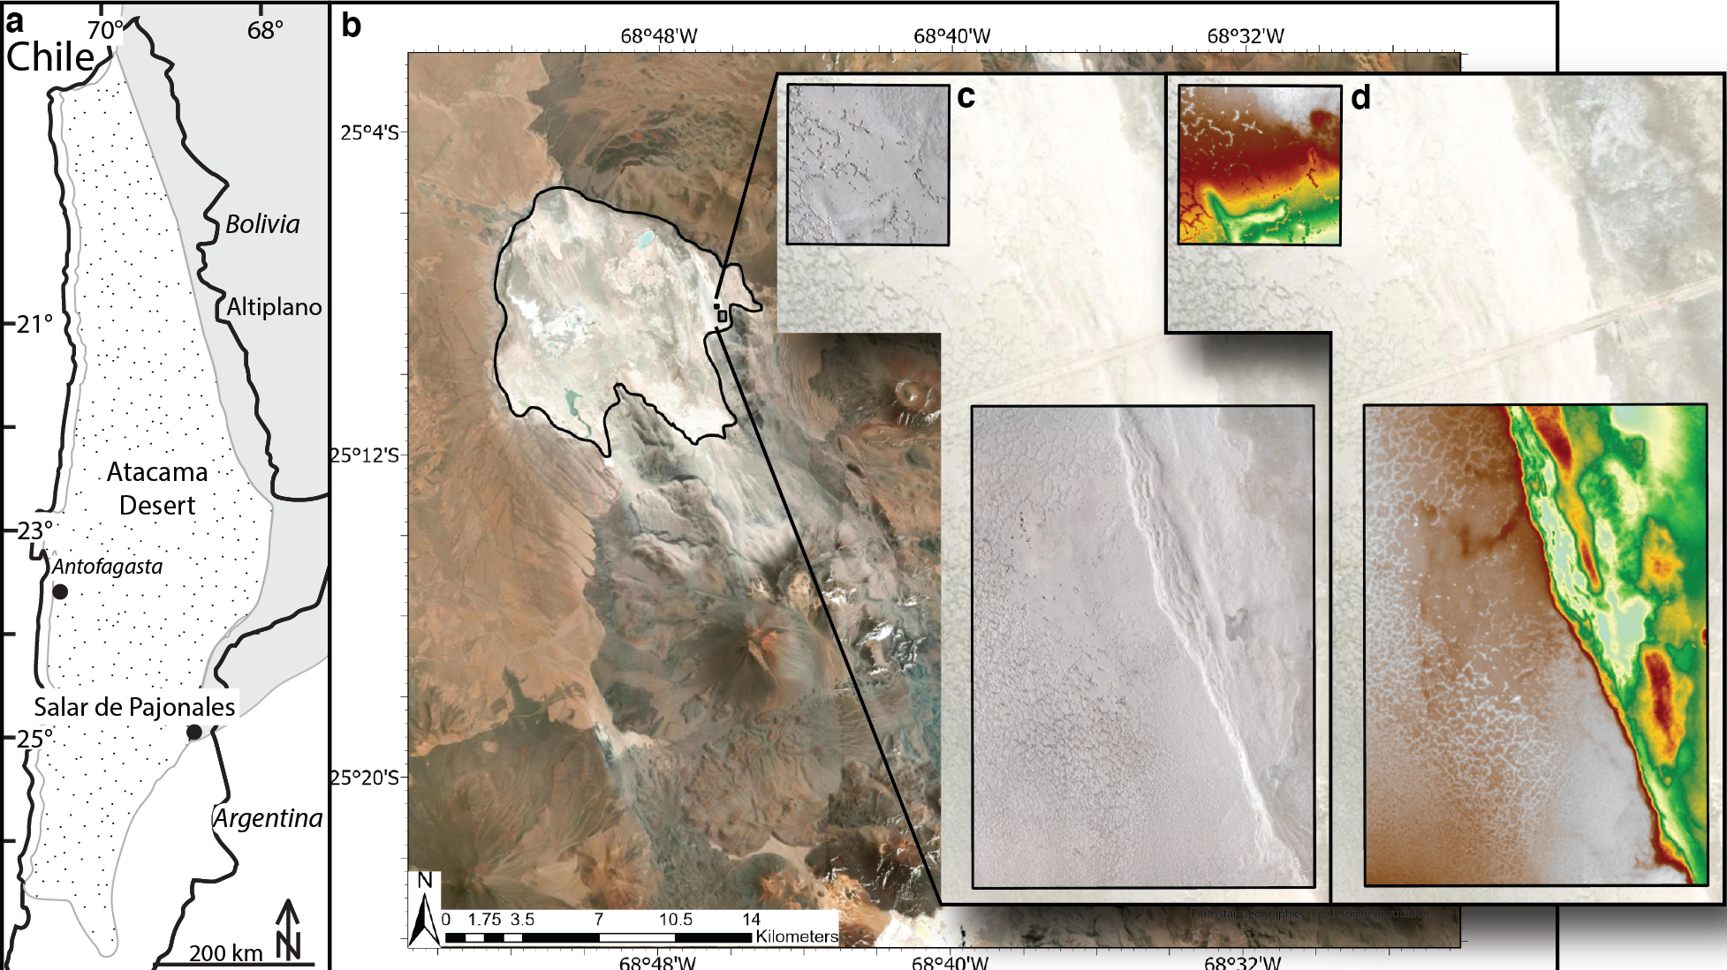
Decimeter to decameter-scale domes and ridges occur in a fossil portion of the Salar de Pajonales.
Notes:
Intrabasinal volume changes associated with wetting/drying, or recrystallization, cycles (gypsum←→anhydrite), along with increases in volume due to deposition of fresh salt from transient brines.

Slide 11
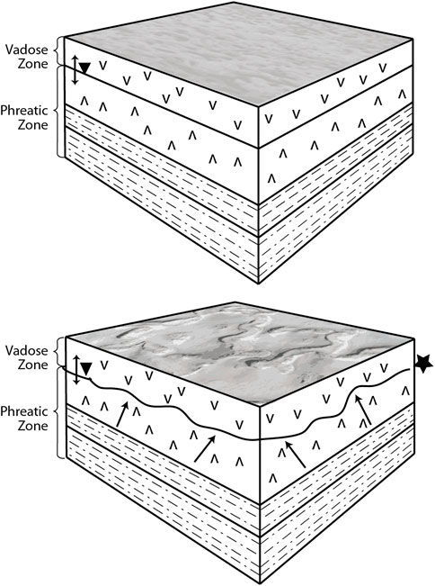
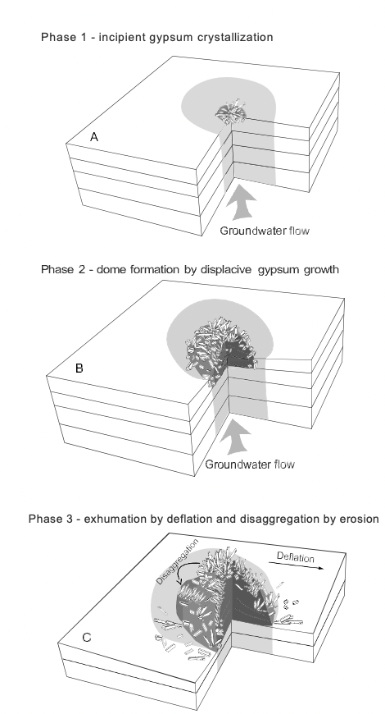
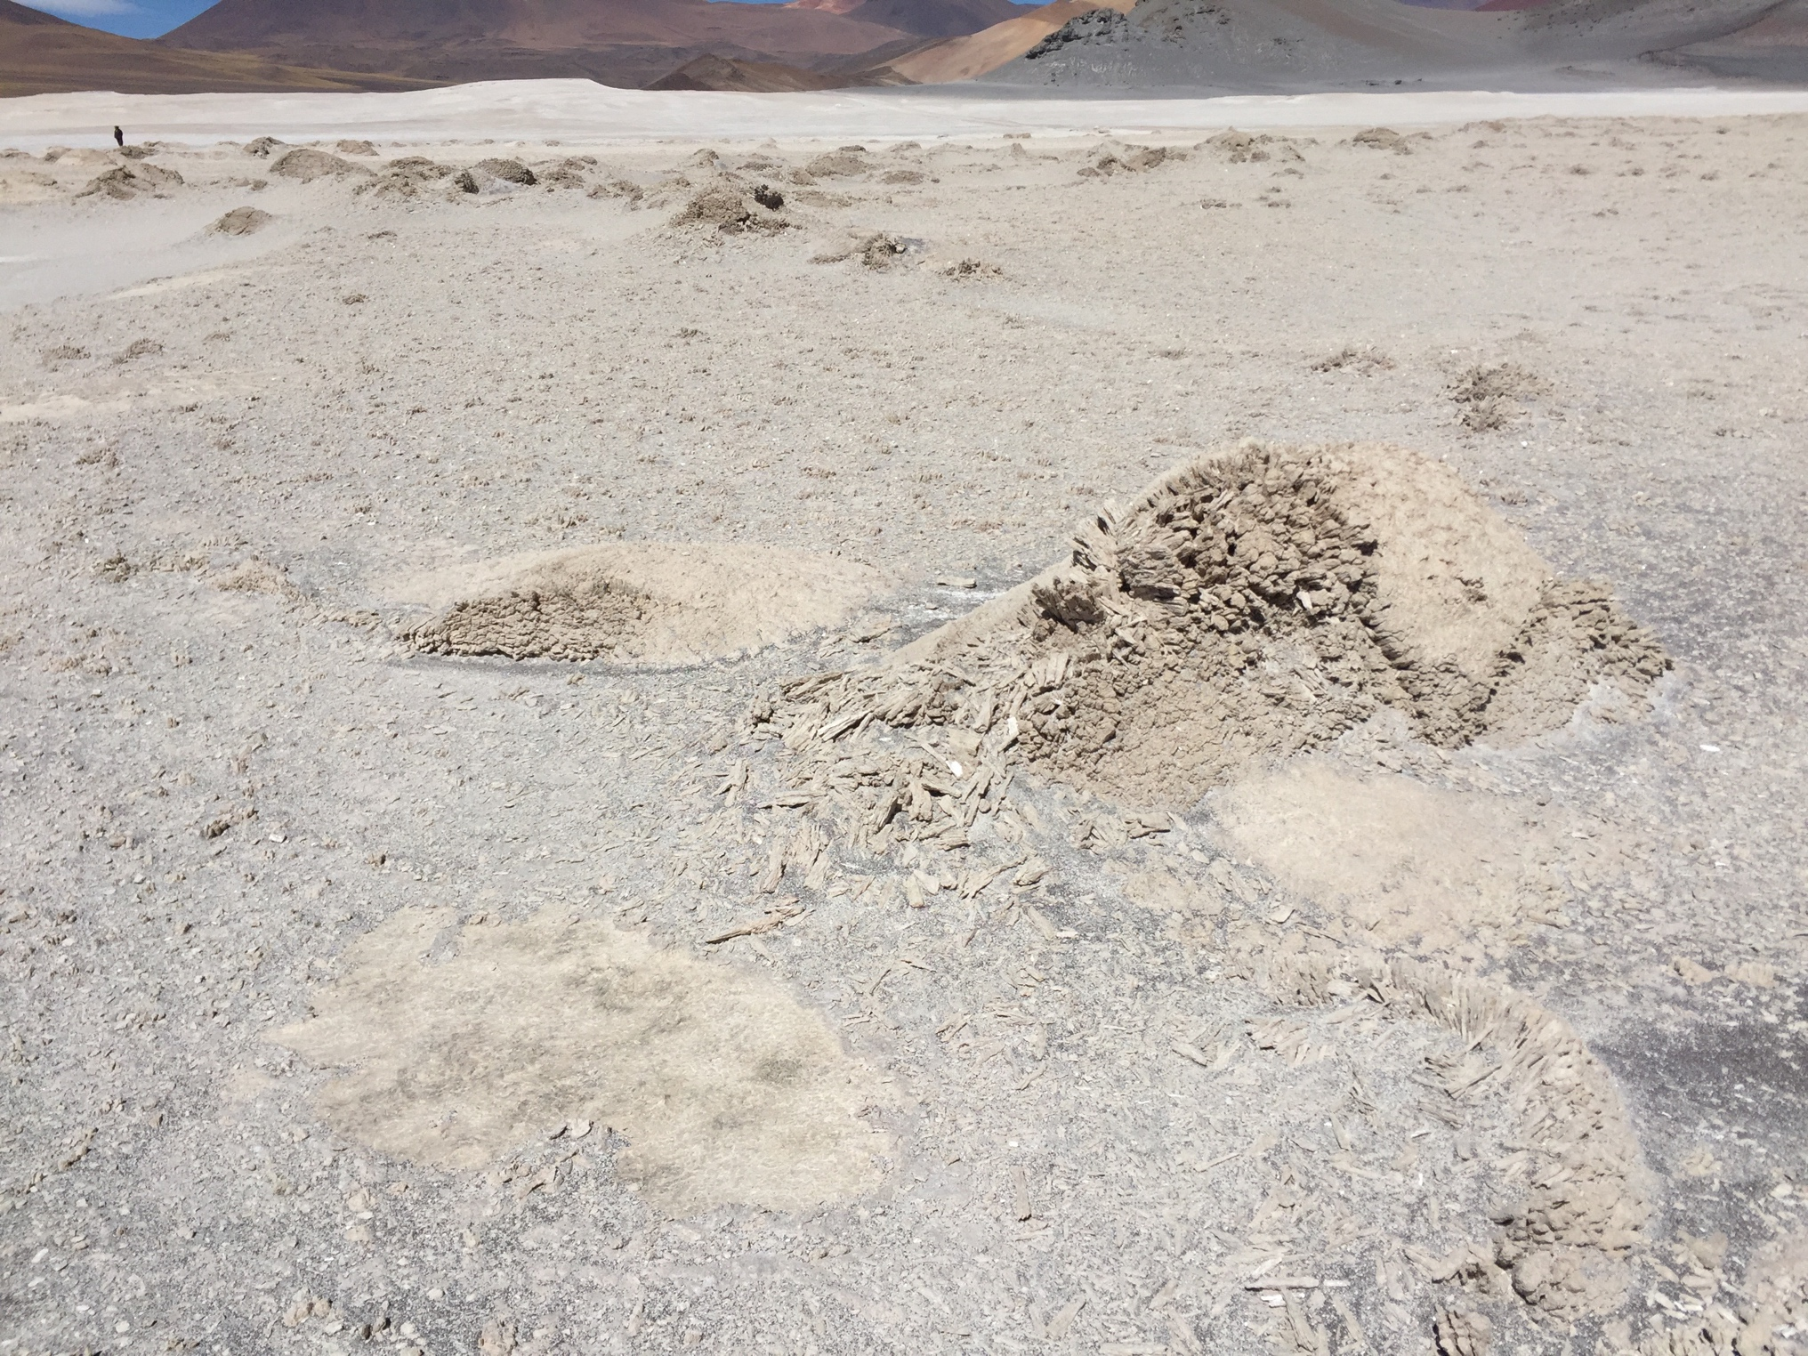
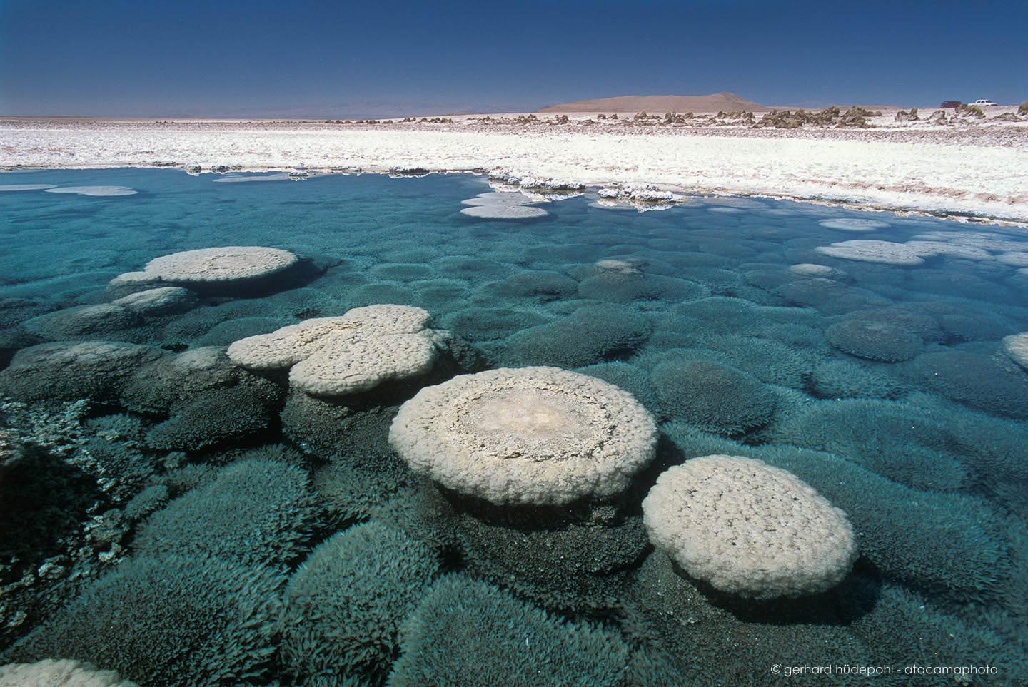
Domes and ridges form through upward-mobile water vapor that precipitates new crystal growth increasing the volume of the crust, which bulges to accommodate surface area.
Hinman et al. 2022; Szynkiewicz et al. 2010
Notes:
Intrabasinal volume changes associated with wetting/drying, or recrystallization, cycles (gypsum←→anhydrite), along with increases in volume due to deposition of fresh salt from transient brines.

Slide 12
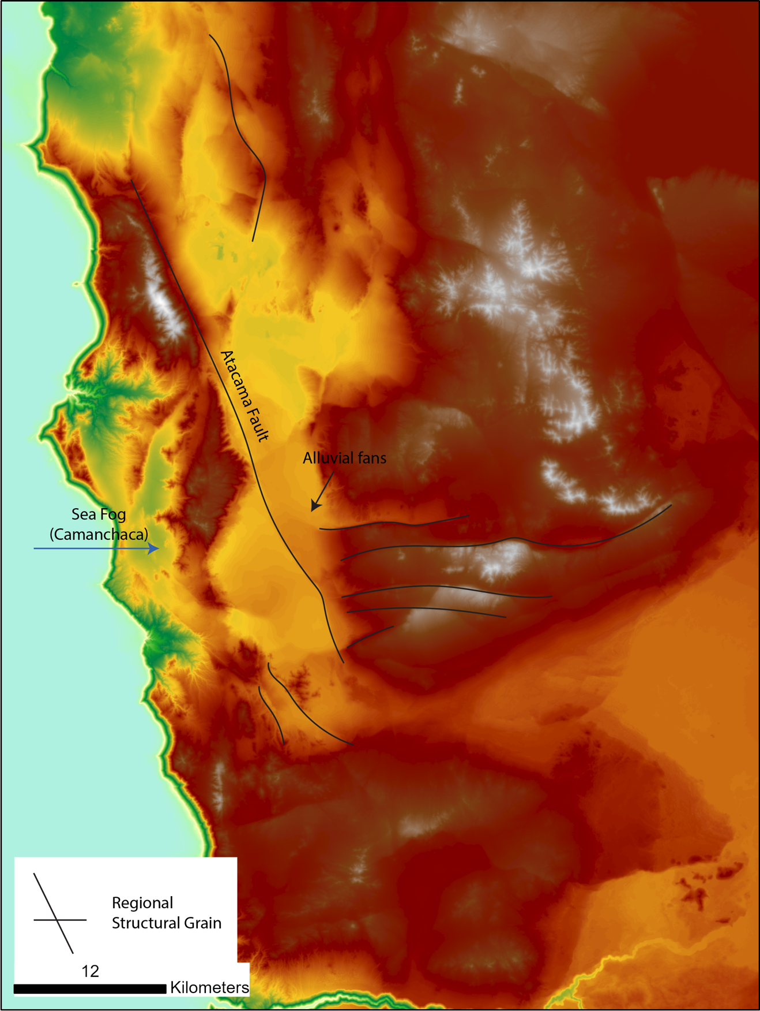
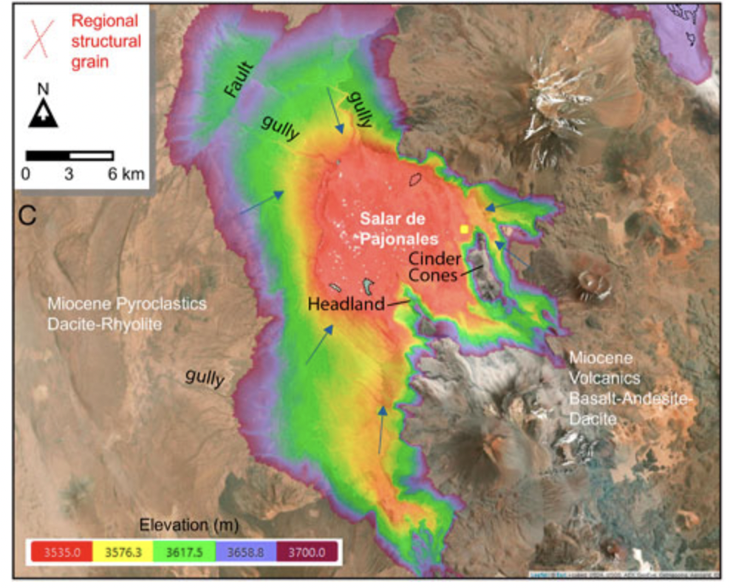
Locally-formed salt constructs are controlled by regional-scale geologic processes.
Salar Grande
Salar de Pajonales
• Locally low topo.
• Long term drying period.
• High evaporation rates compared to precipitation.
• Cyclic and ephemeral source of water
• Fog/rain/aquifer recharge source
• Subsurface heat
• Structural zones of weakness

Slide 13
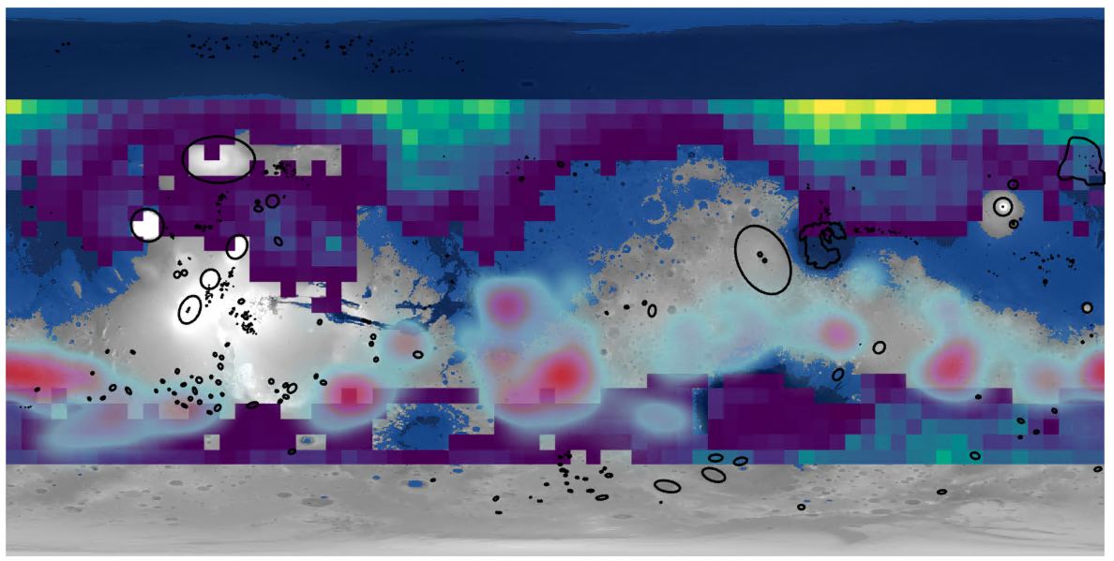
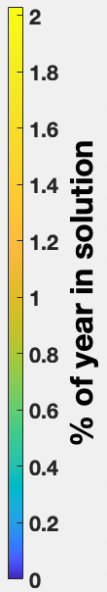

We can filter our search for salt basins on Mars using the regional geologic characteristics learned from Earth.
Hellas
Argyre

Slide 14
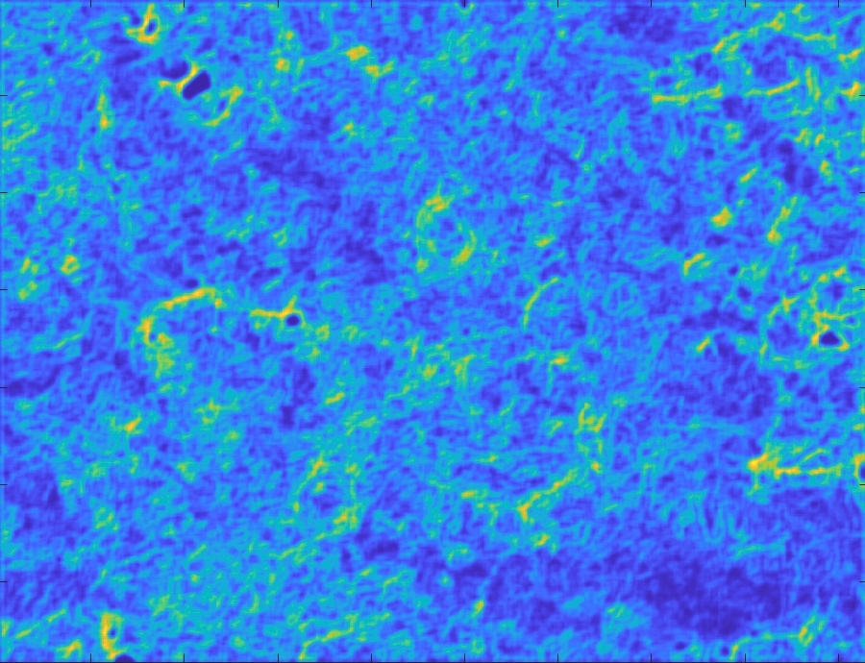
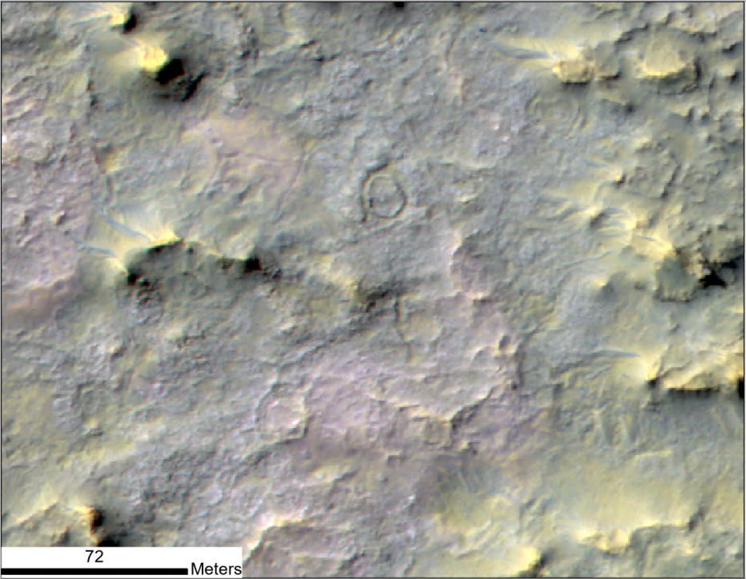
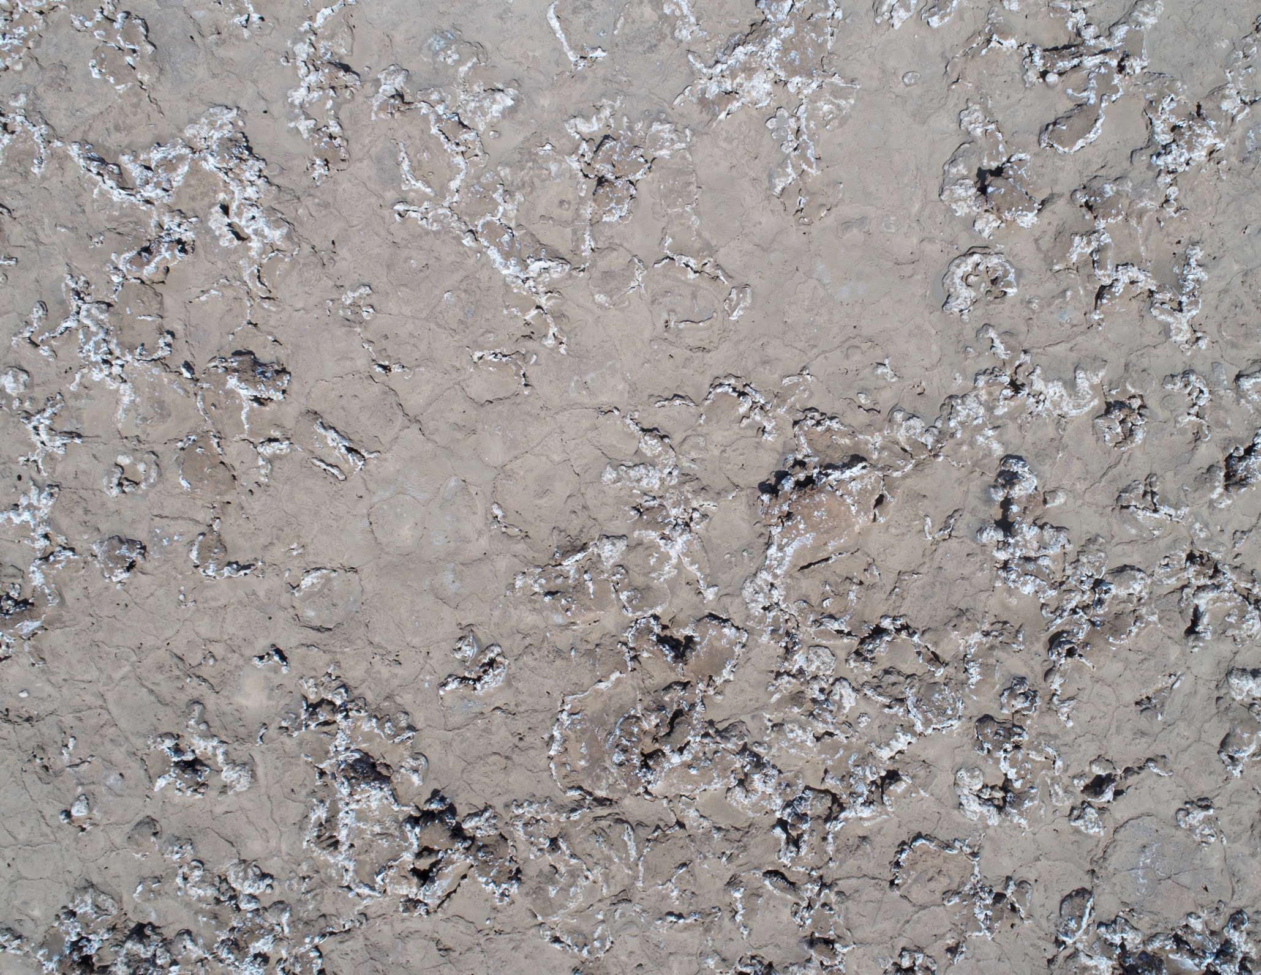
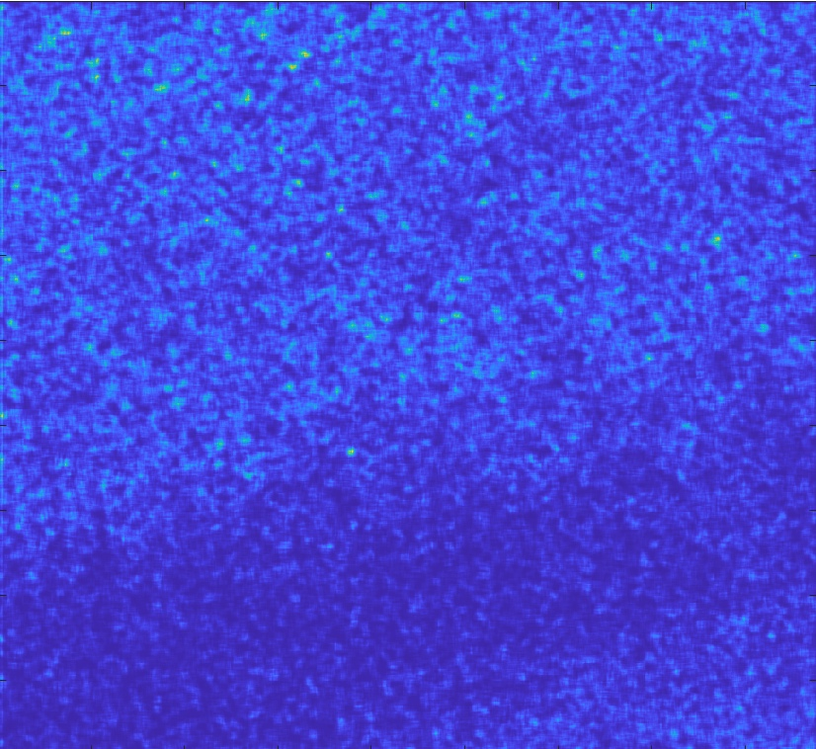

Features in a salt-encrusted basin, NE Hellas.
72 m
2 meters

Slide 15
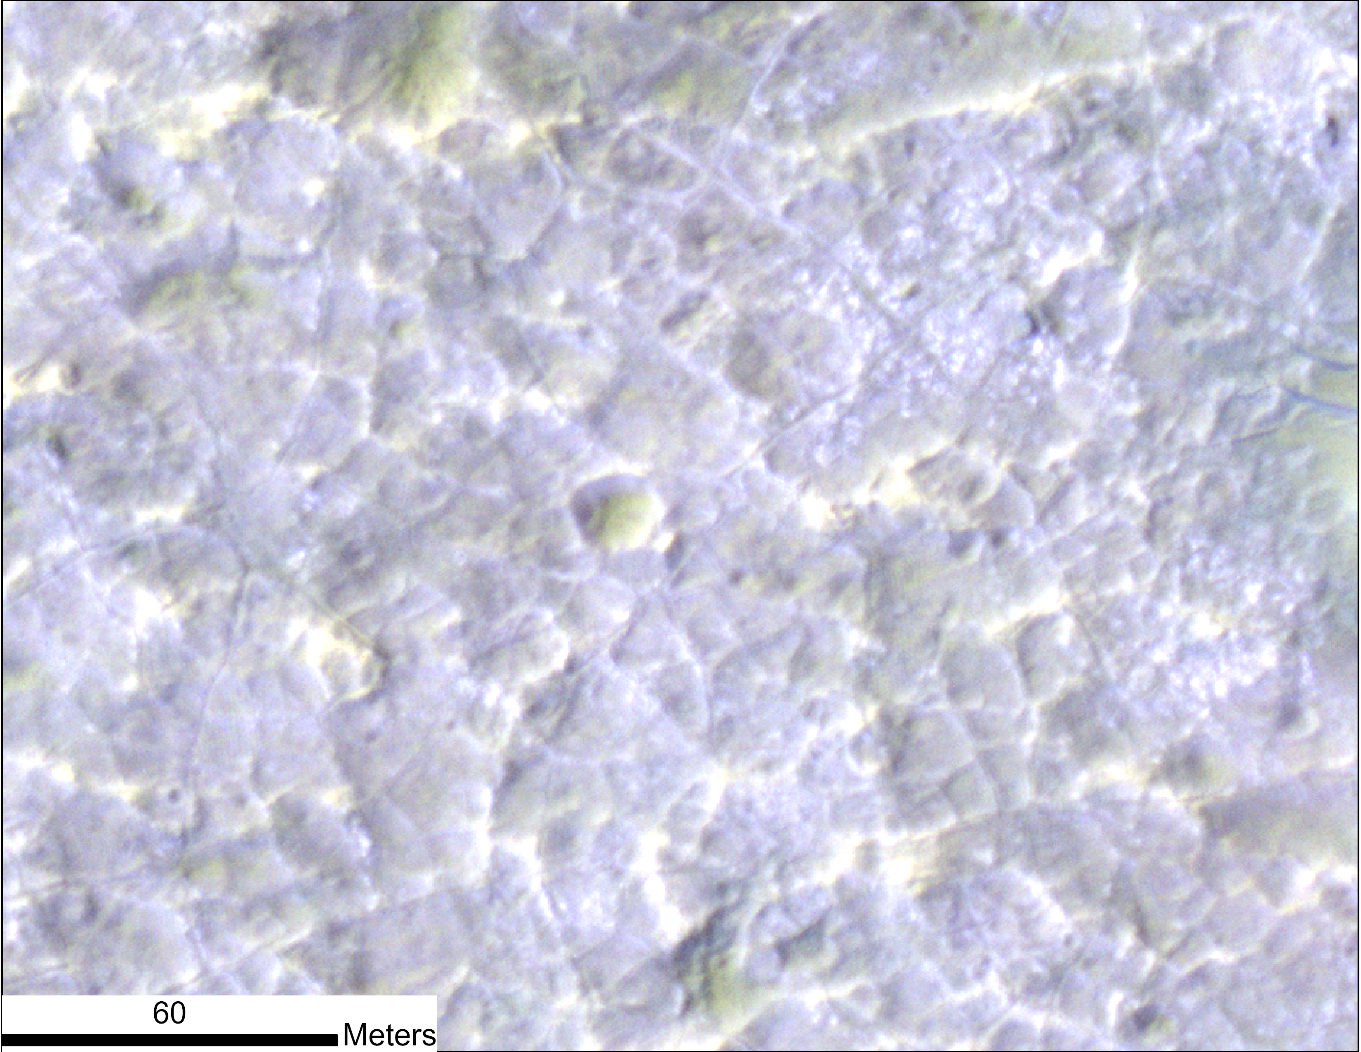
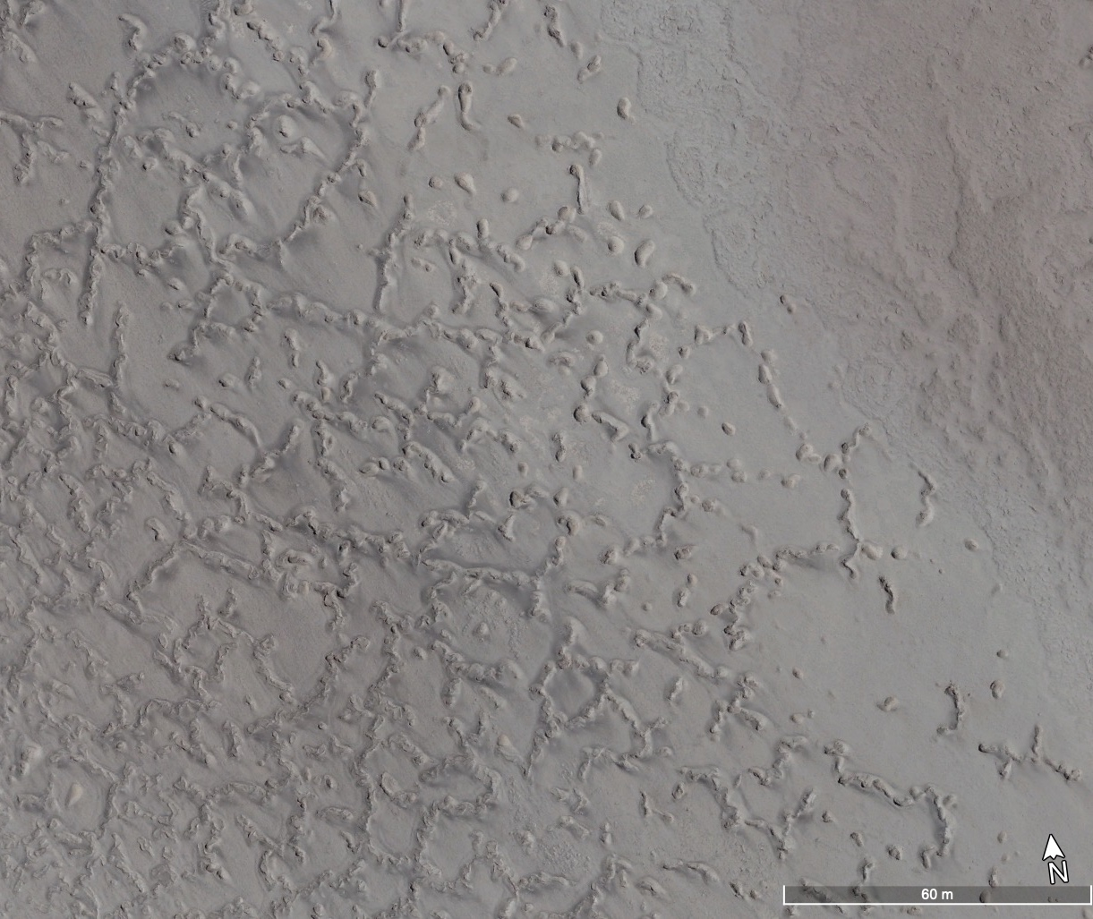
Features in a salt-encrusted basin, NE Hellas.
60 meters

Slide 16
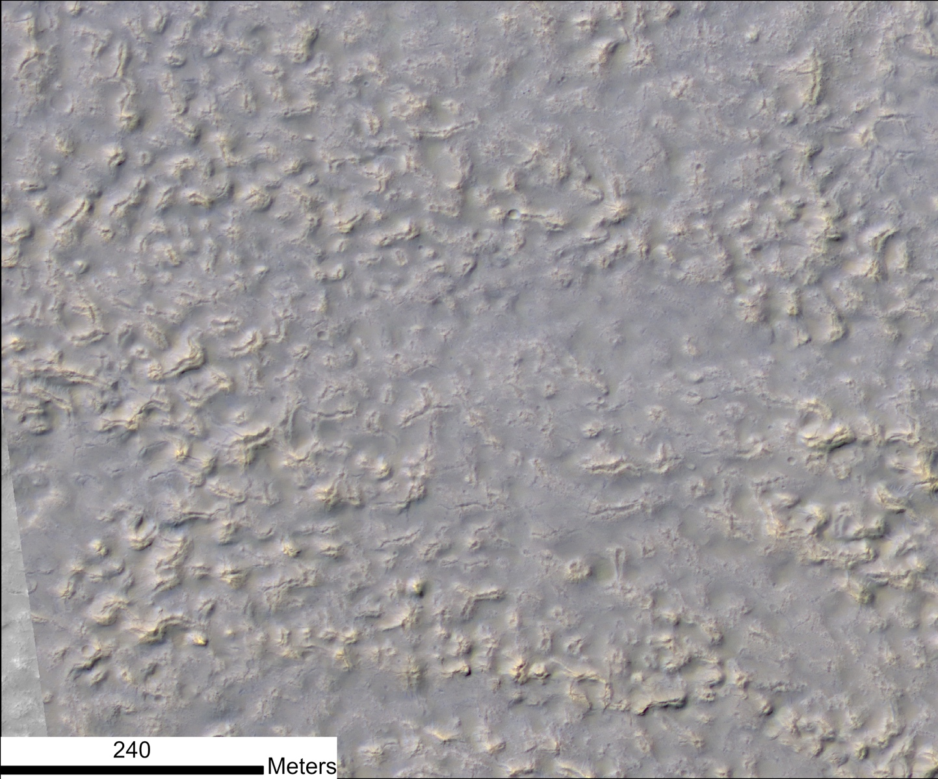
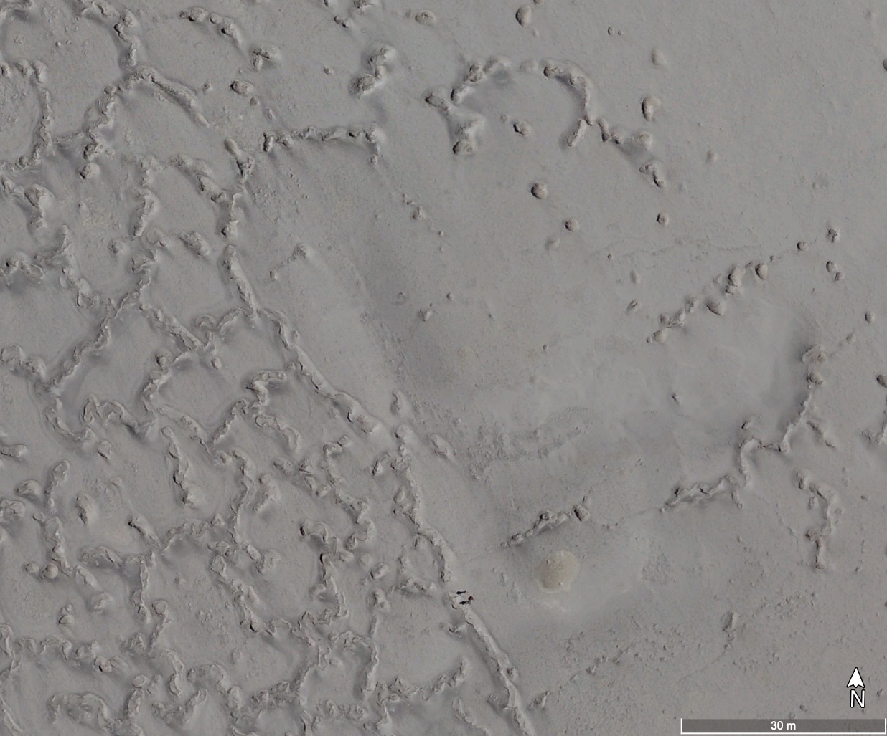
Features northwest of Argyre that were previously interpreted as pingos, but are possible salt constructs.
30 m

Slide 17
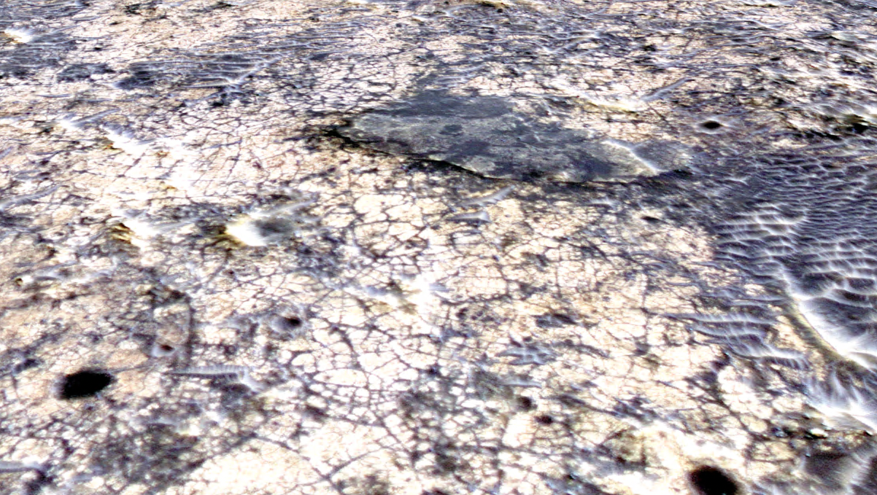
Salt-encrusted basins on Mars with topographic constructs should be considered as future mission landing sites.
A low-cost mission could go to a salt-encrusted basin to investigate:
  Ancient habitability and preservation of organics in martian salt.
  Modern habitability (Rivera-Valentin et al., 2020)
  Modern climate
    wind, water, dust

Slide 19
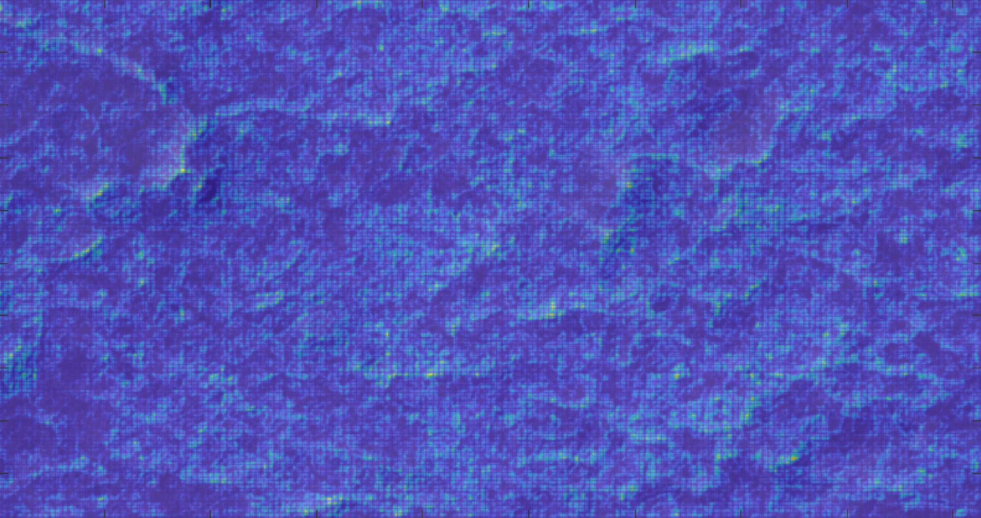
Entropy maps of martian salt crust highlight polygonal patterns in the crust.

Slide 20
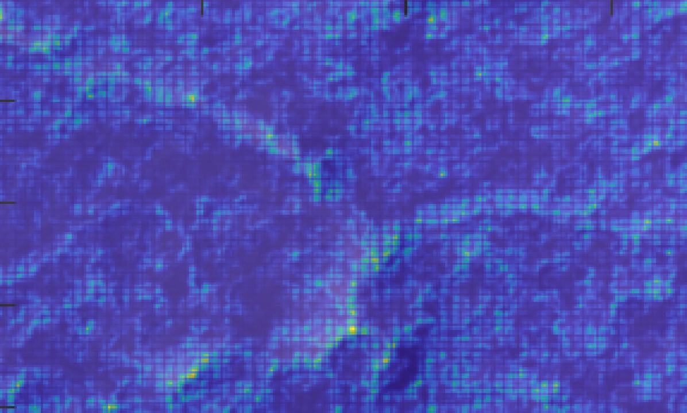

Slide 21
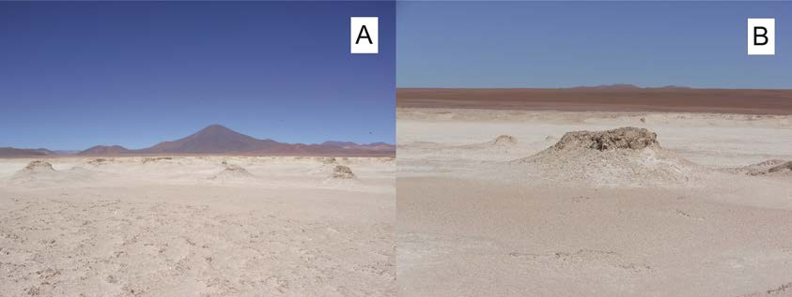
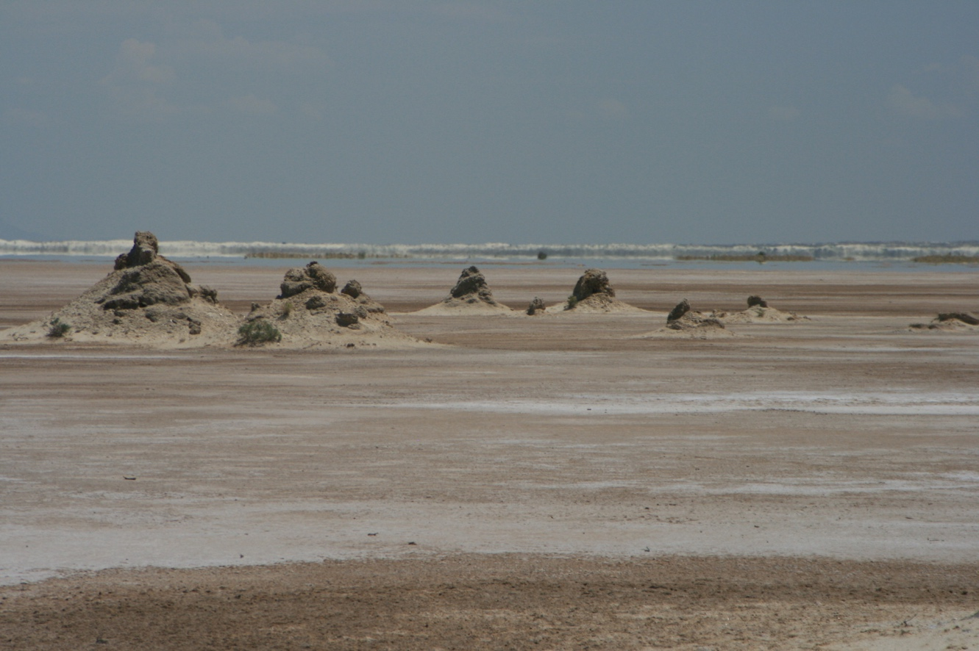
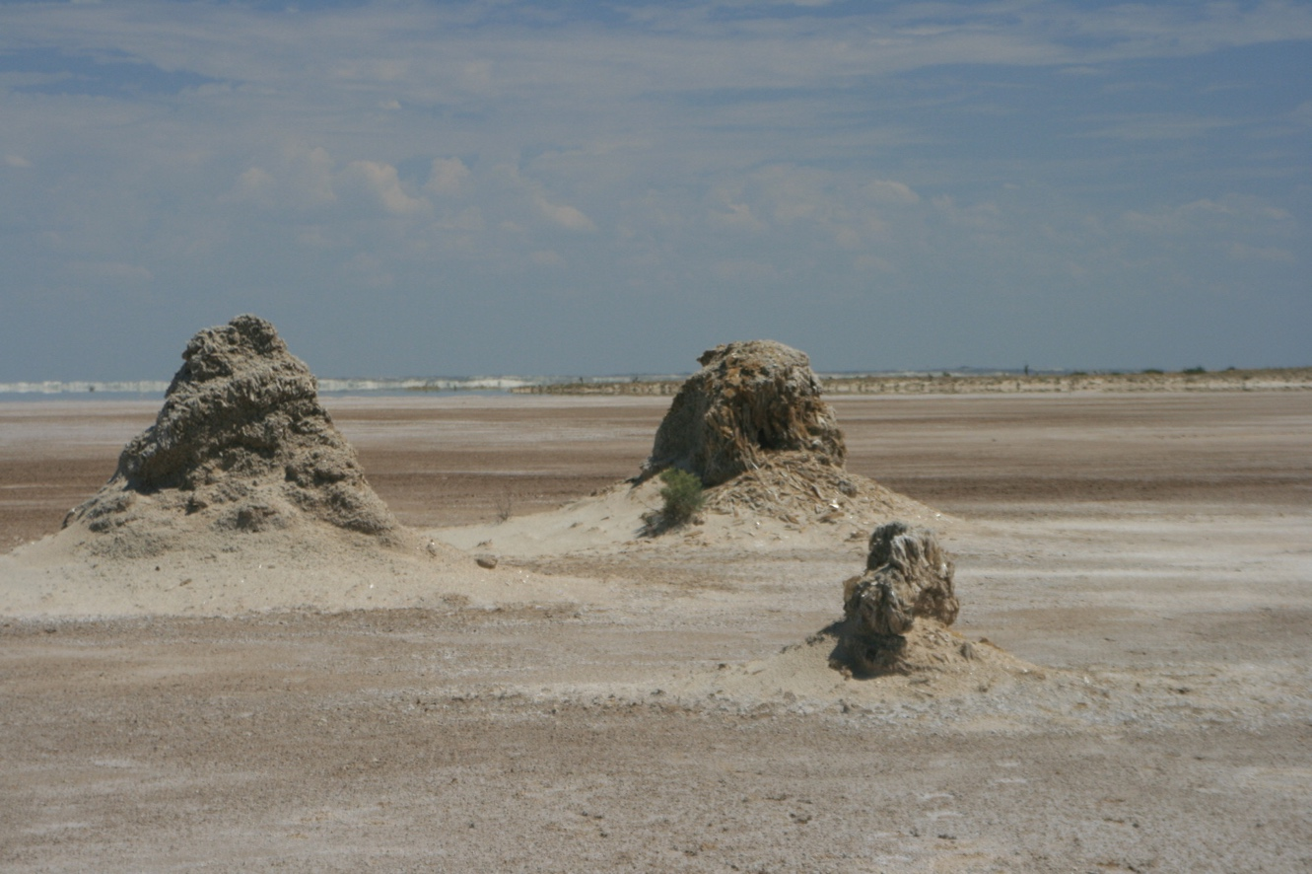
Pajonales
White Sands

Slide 22
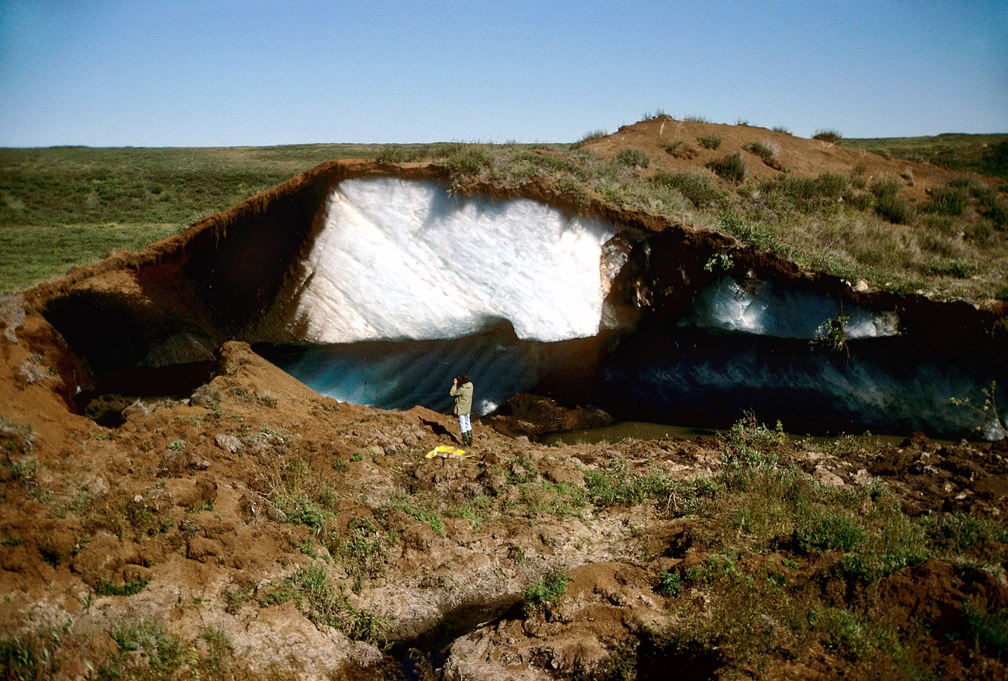
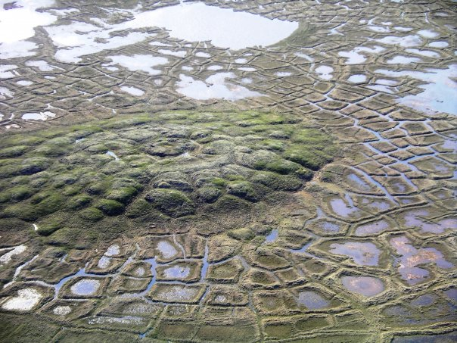
Pingos

