Slide 1
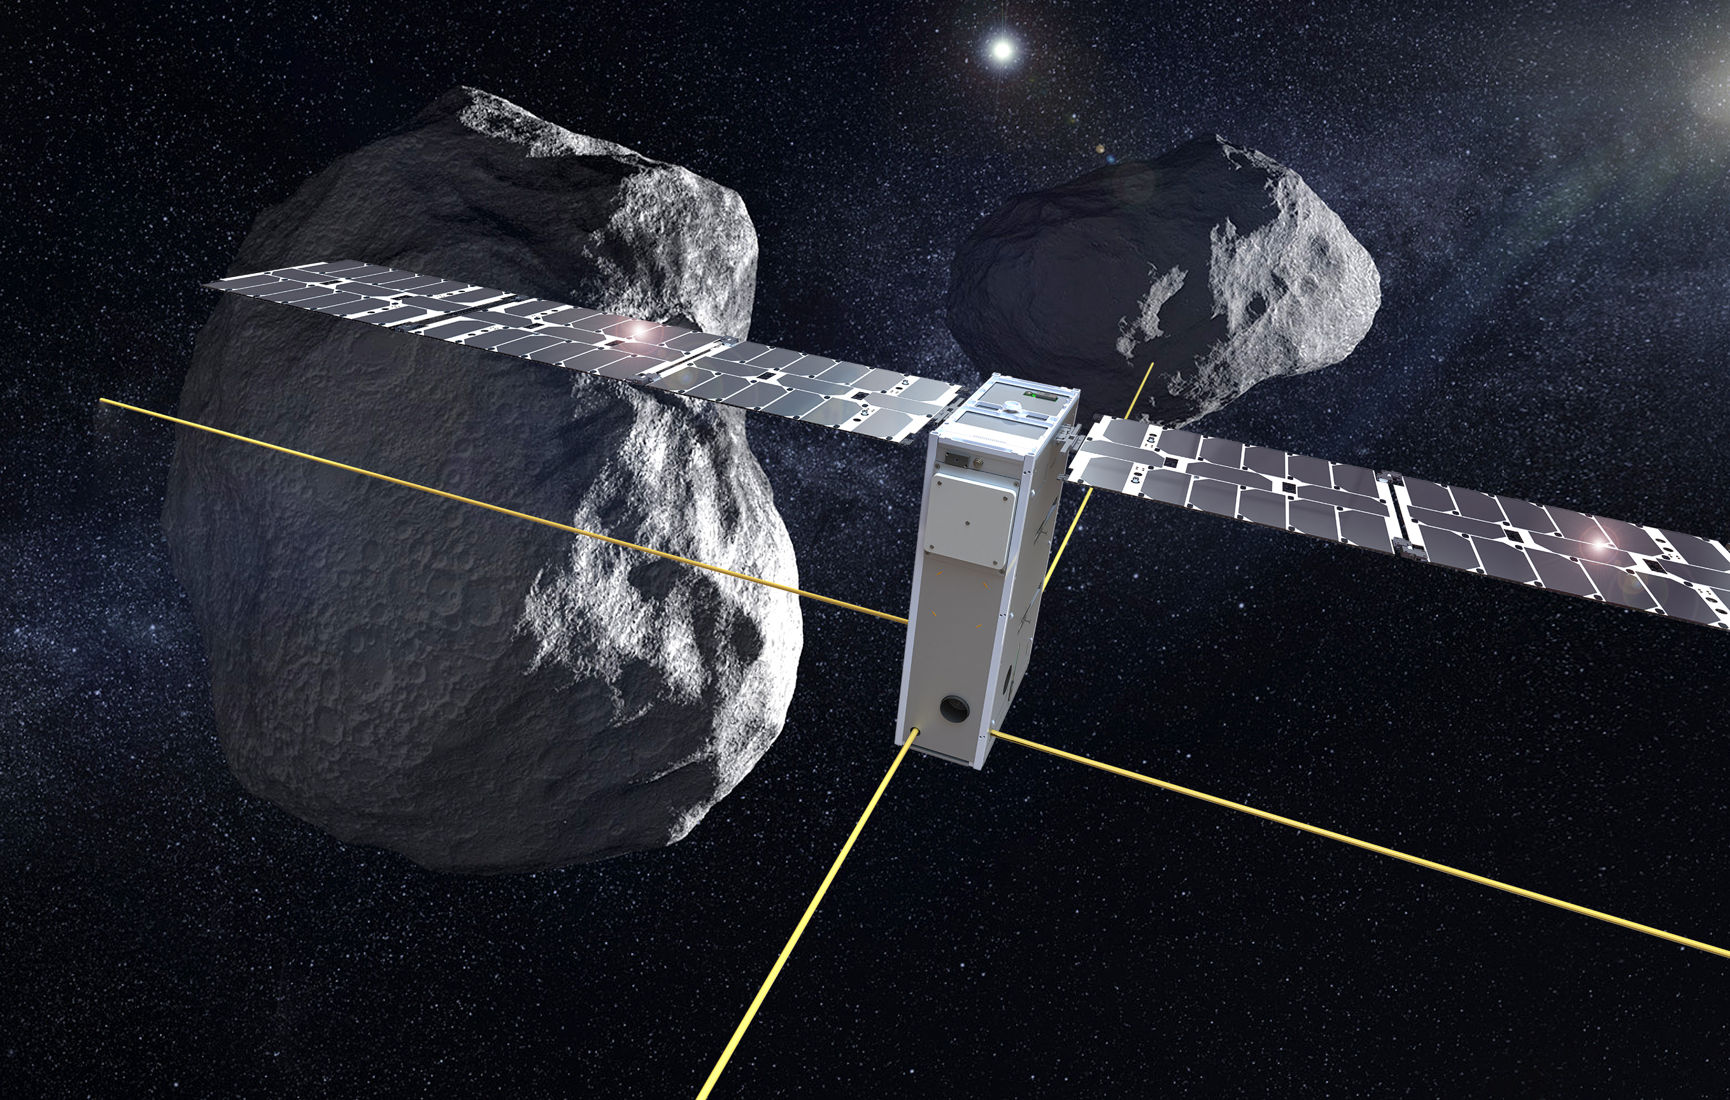









JuRa
Juventas Radar on Hera to fathom Didymoon
Alain Herique, Dirk Plettemeier, Wlodek Kofman and JuRa Team
Filip Záplata

Slide 2
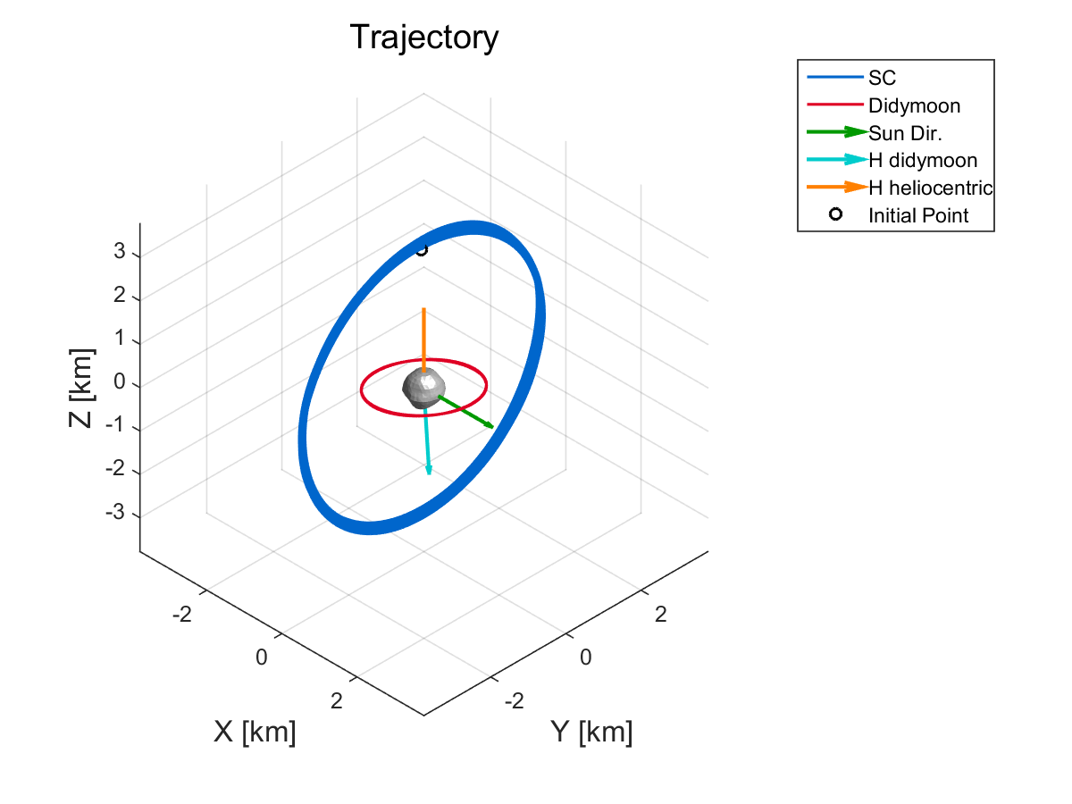
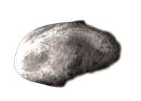
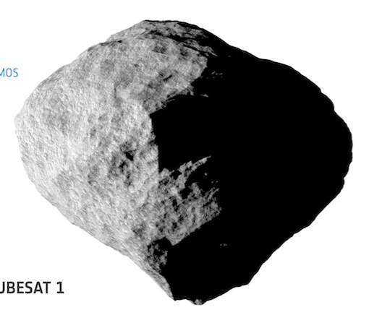
JuRa radar
Monostatic radar
  @ 60 MHz
  Full polar
  Coded radar BPSK
Nominal operation
  Launch 2024
  Operation 2027
  Terminator orbit
  1 month @ 3.3 km radius
  1 month @ 2 km radius (300 m)
 | JuRa
carrier | 60 MHz
signal | BPSK
BW | 20 MHz nominal 30 MHz extended
Resolution | 10 – 15 m (1D)
Polarization | Full linear
Tx power | 5 W
NEσ₀ | Better than -50 dB.m²/m²

Slide 3
Juventas Radar on Hera to fathom Didymoon
First objective: moonlet interior structures
to identify internal structure like layers, voids, sub-aggregate,
to bring out the aggregate structure
to characterize its constitutive blocks in terms of size distribution, heterogeneity at different scales (from sub metric to global)
  Binary system formation and stability conditions
  Impact crater characterization (with limited resolution)

Slide 4
Juventas Radar on Hera to fathom Didymoon
First objective: moonlet interior structures
Second objective: average permittivity and its spatial variation
to retrieve information on composition and porosity
  Full tomography if waves penetrates the whole moonlet

Slide 5
Juventas Radar on Hera to fathom Didymoon
First objective: moonlet interior structures
Second objective: average permittivity and its spatial variation
Secondary objective : The same characterization applied to the main
to identify internal structure
to retrieve information on composition and porosity
to detect difference in structure, texture and composition
  Aggregate structure
  Binary system formation and stability conditions

Slide 6
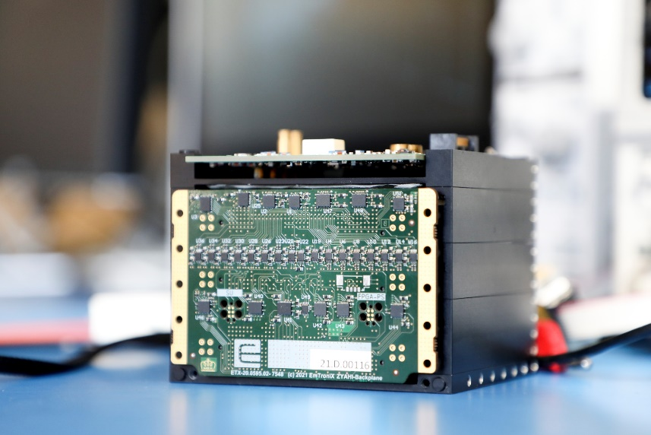
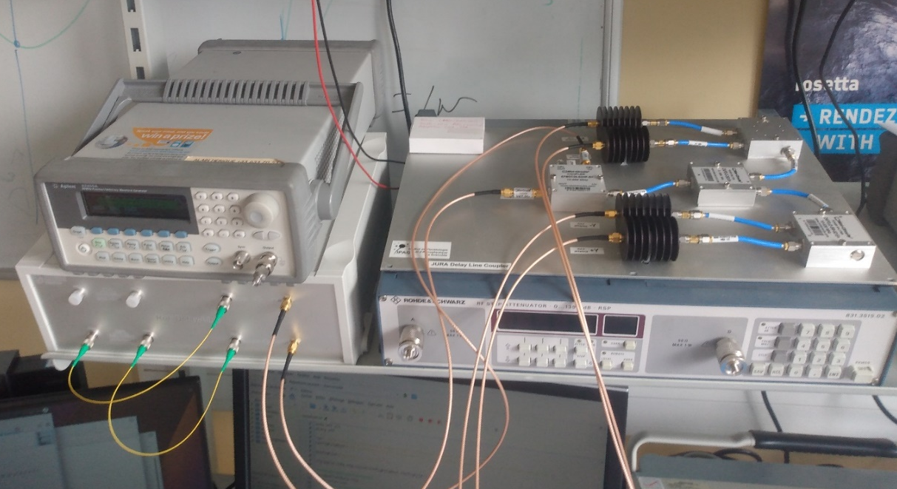
Electronics : EM 2.0
De-risk on the EM (Spring 22)
Radiation test
TV test and EMC
Chock
Calibration
SC Integration (Sumer 22)
Electronic tuning
+ PA re-design
SW validation & consolidation
in progress
GSE : 4 km optical fiber
to simulate propagation path

Slide 7
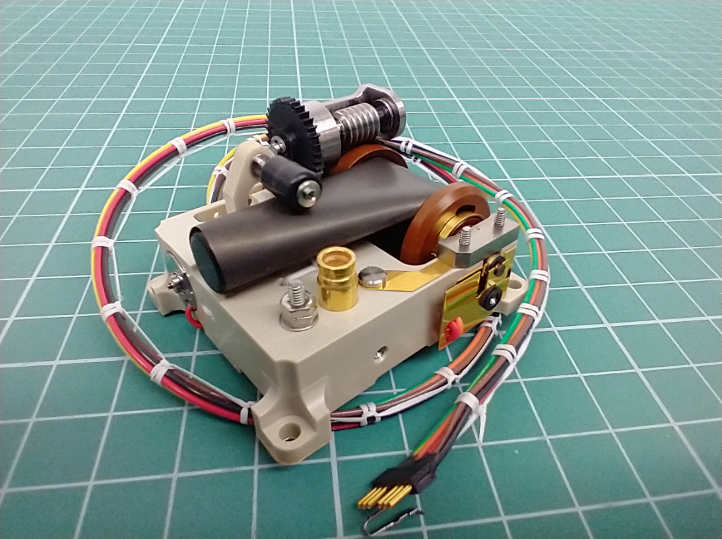
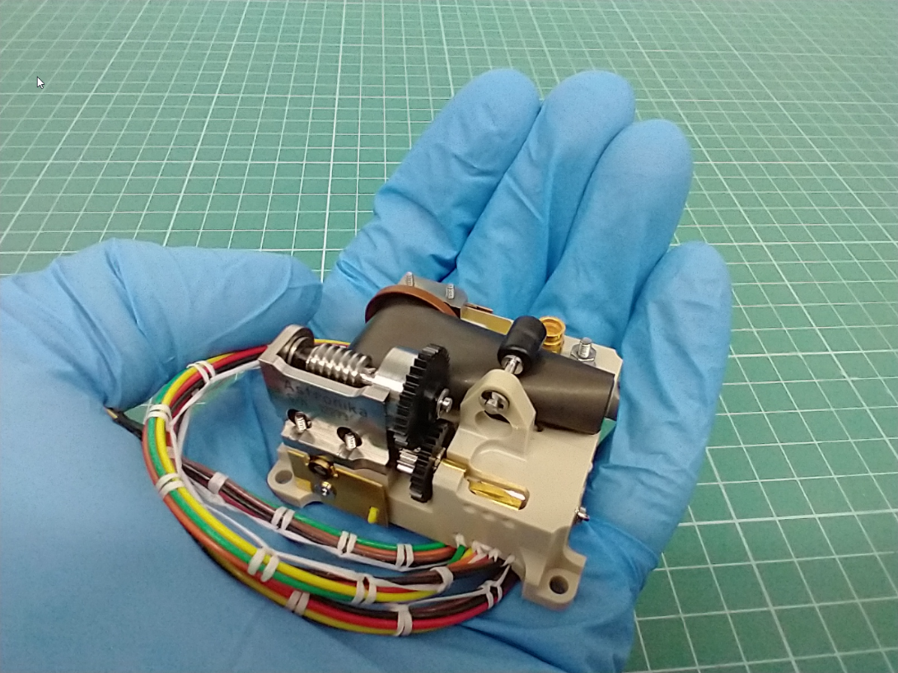
Antenna : Qualification model
2 cross dipoles
4 deployable booms
1.26 m & 65 g each

Slide 8
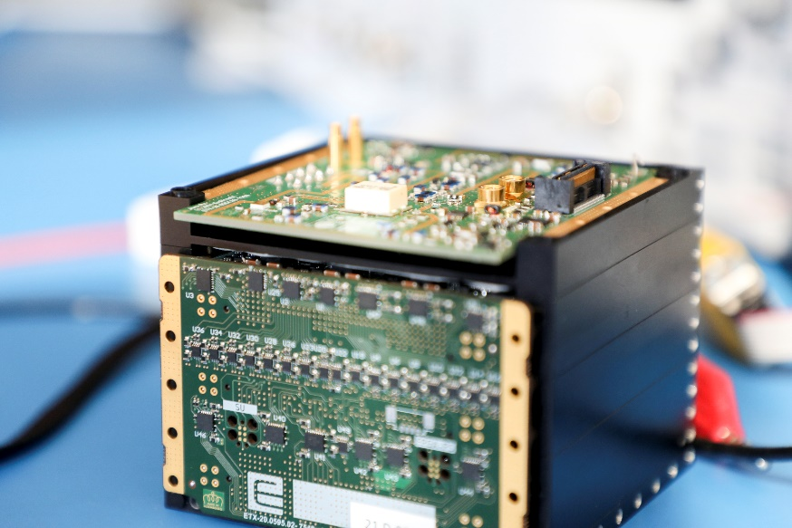
JuRA – Development phases
Electronics Unit
EM 2.0
De-risk test test jun 22
Calibration Jun 22
Design finalisation Sept 22
PFM
Production Sept 22
Instrument AIT Jan 23
Acceptance test Feb/Mar 23
Calibration test Mar 23
Juventas AIT April 23
Antenna Unit
FM
Production & Qualification in progress
Delivery Jan 23

Slide 9
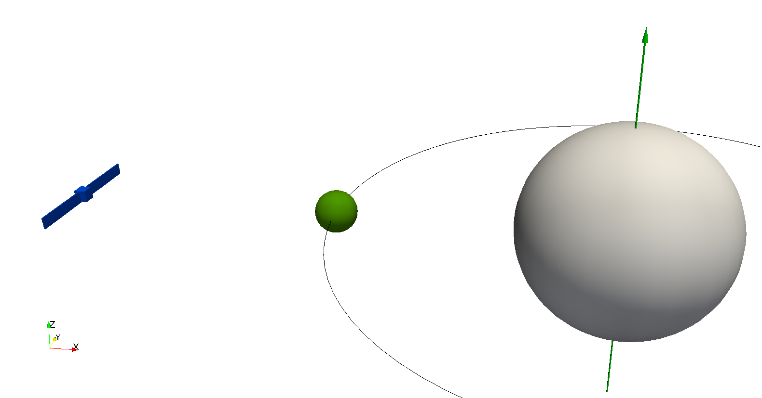
JuRa : Tomographic SAR
Synthetic Aperture Radar 60 MHz mapping Backscattering coefficient
Performances given by the acquisition geometry.
  range measurement (1st dim.)
  moon / main motion (2nd dim.)
  S/C motion : multipasses acquisition (3rd dim.)
Acquisition along arc of orbits
typically 45 minutes (driven by the moon)
Strawman scenario periodic : 45 every 110 minutes
=> no periodicity for final scenario!

Slide 10
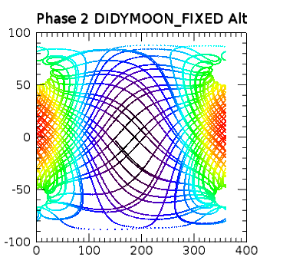
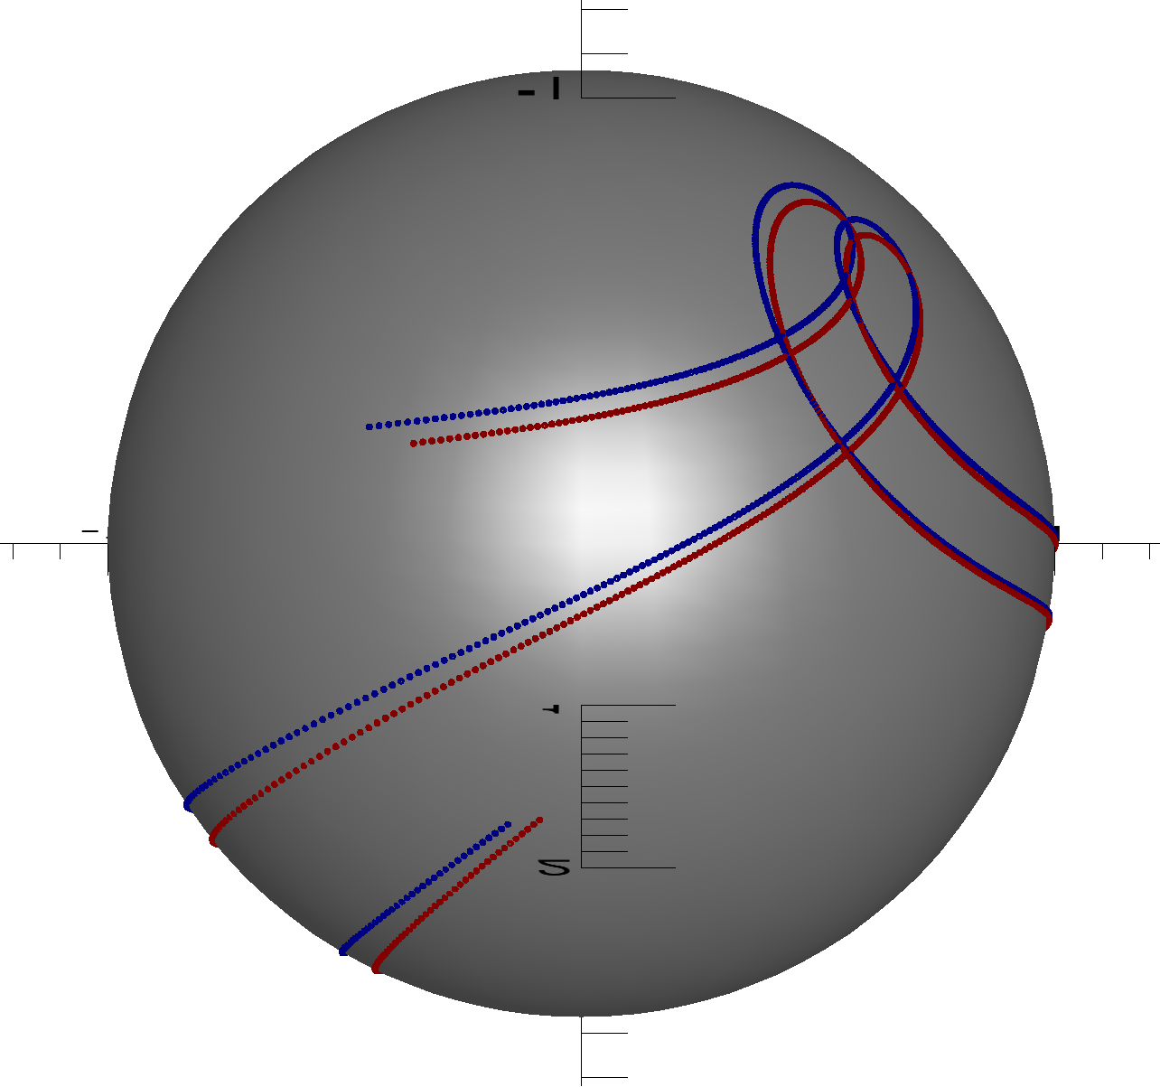
Scenario optimization
Orbits Eval Sphere Performances

Slide 11
JuRa Science Lead
Alain Herique (IPAG)
Dirk Plettemeier (TUD)
JuRa Instrument Team
Sabrina Bottigelli (Emtronix)
Lucas Cicero (Emtronix)
Sunayana Chakradhar (Emtronix)
Ronny Hahnel (TUD)
Amine Kechouindi (Emtronix)
Michal Kubíček (FZa)
Martin Laabs (TUD)
Hugo Naydenov (IPAG)
Dominik Nolbert (Astronika)
Hugo Nowacki (IPAG)
Sylvain Rochat (IPAG)
Yves Rogez (IPAG)
Yann Le Corre (Emtronix)
Cedric Lorant (Emtronix)
Evgeny Zakutin (TUD)
Filip Záplata (FZa)
Acknowledgments
Hera is the ESA contribution to the AIDA collaboration.
Juventas and JuRa are developed under ESA contract supported by national agencies.
JuRa is built by Emtronix (Lux), UGA/IPAG (Fr),
TUD (De), Astronika (Pl) and Filip Zaplata (Cz).
Juventas is built by Gomspace (Lux).
This project has received funding from the European Union’s Horizon 2020 research and innovation program under grant agreement No 870377 (project NEO-MAPP).

Slide 12
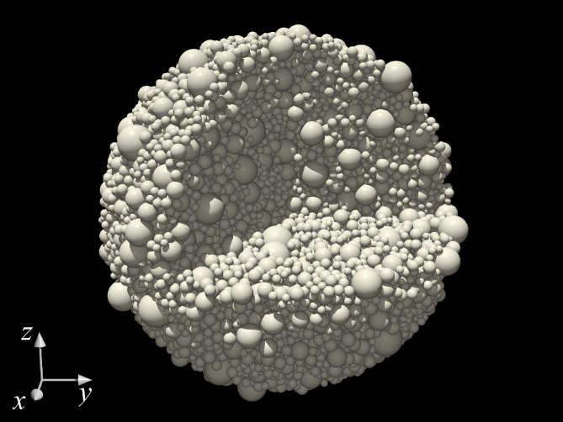
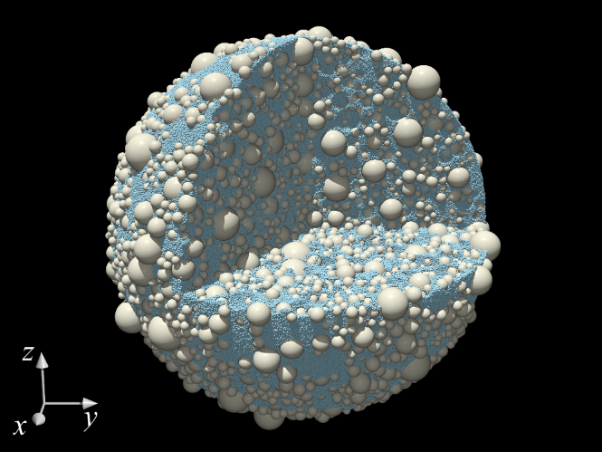



Interior : What is a radar sensitive to?
Complex permittivity (speed & absorption)
  Related to composition, mineralogy, porosity
  Propagation regime depends on its spatial variations
  Return power (backscattering coefficient)
  Permittivity contrast
  Mixing contrast and scales $\frac{\left|∇ε\right|}{ε} \sim \frac{1}{λ}$
  Dust and gravels
$λ$/20
$$20 λ$$
Homogeneous media
Equivalent permittivity
Geometrical optics
refraction
Scattering regime

