Slide 1
The Canadian Roadmap for
Advancing Scholarly Communications
Jonathan Bengtson, Vice-President, Canadian Association of Research Libraries & University Librarian, University of Victoria, Canada
FORCE2017, Berlin, October 25-27, 2017

Slide 2

First a shameless advertisement…
KULA: Knowledge Creation, Dissemination, and Preservation Studies
        Peer-reviewed, open access journal (no APCs!)
    Multi-disciplinary & international
    Focus on knowledge processes, concerned to understand their role, and to project them into the future from both humanistic and technological perspectives
Content will launch in coming weeks (including articles by John Willinsky & Cameron Neylon) + two special issues in coming months on Endangered Knowledge (Bethany Nowviskie (DLF)) and Implementing New Knowledge Environments (Ray Siemens)
https://kula.uvic.ca/

Slide 3
Outline: The Canadian Roadmap for
Advancing Scholarly Communications
Context and Rationale
Roadmap Objectives
  Where Next for Repositories?
  Canadian Scholarly Publishing Working Group
  Portage Research Data Management Network

Slide 4
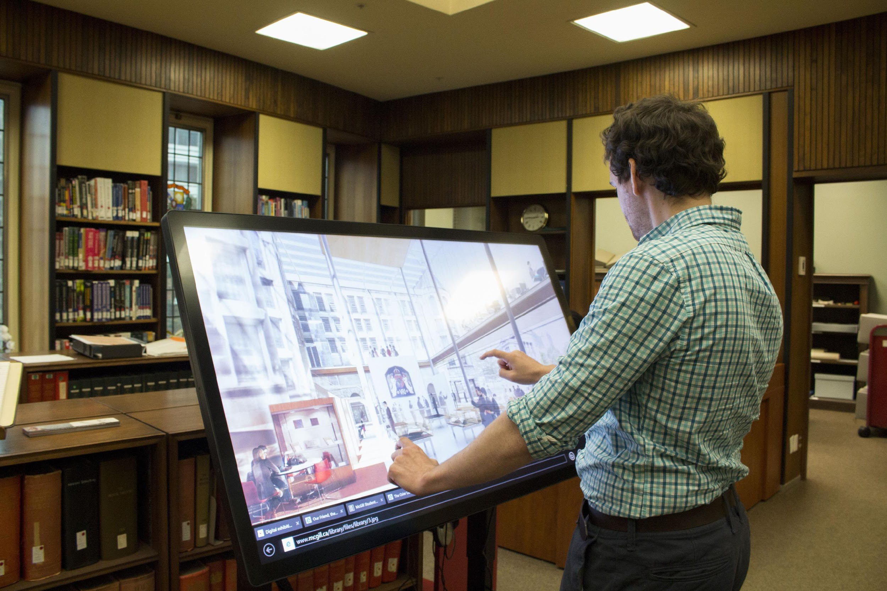

About CARL http://www.carl-abrc.ca/
Canada’s 31 largest research libraries
29 academic libraries based in research-intensive universities across Canada
2 federal institutions: Library and Archives Canada and National Research Council National Science Library
McGill University - Osler Library of the History of Medicine. Photo: Lauren Goldman
A leadership organization
To enhance members’ individual and collective capacity to support higher learning and scholarship
To promote a public policy environment in which libraries, research, and open scholarship will thrive
CARL Fall General Meeting - 2016

Slide 5

About Canada
The current federal government supports research and embraces evidence
Increased investment in research
National Science Advisor created
Open Government strengthened
Long-form census reinstated
Multiple consultations underway:
  Fundamental Science Review
  Innovation Agenda
  Canadian Content in a Digital World
  Leadership Council on Digital Infrastructure
University of Toronto - Thomas Fisher Rare Book Library
Photo: Gordon Belray

Slide 6
Canadian Universities and Sustainable Publishing (CUSP): A White Paper (February 2016)
“The scholarly communications landscape in Canada is on the cusp of transformative change.”
Many factors are converging:
Impact of digital technology on teaching and research
Move towards policies on open access
Oligopoly of international academic publishers
Financial constraints of university budgets
Growing expertise of academic libraries in utilizing and supporting technology-based initiatives

Slide 8
Following the CUSP white paper
Engagement of the provosts of 15 largest universities, and some interest in a statement of principles
Institutions systematically raising awareness amongst faculty and administrators of the need for change
Canadian publishers interested but also concerned –
‘Don’t paint us with the same brush as the big five.’
Now on agenda of Universities Canada (presidents)
… Encouragement that led to development of the Roadmap

Slide 9

The CARL Roadmap (January 2017)
The Roadmap is guided by the vision of an open, sustainable, effective, and innovative scholarly communication system that is governed and managed by the scholarly community, and that reflects a substantial role for Canadian academic libraries.

Slide 10
CARL Scholarly Communications Roadmap
By acting nationally and coordinating internationally, Canada and CARL can be a force for change through:
  Collaborating with other stakeholders in Canada
  Identifying, supporting and promoting ideas with other regions
  Working to change cultures and local practices
  Launching pilot projects designed to expand beyond our borders
  …IARLA mapping on framework underway (CAUL, RLUK, LIBER, ARL)

Slide 11
CARL Roadmap Objectives
Increase awareness and engage stakeholders about the benefits of open access and the need for change
Promote and accelerate the adoption of open science policies
Lower the economic barriers to the creation and dissemination of academic publications
Promote the responsible application of impact and productivity measures for research
Expand the types of research outputs that contribute to the formal scholarly communication system

Slide 12
Encourage adoption of open access policies
Roadmap item 2.1 - With university administrators, develop a best practice institutional open access policy and principles and support their implementation at Canadian universities
As a tool to be used to actively pursue adoption of an institutional open access policy or simply to initiate a conversation on this topic, members of CARL’s Advancing Research Committee are:
Producing a template for a Canadian institutional open access policy;
Compiling advice and strategies from institutions that have gone through process;
Updating existing CARL documentation on author rights to be used concurrently.

Slide 13
Sharing License Costs
Roadmap item 3.3 - Publish and share subscription fees and licensing details
Inspired by the work done in Finland and elsewhere, and by a number of Canadian institutions, CARL aims to:
Adopt the principle of transparency around subscription fees and licensing;
Share as much data around subscription fees and licenses as possible;
Share Canadian data with similar organizations internationally.

Slide 14
Where Next for Repositories?
National Forum with COAR – held Nov 10, 2016
Roadmap item 3.4 - Strengthen and add value to the network of Canadian open access repositories by collaborating more closely and adopting a broader range of services such as assessment and usage measures
Forum objectives:
Strengthen the role and momentum for a Canadian network of repositories within the context of a sustainable open scholarly communication system;
Inform the community about the current state of repositories internationally;
Discuss new and evolving roles for repositories and how they can support library operations;
Develop an agenda for the future of repositories in Canada.

Slide 15
Where Next for Repositories?
National Forum with COAR – held Nov 10, 2016
Follow-up efforts:
Recently partnered with COAR to host a webinar that introduced repository managers in Canada and beyond to the work on reliability of repository statistics by Repository Analytics and Metrics Portal (RAMP) and Institutional Repository Usage Statistics UK (IRUS-UK);
Planning a collaboration with OpenAire to pilot repository metadata aggregation in Canada;
Developing other strategies to support burgeoning repository community of practice in Canada.
http://www.carl-abrc.ca/wp-content/uploads/2017/02/Repos-forum-summary_EN.pdf

Slide 16
Canadian Scholarly Communications
Working Group
Roadmap item 3.5 - Work with Canadian journals to develop, assess and adopt sustainable open access funding models
Facilitated by CARL, with multiple stakeholders including the Canadian Association of Learned Journals, the Association of Canadian University Presses, Érudit, and Public Knowledge Project (PKP) – as well as researchers and one funding body
The final report offers useful insight toward the development of emerging publishing services and platforms in the Canadian research landscape as a key component of a larger knowledge mobilization strategy

Slide 17
Work with Canadian journals on Open Access
Roadmap item 3.5 - Work with Canadian journals to develop, assess and adopt sustainable open access funding models
Follow-up activity:
Supporting the work of organizations like Érudit, who is proposing to develop a national platform for both French and English language journals in Canada, with a suite of services.
https://apropos.erudit.org

Slide 18
Portage: Shared Stewardship of Research Data
Roadmap item 5.1 - Maintain and expand the Portage network for research data management
  Portage is creating a sustainable network of library-based services and collaborative infrastructure for research data management, by coordinating and expanding existing expertise, services, and infrastructure to support academic researchers in Canada.
  Foster a community of practice for research data management
  Facilitate and provide leadership in the development of RDM infrastructure
  Engage and advocate for RDM with stakeholder communities

Slide 19













Working with Multiple RDM Stakeholders

Slide 20
Community of Practice – Network of Experts
Areas of Expertise:
Data Management Planning
Data Discovery
Curation
Preservation
Research Intelligence
RDM Platforms
Training

Slide 21
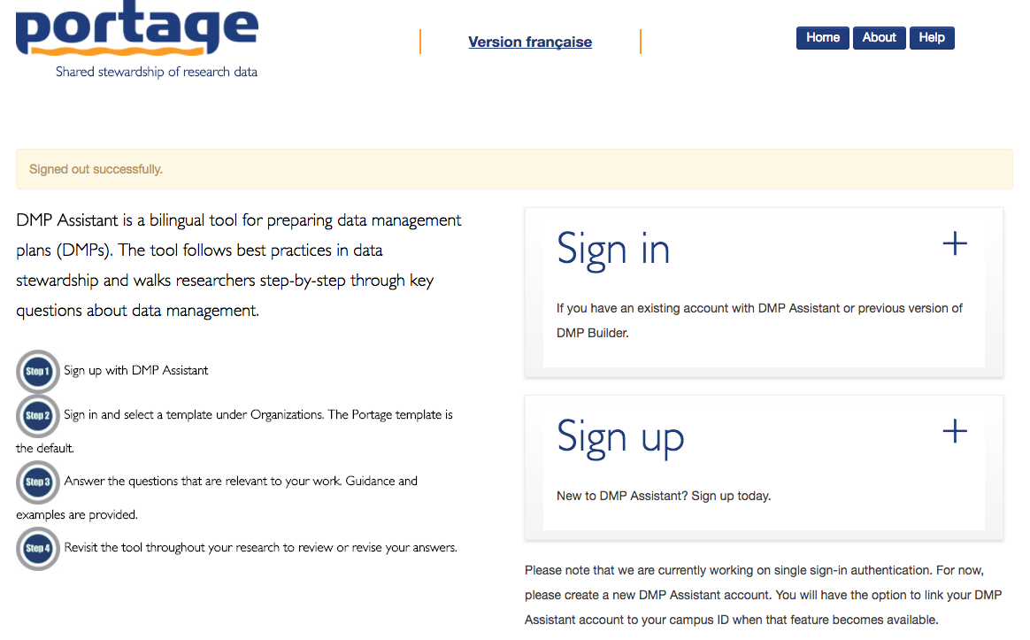
Infrastructure – Recent Developments
Online, bilingual data management planning tool to help researchers create data management plans
Based on Digital Curation Centre’s DMP Online tool
Available to all Canadian researchers
Domain-specific templates in development
Data Management Planning

Slide 22
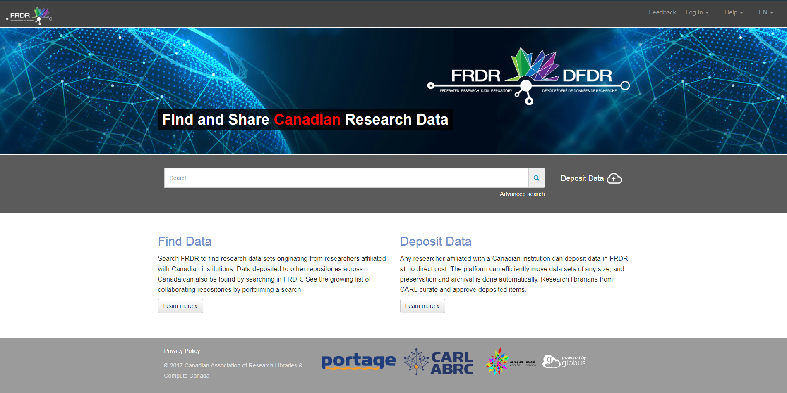
Infrastructure – Recent Developments
Federated Research Data Repository
Joint software development project with Compute Canada
A scalable, federated platform for digital RDM and the discovery of Canadian research data
In limited production as of autumn 2017

Slide 23

Infrastructure – Recent Developments
Dataverse North
Brings together Dataverse providers and research libraries across Canada
Coordinate local and national training, support services, outreach strategies, promotions, and infrastructure development and needs

Slide 24
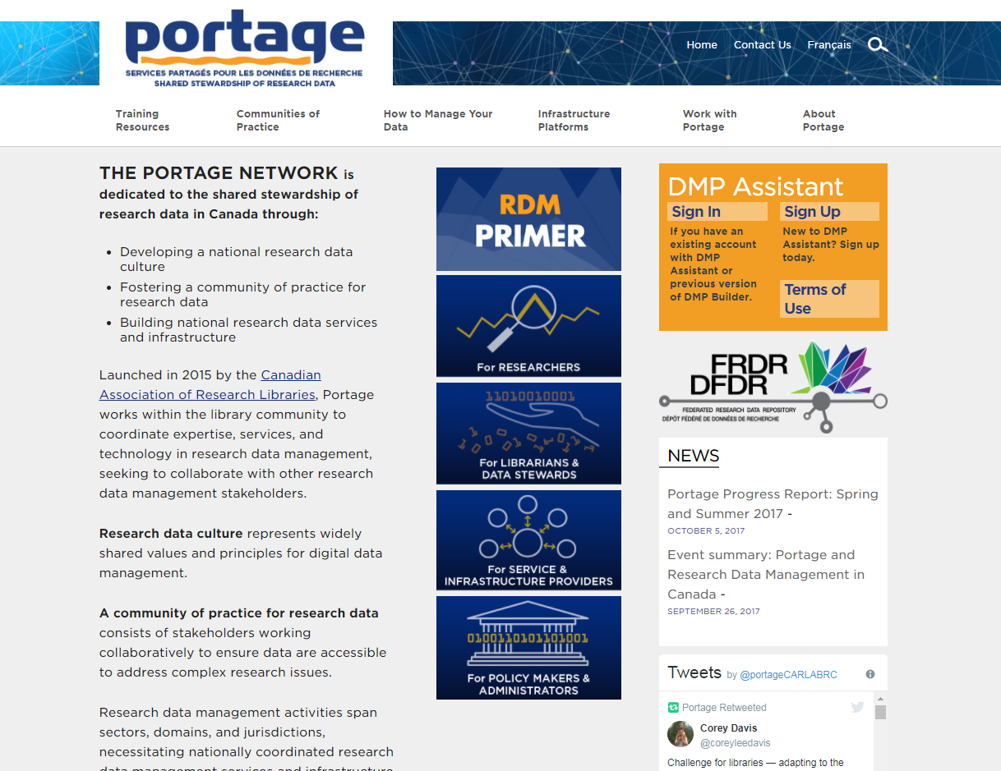
portagenetwork.ca

Slide 25
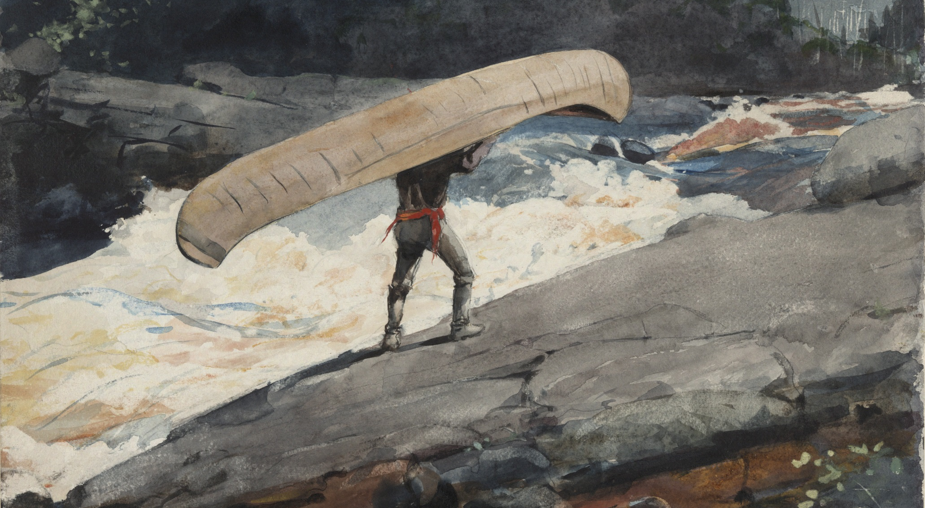
Thank you http://www.carl-abrc.ca/publications-and-documents/
Jonathan Bengtson
bengtson@uvic.ca
Winslow Homer, “The Portage” (1897)

