Slide 1
Research innovations and open science practices in Eastern Europe
Eleonora Dagiene (Lithuania), Najla Rettberg (OpenAire), Mario Malicki (Croatia), Teodor Georgiev (Bulgaria), Aliaksandr Birukou (Springer)

Slide 2
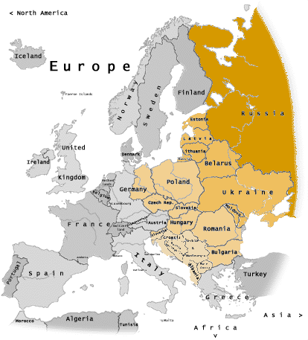
Eastern European countries
Joy (shallot)

Slide 3
 | Members | DOIs
Russian Federation | 413 | 548905
Ukraine | 84 | 55907
Croatia | 82 | 69159
Romania | 76 | 16813
Serbia | 31 | 57311
Slovenia | 30 | 11983
Lithuania | 19 | 28,382
Bulgaria | 16 | 78,861
Bosnia and Herzegovina | 12 | 4994
Macedonia | 8 | 3528
Estonia | 7 | 5960
Latvia | 5 | 3397
Belarus | 3 | 840
Montenegro | 2 | 350
Moldova, Republic of | 1 | 139
Albania | 1 | 184
Grand Total | 790 | 886,713

Slide 5
Live ORCID iDs 3,978,320
 | iDs registered under each country's domain
Russian Federation .ru | 99,855 | 2,51%
Ukraine .ua | 15,679 | 0,39%
Croatia .hr | 5,998 | 0,15%
Romania .ro | 5,950 | 0,15%
Serbia .rs | 4,310 | 0,11%
Slovenia .si | 5,550 | 0,14%
Lithuania .lt | 2,474 | 0,06%
Bulgaria .bg | 4,141 | 0,10%
Bosnia and Herzegovina .ba | 1,286 | 0,03%
Macedonia .mk | 449 | 0,01%
Estonia .ee | 1,988 | 0,05%
Latvia .lv | 1,718 | 0,04%
Belarus .by | 518 | 0,01%
Montenegro .me | 4,435 | 0,11%
Moldova, Republic of .md | 271 | 0,01%
Albania .al | 352 | 0,01%
Please note that this likely underestimates the true number of ORCID users at each country, as it does not include accounts associated with personal email addresses (for example gmail.com).
https://orcid.org/statistics

Slide 6
Are those number disappointing?
No, the numbers are very impressive!
What is special?
What is particularly difficult, particularly easy?
Notes:
kalbos barjeras, mentalitetas, prioritetai
Difficult – senimas neužleidžia pozicijų iki 80-90 metų, nesupratimas, kad viskas kainuoja – sovietinių laikų palikimas, kai darbo jėga nekainavo...
Easy – atviri viskam, net ir blogiems pasiūlymams, ypač kai prisidengiama išsivysčiusių šalių vardais,

