Slide 1
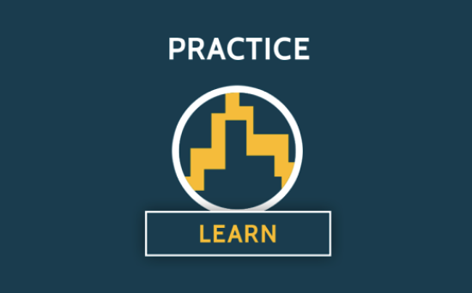
Mind the Gap
Scholarly Commons from Theory to Practice
Fiona Murphy and Maryann Martone
FORCE2017, Berlin, 26 October 2017

Slide 2
Principles
P1. The scholarly commons is an agreement among knowledge producers and users
P2. Research and knowledge should be freely available to all who wish to use or reuse it
P3. Participation in the production and use of knowledge should be open to all who wish to participate
this means that:
this means that:
this means that:
The commons is developed by its members through their practice
The commons is open by default
The commons welcomes and encourages participants of all backgrounds
Global commitment & participation in the commons’ long-term viability and preservation
Scholarly objects and content in
the commons are FAIR
The commons is open to all participants who accept its principles

Slide 3
Rules
R1. Rewards for participating
in the commons are access, opportunity and attribution
R2. The commons is agnostic regarding form and technology
R3. (Use of) external systems or technology, incl. reward systems, must not harm the commons
this means that:
this means that:
this means that:
Provenance of objects
in the commons should be transparent and persistent
The commons exists independently of technology, funding & business models that support and enable it
The form research is disseminated in is determined by the needs of the research itself
The commons has no intrinsic hierarchies, rankings, or reward systems
The commons accepts all objects adhering to its guidelines, regardless of form, genre or approaches
All activities and outputs
that take place in in the commons remain in the commons

Slide 4
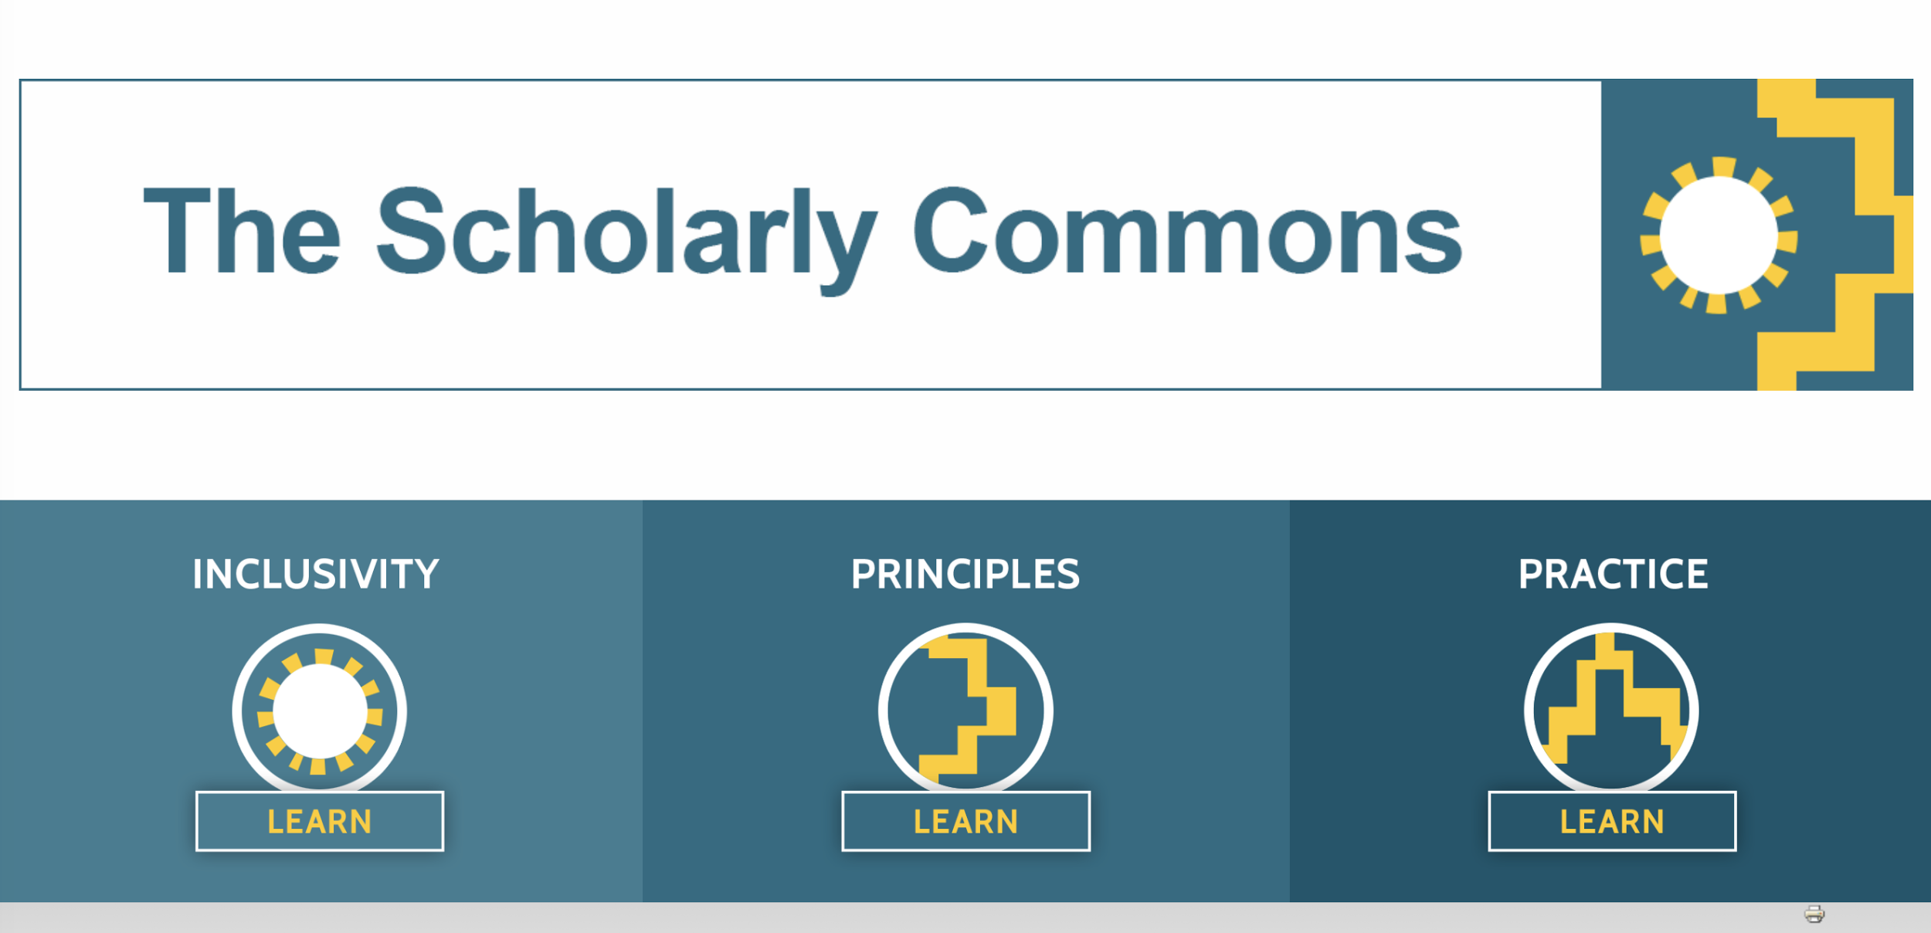

Slide 5
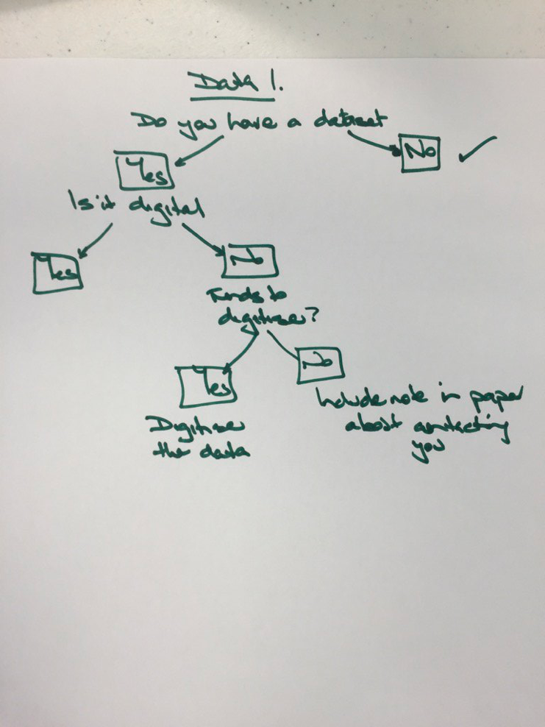
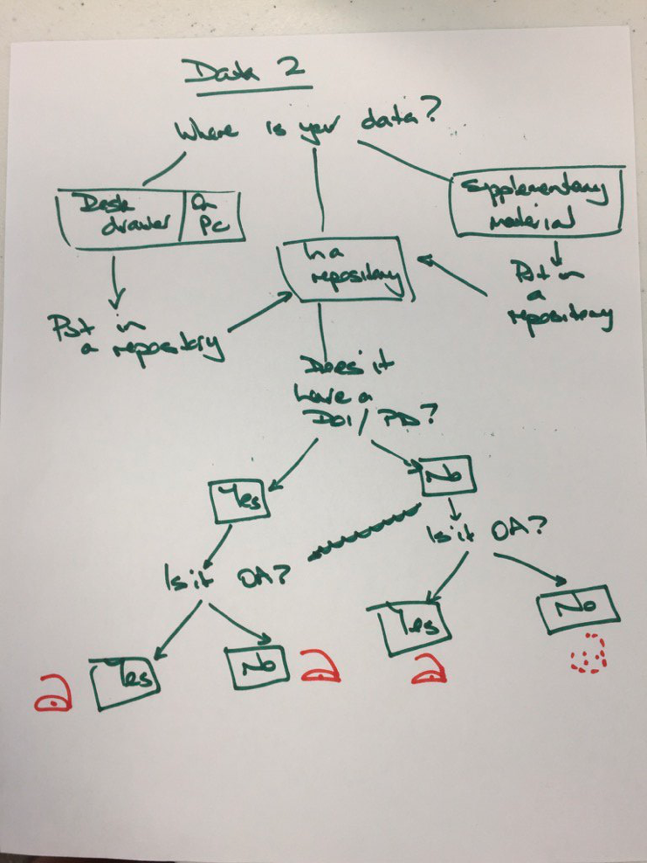
Do we have the tools and “know how” to practice scholarship according to the principles of the Commons?
The Decision Tree Working Group investigated:
1. How to practice Commons compliant scholarship by
2. Working through the some real-life research dilemmas to conduct research and produce outputs that themselves are Commons compliant and
3. Commissioning a software workflow package that both complies with Commons principles and produces useful (and compliant) outputs for scholars.
4. We documented our progress and our frustrations throughout!
https://www.force11.org/scholarly-commons/practice
Notes:
We’ve tried to do this so that the trees themselves are open, FAIR and citable. We found that many of the needed pieces already existed, but the current research infrastructure contains many barriers to practising in this way.

Slide 6
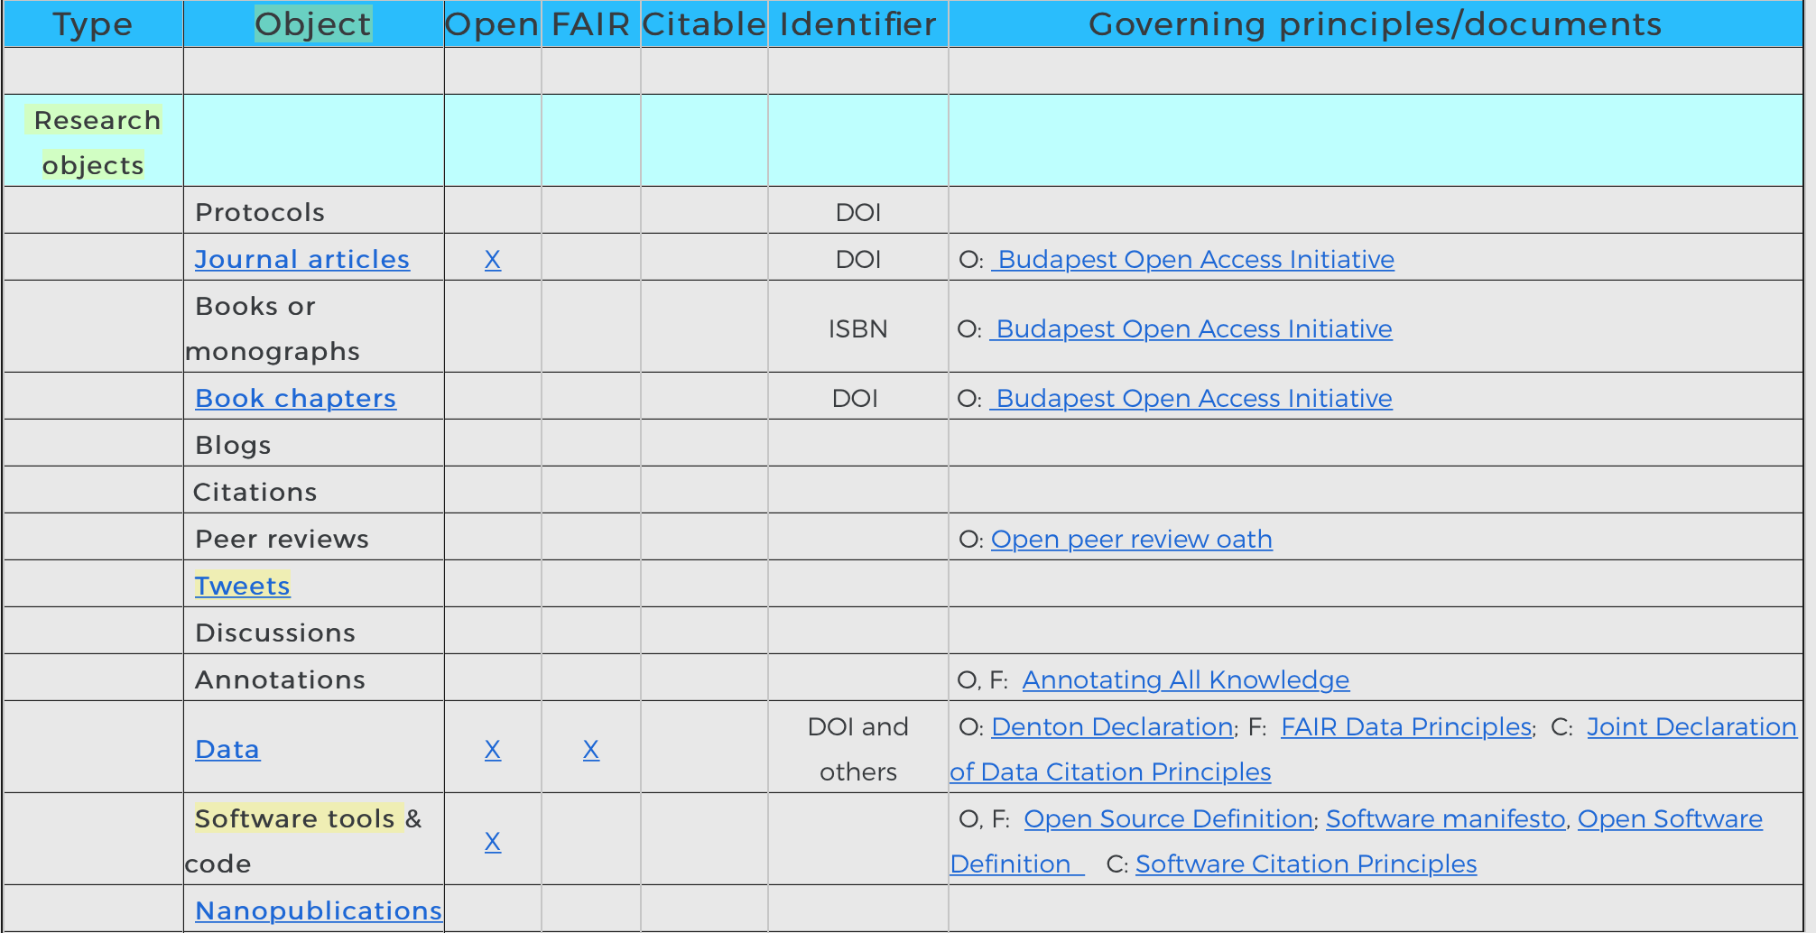
The Matrix of the Commons
An enumerated list of the entities involved: Research objects, e.g.
Data
Software
Narrative works
Materials such as IRB approvals
Entities such as people, organizations and working groups.

Slide 7
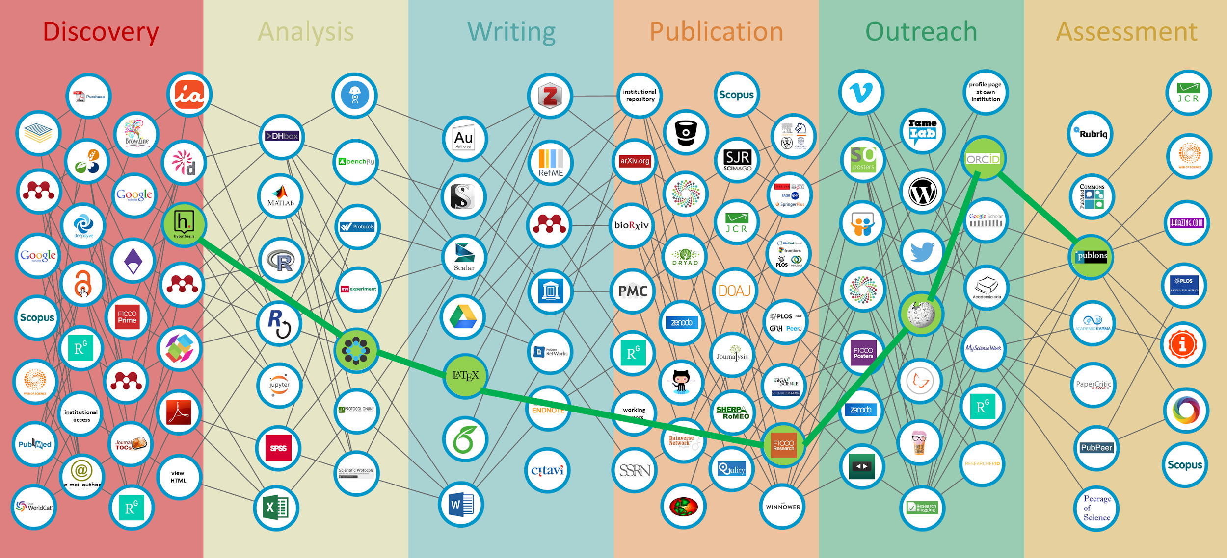
Notes:
We took the approach that we should work in as commons-compliant a way as possible, using existing tools where we could.
“there should be no systemic barriers and disincentives to prevent either such free use or open participation”

Slide 8
The Solicitation
The requirement is to produce a research output decision tree compilation and publishing workflow: a seamless set of tools that will allow people to easily create decision trees that help with decision making about conducting research openly and producing research outputs that are FAIR, open and citable. Where possible we would like to use existing tools and software that are Commons compliant. If these are not available, the proposal should address this by developing solutions.

Slide 9
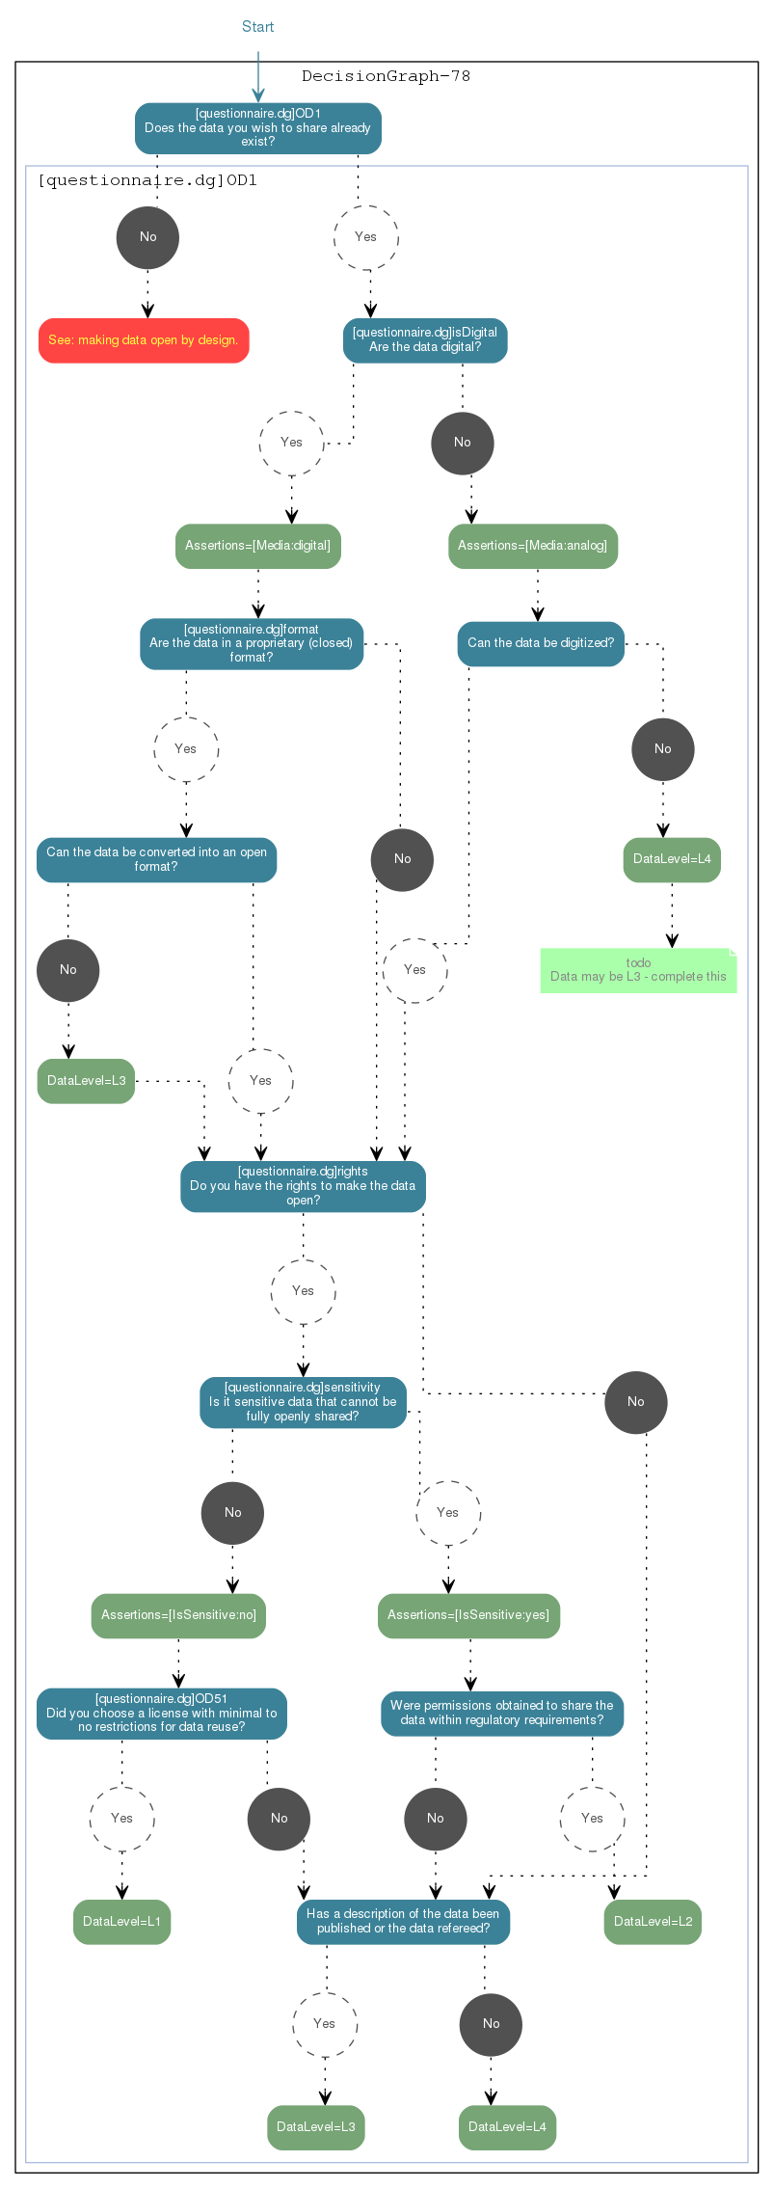
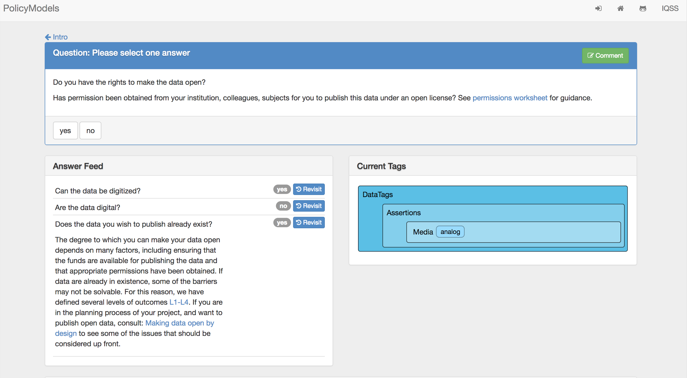
Decision Trees
Notes:
Michael Bar-Sinai of Israel and Harvard has responded. Shout out for subsequent demo sessions

Slide 10
Handbook of the Commons
If you have to cut and paste, the commons is broken
Versioning must be supported; an identifier should always resolve to the latest version
People are objects in the commons too: Single sign-on via ORCID
All scholarly objects should come with the ability to provide feedback, e.g., through annotations, discussions
Assume people are drivers and not mechanics: tools should promote knowledge synthesis and creation
Get rid of stupid: Knowledge producers should be producing knowledge, not formatting references (cut down friction)
All research objects should come with and return machine-readable citation level metadata
All links should be bidirectional
Assume your tool/platform/content will be used with others!

Slide 11
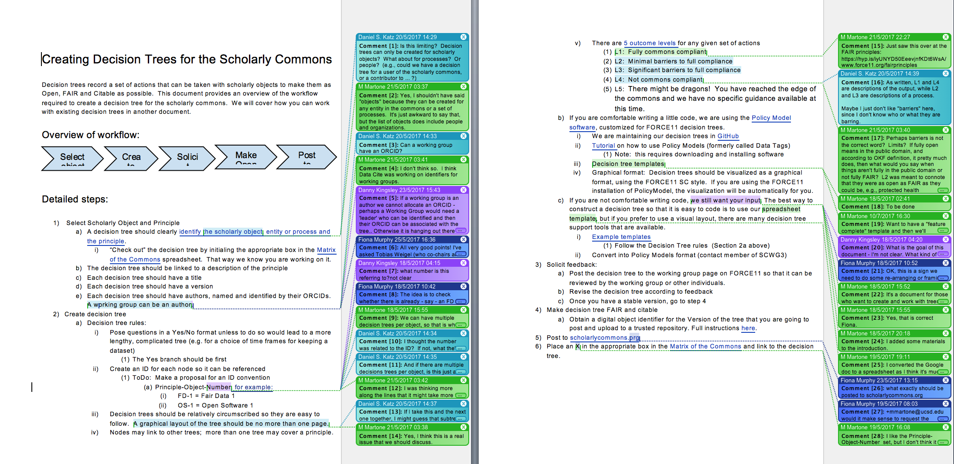
Decision Trees Workflow

Slide 12
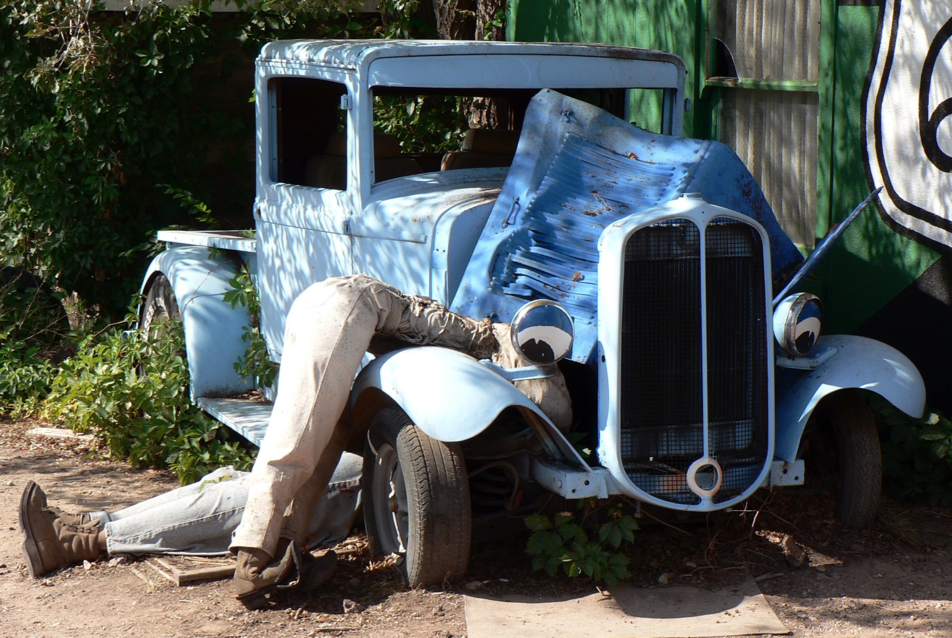
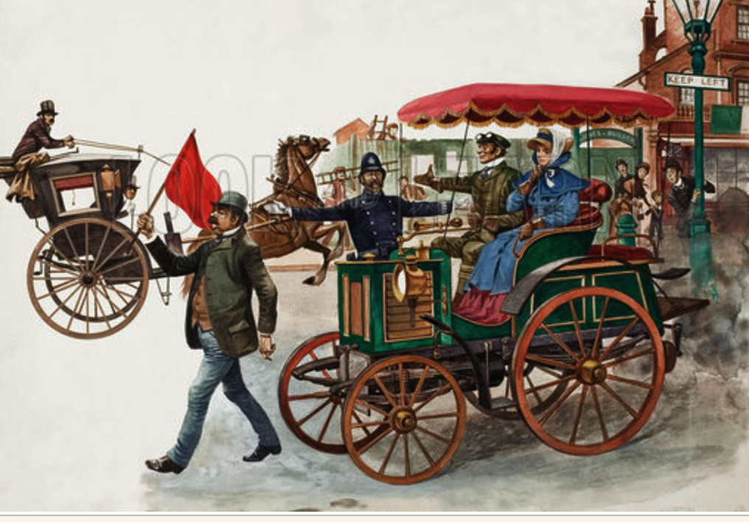
Notes:
We need to be both mechanic and driver. Limit participation. Limits knowledge production.
Picture of 1910s car (needed to be both) People fixing own cars
Red flag act

Slide 13
“Chaotic innovation - or jigsaw pieces?”
Semantic Web
Annotation
Citable
FAIR
DCIP
Credit Taxonomy
Data repositories
ORCID
Social networks
By Katherine Skinner
Altmetrics
PIDs
Data journals
Interoperable

Slide 14
Key questions arising:
How might things be improved?
Some of this is about specific tools, how they are developed (ideally with a holistic perspective rather than simply in response to a single or small-range of problems.
There are a number of pieces already existing: ORCID, Open Science Framework, Zenodo, etc. Although the Scholarly Commons is technologically enabled, it is NOT technically driven.
We need more capacity to allocate persistent identifiers, input metadata and provenance information, attribute actions and works and automate versioning.
Citation is integral to scholarship, but our citation and referencing system is a time sink and inefficient. In light of new technologies, how can it be improved?
What are the consequences of investing in your technology (not monetary but time and effort)?
Notes:
This slide is partly taken from the 3rd blogpost, which continues: “Even in the course of writing this blog post, we discovered new lines of enquiry and possible actions - including a decision tree for allocating byline credit and an eventual governance model that might evolve into a ‘Committee on Commons Ethics’.”

Slide 15
Thank you!
Scholarly Commons Decision Trees Working Group
www.scholarlycommons.org

Slide 16
What do (Commons-compliant) Researchers Really Want?
Scholarly Commons from Theory to Practice: Part 2
Maryann Martone and Fiona Murphy
FORCE2017, Berlin, 26 October 2017

Slide 17
Our Panel
Natalia Manola, OpenAIRE
David Mellor, Center for Open Science
Josh Brown, ORCID
Jose Benito Gonzalez Lopez, Zenodo
Notes:
We introduce. Everyone says all the problems are sorted. How tolerant can we/should we be of other providers in the domain? Standards? If you’re a stakeholder, and you change something it disrupts everything. Persistent identifier or ORCID? (DOIs). Line of least resistance. Partially working cars. None of them are fully realised.

Slide 18
Scholarship should be published in a form that maximizes its utility
Annotation/documentation
Research objects
All work and contributions to work are attributed
No anonymity; transparency as a means to establish trust
Author ID’s
Commons supports a class of knowledge workers to enhance and evaluate content, not keep it out or keep it locked up
Peer review
Making research accessible (understandable) to consumers
Curators
Editors: Create useful collections
Funding and reward systems enhance best practices and don’t work against them
Model for team science: easy to assemble dedicated teams
All who contribute to or use the Commons have a responsibility to care for it
Expectation of service
Develop and enforce norms
Commercial entities that benefit would give back

