Slide 1
Research Enablement Metrics
Assessing the Impact of Being Willing to Share
David Eichmann
School of Library and Information Science &
Iowa Graduate Program in Informatics
The University of Iowa

Slide 2
Connecting the Dots
The real challenge here is translation of information already in existence in scattered sources
  Research networking tools
  Citation databases (e.g., PubMed, Scopus)
  Award databases (e.g., NIH Reporter)
  Curated archives (e.g., GenBank)
  Locked up in text (the research literature)

Slide 3
Phase 1 – CTSAsearch
Turn the data islands into an archipelago
Focus on the VIVO ontology as a common representation
Initially focused on the NIH Clinical and Translational Science Award (CTSA) sites

Slide 4
Why Bother with VIVO
(the ontology)?
Words in a profile are just sequences of characters carrying no meaning
  Try asking Google Scholar what grant funded a given hit…
With structure and relationship comes meaning, aka semantics
  Enter the Semantic Web!

Slide 5
CTSAsearch – architecture
1 VIVO-based SPARQL harvester
2(!) VIVO-based crawlers
1 Profiles-based crawler
2 Platform-specific HTML crawlers
1 Proprietary API harvester (Elsevier Pure)
1 CSV-based loader

Slide 6
CTSAsearch – architecture

Slide 7
CTSAsearch – current
14,354,949 VIVO 1.4 –derived triples
129,288,746 VIVO 1.6 –derived triples
74,160,391 Profiles-derived triples
~218M triples – just from the profiling systems
http://research.icts.uiowa.edu/polyglot/statistics.jsp
Notes:
~218M triples – just from the profiling systems

Slide 8
Recent Work
Cross-linkage across sites
  SciENcv “integration”
  Resolving ‘stubs’
  Formation of a single ecosystem (joint work with Eric Meeks, UCSF, on CrossLinks)
Efficient refresh
Macro concerns
  Institution-scale analytics (gender, disciplinarity, …) (joint work with Charisse Madlock-Brown, U. Tenn. Health Center)
  Identity and authority

Slide 9
Phase 2 – Acknowledgements
(open to submissions of a better name!)

Slide 10
Motivation
Public information regarding collaboration networks are partial and post-hoc
  Grants and publications
Research profiling systems (e.g., VIVO) primarily feed on the above data
Institutional grant tracking systems carry data on attempts at collaboration, but are not open
  But are near-real-time…

Slide 11
Goals
Extend the model to include informal interactions
Explore the degree to which sharing of data, resources, etc. can be identified from full text of papers

Slide 12
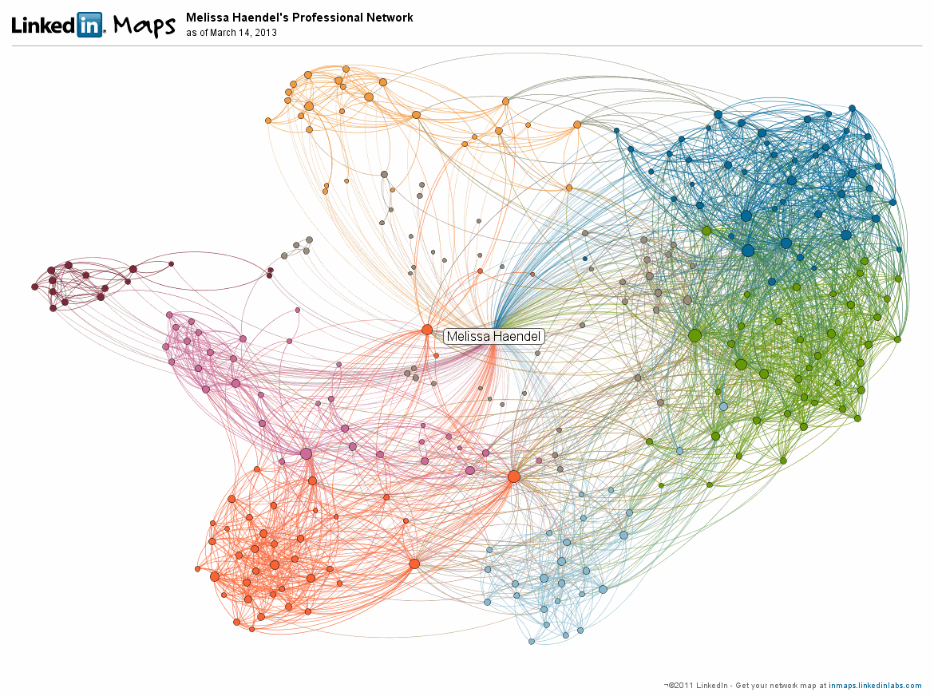
Melissa Haendel’s LinkedIn Map

Slide 13
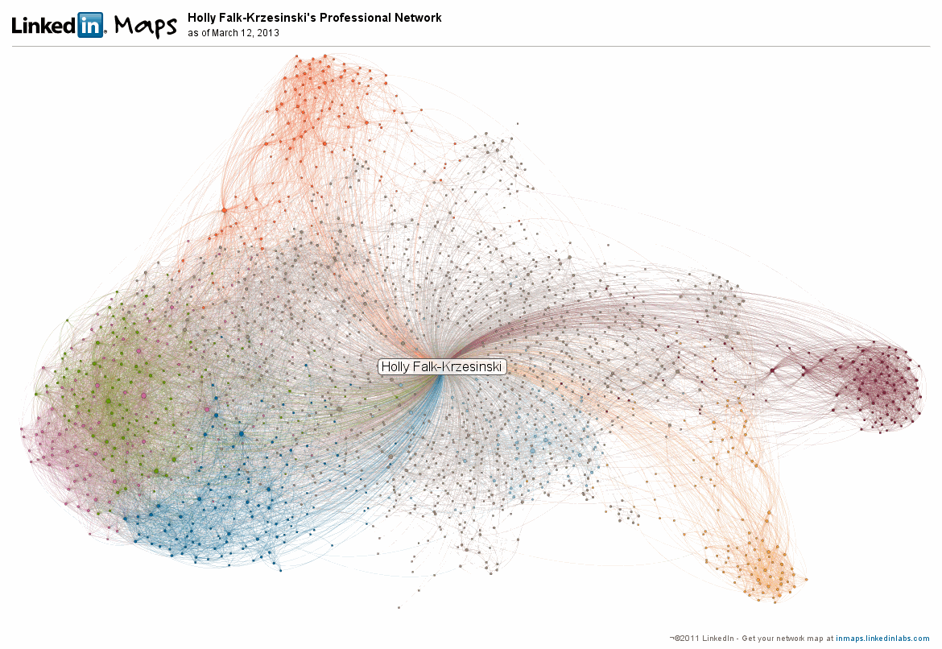
Holly Falk-Krzesinski’s LinkedIn Map

Slide 14
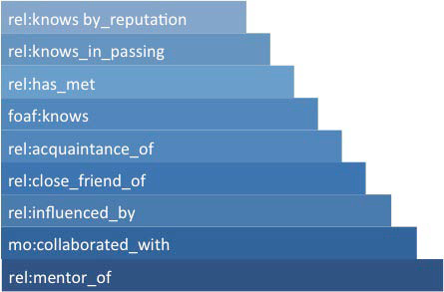
Pattuelli’s Spectrum of Relationships (2012)
http://www.oclc.org/content/dam/research/grants/reports/2012/pattuelli2012.pdf

Slide 15
Pattuelli’s Spectrum of Relationships (2012)
RN
Tools
http://www.oclc.org/content/dam/research/grants/reports/2012/pattuelli2012.pdf

Slide 16
Pattuelli’s Spectrum of Relationships (2012)
Linked
In
RN
Tools
http://www.oclc.org/content/dam/research/grants/reports/2012/pattuelli2012.pdf

Slide 17
Pattuelli’s Spectrum of Relationships (2012)
Ontologies used
  foaf (Friend of a Friend)
  rel (Relationship)
  mo (Music)
Echos of Trigg’s link taxonomy
  Trigg, R. 1983. Network-Based Approach to Text Handling for the Online Scientific Community. Ph.D. dissertation, Department of Computer Science, University of Maryland, technical report TR-1346

Slide 18
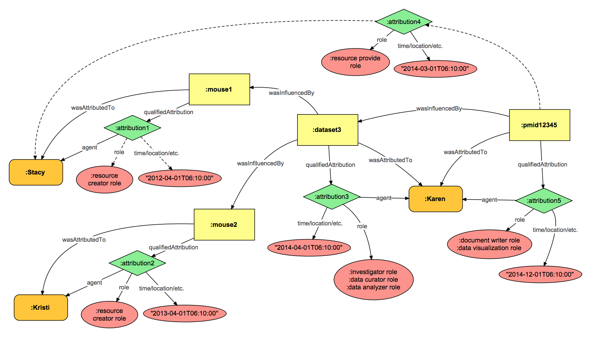
Connecting the Dots – Take 2
Figure courtesy of
Melissa Haendel, OHSU

Slide 19

PubMed Central Open Access
5,21,429 papers (as of last yesterday morning)
1,738,192 with acknowledgements
2,592,159 sentences
15,429,170 parses
135,405,309 fragments
PubMed as of yesterday morning: 27,727,909 articles
Notes:
17x…

Slide 20
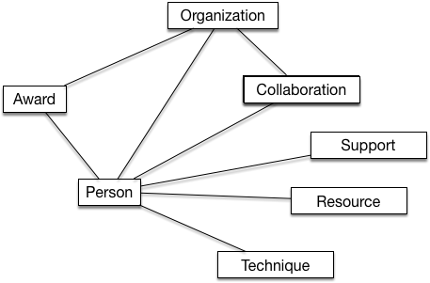
Connected Entities in PMC Schema

Slide 21
Why Fragments?

Slide 22
Syntax Fragment Frequency Approach
Walk the syntax trees and for every interior node (basically phrases), generate a syntax fragment of depth 2
[S [NP EK/NNP ] [VP analysed/VBD [NP the/DT data/NNS ] ] ./. ]
[S [NP NNP ] [VP VBD [NP DT NNS ] ] . ]
[NP EK/NNP ]
[VP VBD [NP DT NNS ] ]
[NP DT NNS ]

Slide 23
SFF Approach, con’t.
Prior to fragmentation, annotate nodes with entity classes
  This is domain-specific and run-time extensible
[S [NP EK/NNP ]
[VP analysed/VBD [NP the/DT data/NNS ] ] ./. ]
  [S [NP:Author NNP:Author ]
  [VP VBD [NP:Resource ] ] . ]

Slide 24
SFF Algorithm
Walk the tree down to the leaves and annotate them using vocabulary categories
Instantiate entity instances, both in the database and in (typically the most lowest noun phrases of) the syntax tree
Bottom-up apply the entity promotion rules
Finally, apply the relationship extraction rules to populate that set of relations in the database

Slide 25
The Live System...

Slide 26
Next Steps
Continue slogging through extraction pattern definition? Definitely. This has developed into a plausible crowd-sourcing framework.
Align current category scheme with shared representation/ontology. If so, which?
Provisioning access to extracted data – formats?
Something completely different as a means of assessment?

